Slide 1
The first person to get up and do five star jumps gets unlimited Mars Bars for the rest of the lesson. You will get one to eat every 5 minutes.

Slide 3
1.1 Competitive Markets
Demand

Slide 4
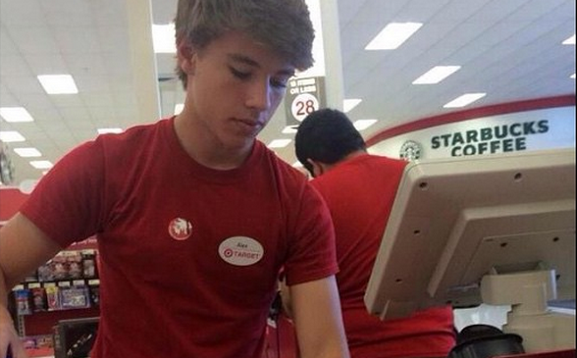
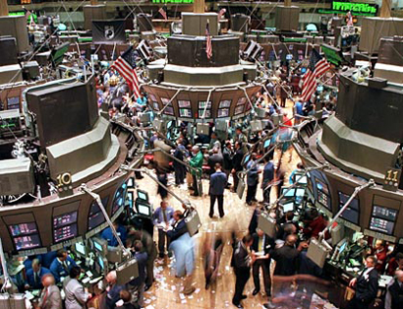
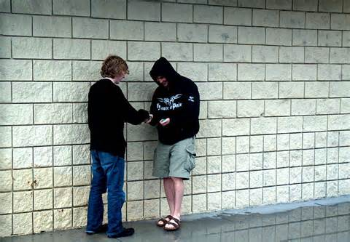
What is a market?
A market is a meeting of buyers and sellers
Notes:
Ask the students to give examples

Slide 5
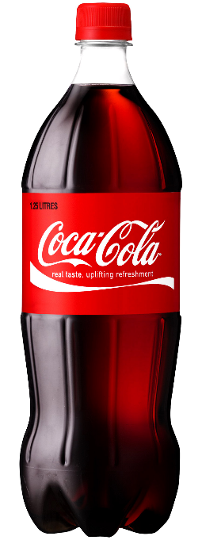
The Drink Auction
I am willing to sell an ice-cold drink. How much are you willing to pay?

Slide 6
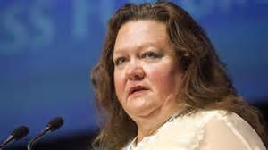
Demand defined
Demand
Demand is the different quantities of goods that consumers are willing and able to buy at different prices.

Slide 7
Law of Demand
Inverse Relationship

Slide 8
Law of demand
As Price Falls…
…Quantity Demanded Rises
As Price Rises…
…Quantity Demanded Falls
Quantity Demanded
Price

Slide 9
Law of Demand
Three reasons
The Substitution effect
The Income effect
The Law of Diminishing Marginal Utility
We will define and explain each…

Slide 10
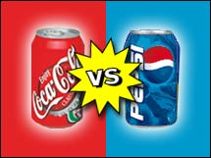
Law of Demand
1. The Substitution Effect

Slide 11
Law of Demand
2. The Income Effect
If the price goes down for a product, the purchasing power increases for consumers -allowing them to purchase more.

Slide 12
Law of Demand?
3. Law of Diminishing Marginal Utility
Utility = Satisfaction
We buy goods because we get utility from them
The law of diminishing marginal utility states that as you consume more units of any good, the additional satisfaction from each additional unit will eventually start to decrease
In other words, the more you buy of ANY GOOD the less satisfaction you get from each new unit.

Slide 13
Law of Demand
What does this have to do with the Law of Demand?
How does this effect the pricing of businesses?

Slide 14
Can you see the Law of Diminishing Marginal Utility in Disneyland’s pricing strategy?
Change
N/A
$54
$33
$15
$10
$5

Slide 15
The Demand Curve
Let’s draw ours from earlier…
y-axis is always Price (P)
x-axis is always Quantity (Q)

Slide 16
Graphing demand
Demand Schedule
Price of Cereal
$5
4
3
2
1
Price | Quantity Demanded
$5 | 10
$4 | 20
$3 | 30
$2 | 50
$1 | 80
Demand
o
Q
10 20 30 40 50 60 70 80
Quantity of Cereal

Slide 17
How do we get market Demand?
Cam’ron
Quayara
Other Individuals
Market
Price | Q Demd
$5 | 1
$4 | 2
$3 | 3
$2 | 5
$1 | 7
Price | Q Demd
$5 | 0
$4 | 1
$3 | 2
$2 | 3
$1 | 5
Price | Q Demd
$5 | 9
$4 | 17
$3 | 25
$2 | 42
$1 | 68
Price | Q Demd
$5 | 10
$4 | 20
$3 | 30
$2 | 50
$1 | 80
P
P
P
P
$3
$3
$3
$3
D
D
D
D
3
Q
2
Q
25
Q
30
Q

Slide 18
Shifts in Demand
CHANGES IN DEMAND
Ceteris paribus-“all other things held constant.”
If the price goes down there will be an increase in quantity demanded.
If the price goes up, there will be a decrease in quantity demanded.
An increase in demand means that at each price, more people are willing and able to buy.
This is a change in demand, not a change in quantity demanded
Changes in price
DO NOT shift
the curve!
Notes:
Draw these situations on an adjacent board.

Slide 19
Shift in Demand
Demand Schedule
What if cereal
makes you smarter?
Price of Cereal
$5
4
3
2
1
Price | Quantity Demanded
$5 | 10
$4 | 20
$3 | 30
$2 | 50
$1 | 80
Demand
o
Q
10 20 30 40 50 60 70 80
Quantity of Cereal

Slide 20
Shift in Demand
Demand Schedule
What if cereal
causes baldness?
Price of Cereal
Increase in Demand
More people want cereal at each price level
$5
4
3
2
1
Price | Quantity Demanded
$5 | 10
$4 | 20
$3 | 30
$2 | 50
$1 | 80
30
40
50
D₁
70
Demand
100
o
10 20 30 40 50 60 70 80
Q
Quantity of Cereal
20

Slide 21
Shift in Demand
Demand Schedule
Price of Cereal
$5
4
3
2
1
Decrease in Demand
Prices didn’t change but people want LESS cereal
Price | Quantity Demanded
$5 | 10
$4 | 20
$3 | 30
$2 | 50
$1 | 80
0
5
20
30
D₂
Demand
60
o
10 20 30 40 50 60 70 80
Q
Quantity of Cereal

Slide 22
Shift in Demand
Demand Schedule
What if the price
of MILK goes up?
Price of Cereal
$5
4
3
2
1
Price | Quantity Demanded
$5 | 10
$4 | 20
$3 | 30
$2 | 50
$1 | 80
Demand
o
Q
10 20 30 40 50 60 70 80
Quantity of Cereal
22

Slide 23
What Causes a Shift in Demand?
5 Factors (Shifters) of Demand:
Tastes and Preferences
Price of Related Goods
Income
Future Expectations
Demographics
Changes in PRICE don’t shift the curve. It only causes movement along the curve.

Slide 24
Factors of Demand – Tastes and Preferences
The demand curve can be affected by a change in the tastes and preferences of consumers.
Advertising
2. Trends

Slide 25
Factors of Demand – Tastes and Preferences
3. New information

Slide 26
Factors of Demand – Prices of related goods
The demand curve for one good can be affected by a change in the price of ANOTHER related good.
Substitutes are goods used in place of one another.
If price of Pepsi falls, demand for Coke will…

Slide 27
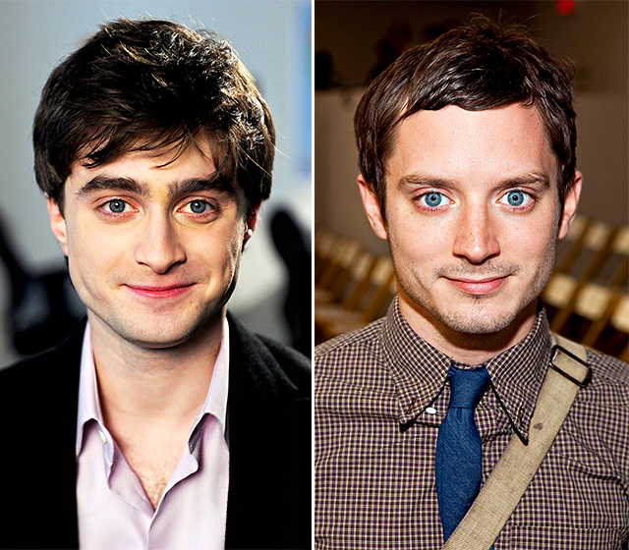
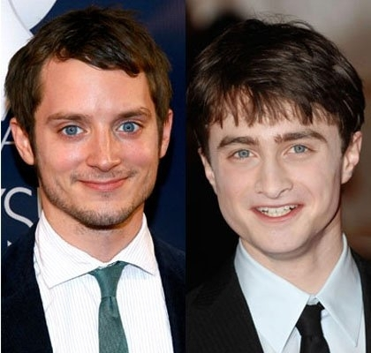
Substitutes
Notes:
27

Slide 28
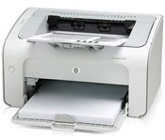
Factors of Demand – Prices of related goods
2. Complements are two goods that are bought and used together.
If price of skis falls, demand for ski boots will...

Slide 29
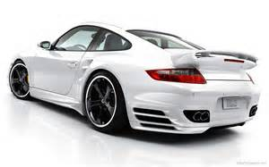
Factors of Demand - Income
The incomes of consumers change the demand, but how depends on the type of good.
Normal Goods
As income increases, …
As income falls, …
E.g luxury cars, takeaway coffee, jewellery
Notes:
Spam-Inferior
Yachts- Normal
Off Brand Cereal-Inferior
McDonald’s-Inferior
Toilet Paper- Probably no connection to income (The point-some products are very reliant on income and others are not)

Slide 30
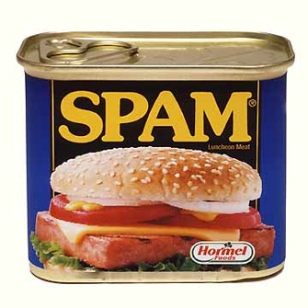
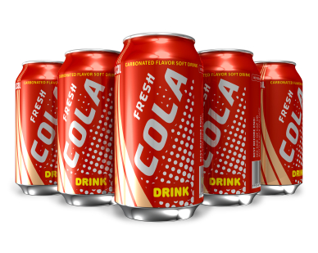
Factors of Demand - Income
2. Inferior Goods
E.g. low-grade mince meat, used cars

Slide 31
Factors of Demand – Future expectations
Future expectations of price can shift demand.
Lower expected future price = decrease in demand (shift to the left)
Higher expected future price = increase in demand (shift to the right)

Slide 32
Factors of Demand – Demographics
Changes in market size will affect demand.
Changes in demographics will affect demand.
e.g. in an ageing suburb, demand for childcare will decrease

Slide 33
Change in Quantity demanded vs. Change in Demand
There are two ways to increase quantity from 10 to 20
Price of Cereal
P
A to B is a change in quantity demanded (due to a change in price)
A to C is a change in demand (shift in the curve)
A
C
$3
$2
B
D₂
D₁
o
Q Cereal
10 20
Quantity of Cereal

Slide 34
Practice
First, identify the determinant (shifter) then decide if demand will increase or decrease
 | Shifter | Increase or Decrease | Left or Right
1
2
3
4
5
6
7
8
Notes:
Number of consumers, increase.
Income, decrease.
Substitutes, decrease.
Price doesn’t shift curve, no change.
Tastes and preferences, decrease.
Expectations, increase.
Complements, decrease.
Price doesn’t shift curve, no change.

Slide 35
Practice
First identify the determinant (Shifter). Then decide if demand will increase or decrease
Hamburgers (a normal good)
Population boom
Incomes fall due to recession
Price for burritos falls to $1
Price increases to $5 for hamburgers
New health craze- “No ground beef”
Hamburger restaurants announce that they will significantly increase prices next month
Government heavily taxes shakes and fries, causes their prices to quadruple.
Restaurants lower price of burgers to $.50
Draw the demand diagrams
Notes:
35

