Slide 1

Supply

Slide 2
The Market for Notes
I am willing to pay up to $10 to a student in this class for him or her to provide with an extra handwritten copy of their notes on Supply*.
As there should be numerous students willing to supply this service, I will hold an auction.
All students willing to supply this for $10 should stand up, then, as the price is lowered, students should sit down when they are no longer willing to provide the product.
* The notes must be written in crayon on separate pieces of paper

Slide 3
Supply Defined
Supply is the different quantities of a good that sellers are willing and able to sell (produce) at different prices.
Direct positive relationship
  As price increases, …
  As price falls, …
  Why? Because, at higher prices, profit seeking firms have an incentive to produce more.
  Example

Slide 4
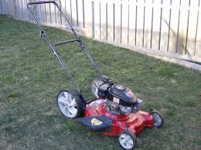
Supply and Opportunity Cost
As the price of a product increases, the opportunity cost of not supplying it increases.
e.g Lawn mowing

Slide 5
Example of Supply
You own an lawn mower and you are willing to mow lawns.
How many lawns will you mow at these prices?
Price per lawn mowed | Quantity Supplied
Supply Schedule
$1
$5
$20
$50
$100
$1000

Slide 6
How do we get market Supply?
Vandalay Industries
Kruger Industries
Other companies
Market
Price | Q Supd
$5 | 10
$4 | 7
$3 | 5
$2 | 3
$1 | 1
Price | Q Supd
$5 | 8
$4 | 6
$3 | 4
$2 | 2
$1 | 1
Price | Q Supd
$5 | 36
$4 | 28
$3 | 20
$2 | 15
$1 | 10
Price | Q Supd
$5 | 54
$4 | 41
$3 | 29
$2 | 20
$1 | 12
P
P
P
P
$3
$3
$3
$3
S
S
S
S
5
Q
4
Q
25
Q
29
Q

Slide 7
Graphing Supply
What if new
companies start making
cereal?
Supply Schedule
Price of Cereal
Supply
$5
4
3
2
1
Price | Quantity Supplied
$5 | 50
$4 | 40
$3 | 30
$2 | 20
$1 | 10
o
Q
10 20 30 40 50 60 70 80
Quantity of Cereal
7

Slide 8
Change in Supply
Supply Schedule
Price of Cereal
Supply
S₂
$5
4
3
2
1
Price | Quantity Supplied
$5 | 50
$4 | 40
$3 | 30
$2 | 20
$1 | 10
70
60
Increase in Supply
More cereal is produced at each price level
50
40
30
o
10 20 30 40 50 60 70 80
Q
Quantity of Cereal
8

Slide 9
Shifts in Supply
CHANGES IN SUPPLY
If the price goes down there will be a decrease in quantity supplied.
If the price goes up, there will be an increase in quantity supplied.
An increase in supply means that at each price, producers are willing to supply more.
This is a change in supply, not a change in quantity supplied
Changes in price
DO NOT shift
the curve!
Notes:
Draw these situations on an adjacent board.

Slide 10
Change in Supply
Supply Schedule
What if a drought
destroys corn and wheat
crops?
Price of Cereal
Supply
$5
4
3
2
1
Price | Quantity Supplied
$5 | 50
$4 | 40
$3 | 30
$2 | 20
$1 | 10
o
Q
10 20 30 40 50 60 70 80
Quantity of Cereal
10

Slide 11
Change in Supply
Supply Schedule
Price of Cereal
Supply
$5
4
3
2
1
S₂
Price | Quantity Supplied
$5 | 50
$4 | 40
$3 | 30
$2 | 20
$1 | 10
30
20
Decrease in Supply
Less cereal is produced at each price level
10
1
0
o
10 20 30 40 50 60 70 80
Q
Quantity of Cereal
11

Slide 12
Change in Supply
What if cereal companies
find a quicker way to make
cereal?
Supply Schedule
Price of Cereal
Supply
$5
4
3
2
1
Price | Quantity Supplied
$5 | 50
$4 | 40
$3 | 30
$2 | 20
$1 | 10
o
Q
10 20 30 40 50 60 70 80
Quantity of Cereal
12

Slide 13
6 Shifters (Factors) of Supply
Prices/Availability of inputs (resources)
Number of Sellers
Technology
Government Action: Taxes & Subsidies
Opportunity Cost of Alternative Production
Future expectations of profit
Changes in PRICE don’t shift the curve. It only causes movement along the curve.

Slide 14
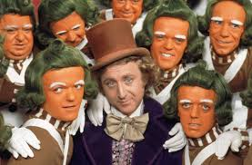

Factors of supply – Prices of Inputs (resources)
The cost of inputs (resources) will impact how much is supplied.

Slide 15

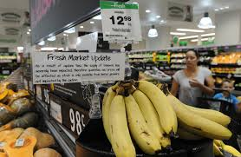
Factors of supply – Availability of Inputs (resources)
The availability of inputs (resources) will impact how much is supplied.
e.g. coffee, cocoa, oil

Slide 16
Factors of Supply – Number of sellers
More sellers = increased supply
Fewer sellers = decreased supply

Slide 17
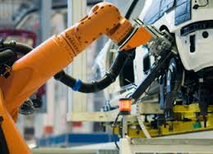
Factors of supply - Technology
Increase in technology means more effective production methods

Slide 18

Factors of supply – Government Intervention - Taxes and subsidies
The introduction or change of a tax will affect the amount supplied.
e.g alcopops
A tax is essentially an
increase in the costs of
production.

Slide 19

Factors of supply – Taxes and subsidies
The government grants money to producers so that more of that item is produced.
This acts as a decrease in the cost of production.

Slide 20
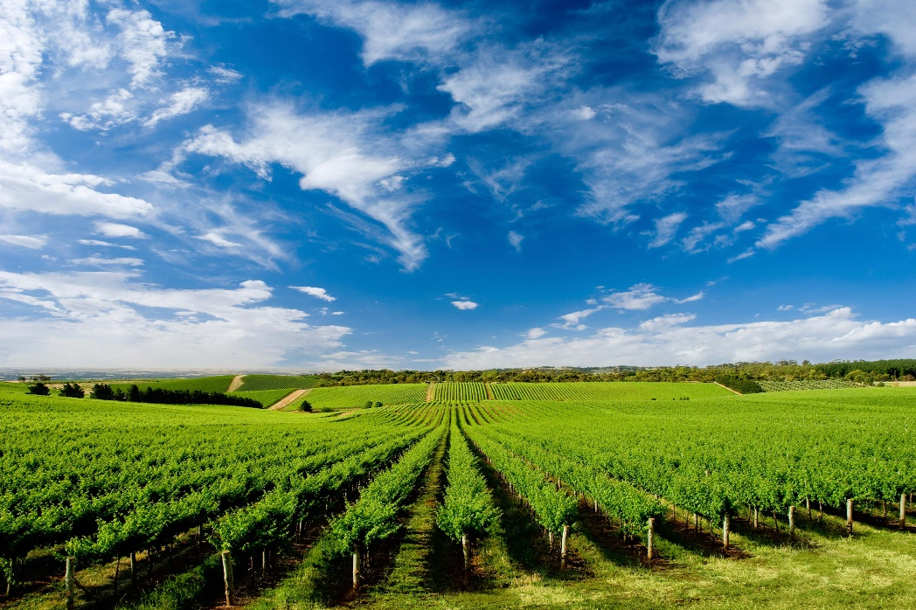
Factors of supply – Opportunity cost of alternative production
Prices of other goods
If the price of another good increases, it becomes more attractive to produce that instead.
e.g. vineyards, farmers
Resources must be able
to be switched

Slide 21

Factors of Supply - Expectations of future profit
E.g. Olympic tourism

Slide 22
Supply Practice
First, identify the determinant (shifter) then decide if supply will increase or decrease
 | Shifter | Increase or Decrease | Left or Right
1
2
3
4
5
6
Notes:
Number of consumers, increase.
Income, decrease.
Substitutes, decrease.
Price doesn’t shift curve, no change.
Tastes and preferences, decrease.
Expectations, increase.
Complements, decrease.
Price doesn’t shift curve, no change.
22

Slide 23
Supply Practice
Which determinant (SHIFTER)?
Increase or decrease?
Which direction will curve shift?
Hamburgers
  Mad cow disease kills 20% of cows
  Price of hamburgers increase 30%
  Government taxes burger producers
  Restaurants can produce burgers and/or tacos. A demand increase causes the price for tacos to increase 500%
  New bun baking technology cuts production time in half
  Minimum wage increases to $20

