Slide 1
Cross-Price Elasticity of Demand (XED)
Cross-Price elasticity shows how sensitive a product is to a change in price of another good
It shows if two goods are substitutes or complements
XED = $\frac{Percentage change in quantity demanded (product x)}{percentage change in price (product y)}$ $= \frac{\%∆Qd(x)}{\%∆P(y)}$
P increases 20%
Q decreases 15%
XED coefficient is negative = complements
XED coefficient is positive = substitutes

Slide 2
Cross-Price Elasticity of Demand (XED)
XED practice
The owners of a pizza shop find that when their competitor, a hamburger shop, lowers the price of a burger from $2 to $1.80, the number of pizza slices that they sell each week falls from 400 to 380, due to the lower-priced burger.
With this information, we can calculate the XED for the pizza slices
Step 1 – calculate % change in price of product y
$$= \frac{change in price}{original price}×100= \frac{−.2}{2} ×100=−10\%$$
Step 2 – calculate % change in quantity demanded of product x
$$= \frac{change in quantity demanded}{original quantity demanded}×100= \frac{−20}{400} ×100=−5\%$$
Step 3 – calculate XED or product x
XED $= \frac{Percent change in quantity demanded of product x}{Percent change in price of product y}= \frac{\%∆Qd(x)}{\%∆P(y)} =\frac{−5\%}{−10\%}=+0.5$

Slide 3
Cross-Price Elasticity of Demand (XED)
Unlike PED, XED may be positive or negative
The sign is important
XED values show the strength of the relationship.
High positive number = very close substitutes
XED value Negative Zero Positive
R’ship Close Remote Unrelated Remote Close complements complements products substitutes substitutes

Slide 4
Calculate the XED and state whether the goods are complements or substitutes
More XED practice
A 10% rise in the price of fish may cause demand for chicken to increase by 2%.
The fall in the price of paper by 20% causes the demand for pens to increase by 5%.
A 20% rise in the price of ice cream causes demand for sweets to increase by 4%.
A 12% fall in the price of air fares leads to a 30% rise in the demand for foreign holidays.
A 10% rise in bikes will leave the demand for cheese unaffected.

Slide 5
Answers…
A 10% rise in the price of fish may cause demand for chicken to increase by 2%. +2% / +10% = +0.2
The fall in the price of paper by 20% causes the demand for pens to increase by 5%. +5% / -20% = -0.25
A 20% rise in the price of ice cream causes demand for sweets to increase by 4%. +4% / +20% = +0.2
A 12% fall in the price of air fares leads to a 30% rise in the demand for foreign holidays. +30% / -12% = -2.5
A 10% rise in bikes will leave the demand for cheese unaffected. 0% / +10% = 0

Slide 6
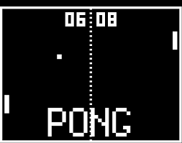
Who cares?
Firms can use XED estimates to predict:
The impact of other firms’ pricing strategies on demand for their own products:

Slide 7
Who cares?
Pricing strategies for complementary goods:
Popcorn and cinema tickets are strong complements. Popcorn has a very high mark up i.e. popcorn costs very little to make but sells for a high price
If firms have a reliable estimate for XED they can estimate the effect, say, of a two-for-one cinema ticket offer on the demand for popcorn

Slide 8
Income Elasticity of Demand (YED)
Income elasticity shows how sensitive a product is to a change in INCOME
It shows if goods are normal or inferior
YED = $\frac{Percentage change in quantity demanded}{percentage change in income}$ $= \frac{\%∆Qd}{\%∆Y}$
Income increases 20%, and quantity decreases 15% then the good is a…
INFERIOR GOOD

Slide 9
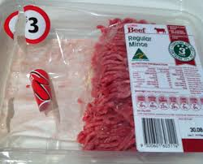
Income Elasticity of Demand (YED)
Unlike PED, but like XED, YED may be positive or negative
The sign is important
YED = negative = inferior good
YED = positive = normal good

Slide 10
Income Elasticity of Demand (YED)
YED practice
A person has an increase in annual income from $60,000 per year to $66,000 per year. She then increases her annual spending on holidays form $2,500 to $3,000.
With this information, we can calculate her YED for holidays
Step 1 – calculate % change in income
$$= \frac{change in income}{original income}×100= \frac{6,000}{60,000} ×100=10\%$$
Step 2 – calculate % change in quantity demanded
$$= \frac{change in quantity demanded}{original quantity demanded}×100= \frac{500}{2500} ×100=20\%$$
Step 3 – calculate YED
YED $= \frac{Percent change in quantity demanded}{Percent change in income}= \frac{\%∆Qd(x)}{\%∆P(y)} =\frac{20\%}{10\%}=2$

Slide 11
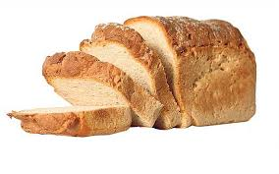
Income Elasticity of Demand (YED)
Two more good types…
Necessity goods
Income inelastic
Demand changes little as income rises or falls

Slide 12
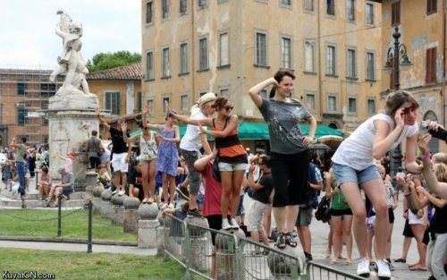
Income Elasticity of Demand (YED)
Two more good types…
Luxury goods
Income elastic
Demand changes significantly as income rises/falls
Non-essential

Slide 13
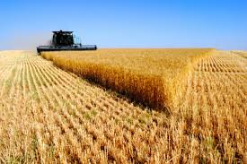
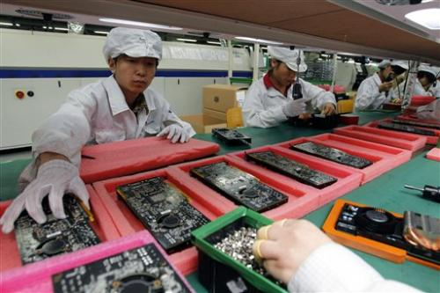
Applications of YED
Three sectors of production
Primary
Makes direct use of resources, e.g. Agriculture, Forestry, Mining
Secondary
Manufacturing
Tertiary
Services
What kind of YED would each sector have?

Slide 14
Applications of YED
Three sectors of production
Primary
Makes direct use of resources, e.g. Agriculture, Forestry, Mining
Inelastic
Secondary
Manufacturing
More elastic
Tertiary
Services
More elastic
again
What kind of YED would each sector have?

Slide 15
Applications of YED
As incomes increase…
What happens to the demand for primary products?
What happens to the demand for secondary products?
What happens to the demand for tertiary products?
Less developed countries are reliant on primary production.
$∴$ As world income increases, demand for what these countries produces remains static. Demand for what developed countries produces increases.
The income gap widens

Slide 16
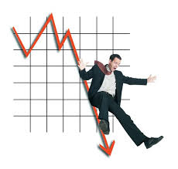
Applications of YED
Businesses need to understand consumer responsiveness
In good times, people will buy more income elastic goods
In bad times, customers will ‘tighten their belts’, and put off their spending.

Slide 17
Price Elasticity of Supply
THE LAW OF SUPPLY SAYS...
Producers will supply more when prices go up and less when prices go down
HOW MUCH MORE OR LESS?
DOES IT MATTER?

Slide 18
Price Elasticity of Supply (PES)
Elasticity of Supply-
Measurement of producers’ responsiveness to a change in price.
What will happen if prices increase? How much will it affect Quantity Supplied
INelastic = Insensitive to a change in price (Steep curve)
Most goods have INelastic supply in the short-run
Elastic = Sensitive to a change in price (Flat curve)
Most goods have elastic supply in the long-run
Perfectly Inelastic = Q doesn’t change (Vertical line)
Set quantity supplied

Slide 19
Price Elasticity of Supply
PES = $\frac{Percentage change in quantity supplied}{percentage change in price}$ $= \frac{\%∆Qs}{\%∆P}$
Notes:
Luxury car tax

Slide 20
Perfectly Inelastic Supply
Price
Supply
Quantity supplied

Slide 21
Perfectly Elastic Supply
Price
Supply
Quantity supplied

Slide 22
Price Elasticity of Supply (PES)
PES practice
A publishing firm realises that they can now sell their monthly magazine for $5.50 instead of $5.00. In light of this, they increase their supply from 200,000 to 230,000 magazines per month.
With this information, we can calculate the PES for the magazine.
Step 1 – calculate % change in price
$$= \frac{change in price}{original price}×100= \frac{0.5}{5} ×100=10\%$$
Step 2 – calculate % change in quantity supplied
$$= \frac{change in quantity supplied}{original quantity supplied}×100= \frac{30,000}{200,000} ×100=15\%$$
Step 3 – calculate PES
PES $= \frac{Percent change in quantity supplied}{Percent change in price}= \frac{\%∆Qs}{\%∆P} =\frac{15\%}{10\%}=1.5$

Slide 23
Elastic supply PES > 1
e.g. DVDs
Short production time
Easy to store

Slide 24
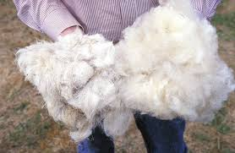
Inelastic supply PES < 1
e.g. Primary products
Long production time
Hard to store
Show the effect of an increase in demand for apples when apples have a perfectly inelastic supply curve in the short run.

Slide 25
Examples of PES
A 10-percent increase in the price of steel causes a 15-percent increase in the quantity supplied. What is the PES?
Suppose the price elasticity of supply of bread is 2.
What will be the effect of a 10% decline in the price of bread?
The price elasticity of supply for steel is 15%/10% = 1.5.
PES: $\frac{x}{−10 }=2$
$$x=−20$$
20% reduction in quantity supplied

Slide 26
Examples of PES
Suppose the price elasticity of supply of bread is 2.
A 10-percent decline in the price of bread will, therefore, result in a 20-percent reduction in quantity supplied, because
–20%/ –10% = 2.

Slide 27
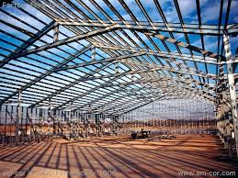
Determinants of PES
How much costs rise as output is increased
A new factory?
Is there spare capacity?
High costs of increasing supply = inelasticity

Slide 28
Determinants of PES
2. Time period considered
In the short run, supply tends to be inelastic
In the long run, supply tends to be elastic

Slide 29
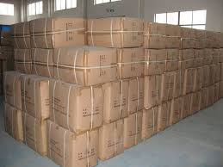
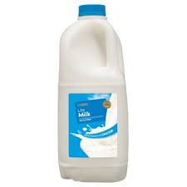
Determinants of PES
3. Ability to store stocks
For durable goods, stockpiles can be used to ensure supply elasticity
There are goods that can’t be stored.
E.g. labour, perishables

