Slide 1
1.2 Elasticity
Price Elasticity of Demand (PED)

Slide 2
THE LAW OF DEMAND SAYS...
Consumers will buy more when prices go down and less when prices go up
HOW MUCH MORE OR LESS?
DOES IT MATTER?

Slide 3
Price elasticity of demand shows how sensitive quantity is to a change in price.

Slide 4
Four Types of Elasticity
Price elasticity of Demand (PED)
Cross-Price Elasticity (XED)
Income Elasticity (YED)
Price elasticity of Supply (PES)

Slide 5
Price Elasticity of Demand (PED)
Elasticity of Demand
Measurement of consumers’ responsiveness to a change in price.
What will happen if prices increase? How much will it effect Quantity Demanded
Who cares?
Used by firms to help determine prices and sales
Used by the government to decide how to tax

Slide 6
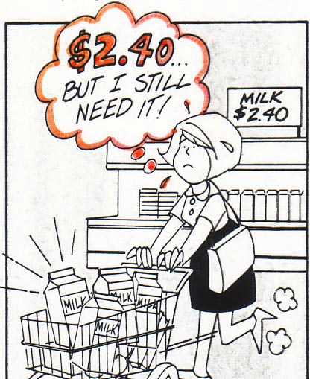
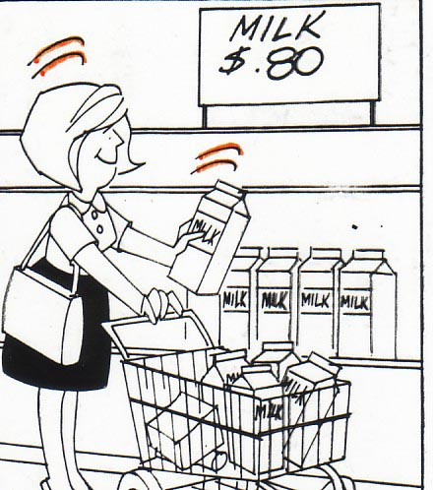
Inelastic Demand

Slide 7
Inelastic Demand
INelastic = Quantity is INsensitive to a change in price.
If price increases, quantity demanded will fall a little
If price decreases, quantity demanded increases a little.
In other words, people will continue to buy it.
20%
5%
An INELASTIC demand curve is steep! (looks like an “I”)
Examples:
Petrol
Milk
Nappies
Medical Care
Toilet paper
Chewing gum

Slide 8
Inelastic Demand
General Characteristics of INelastic Goods:
Few Substitutes
Necessities
Small portion of income
Required now, rather than later
Elasticity coefficient less than 1
20%
5%
PED = $\frac{Percentage change in quantity demanded}{percentage change in price}$ $= \frac{\%∆Qd}{\%∆P}$ = $\frac{−5 }{20}$
$$= −.25$$
Elasticity is generally expressed as a positive value, e.g. PED = 0.25

Slide 9
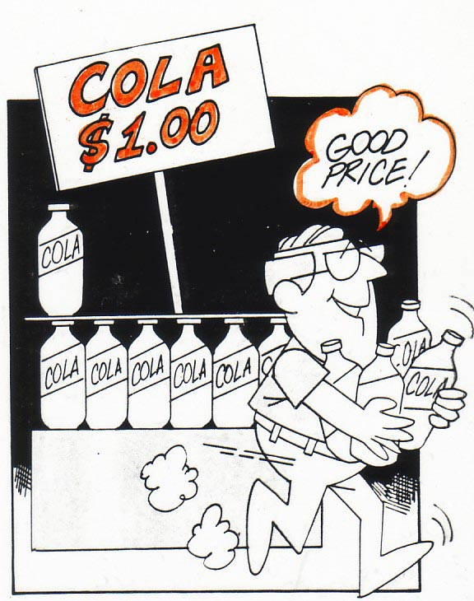
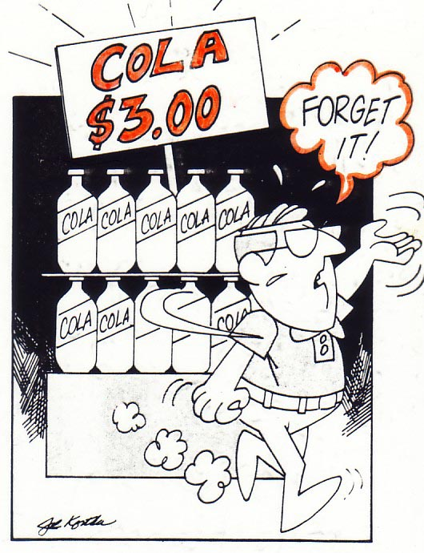
Elastic Demand

Slide 10
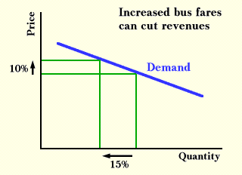
Elastic Demand
Elastic = Quantity is sensitive to a change in price.
If price increases, quantity demanded will fall a lot
If price decreases, quantity demanded increases a lot.
In other words, the amount people buy is sensitive to price.
An ELASTIC demand curve is flatter!
Examples:
Soft drink
Boats
Beef
Real Estate
Pizza
Gold

Slide 11
Elastic Demand
General Characteristics of Elastic Goods:
Many Substitutes
Luxuries
Large portion of income
Plenty of time to decide
Elasticity coefficient greater than 1
PED = $\frac{Percentage change in quantity demanded}{percentage change in price}$ $= \frac{\%∆Qd}{\%∆P}= \frac{−15}{10}=(−)1.5$

Slide 12
Price Elasticity examples
Suppose a 20% increase in the price of petrol causes a 10% decline in the quantity demanded. The price elasticity of demand is:
Suppose the price elasticity of demand for men’s suits is 3. How much of a price cut will result in a 30% increase in quantity demanded?

Slide 13
Real world example
In 1991, Apple computer lowered the prices of its Macintosh machines by an average of 50%.
The resulting increase in quantity demanded amounted to 85%.
The price elasticity of demand for Macs at that time was, therefore, 85%/-50% = –1.7 = 1.7

Slide 14
Categorising elasticities
PED < 1 Inelastic
PED > 1 Elastic
PED = 1 Unit elastic

Slide 15
Perfectly Inelastic Demand
Price
Demand
Quantity demanded

Slide 16
Perfectly Elastic Demand
Price
Demand
Quantity demanded

Slide 17
Slope and elasticity
Calculate:
PED from point A to B
PED from point B to C
PED from point C to D
PED from point D to E
P
5
4
3
2
1
A
Price elasticity and the slope of the curve are not the same
B
C
D
E
Demand
0 1 2 3 4 5
Q

Slide 18
Unit Elastic Demand
Price
PED = 1
Demand
Quantity demanded

Slide 19
Total revenue test
P
Market for apples
P₁
Revenue gained
P
D
Revenue foregone
Q₁
Q
0
Q

Slide 20
Total revenue test
P
Market for petrol
P₁
Revenue gained
P
Revenue foregone
D
Q₁
0
Q
Q

Slide 21
Price Elasticity of Demand and Total Revenue
If you know the price elasticity of demand of a product, you can forecast the effects of price changes on total revenue.

Slide 22
Determinants of PED
Number and closeness of substitutes
Necessity
The passage of time
Addiction
Proportion of income
Branding and advertising

Slide 23
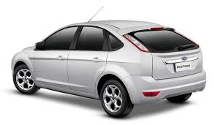
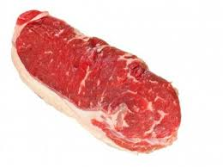
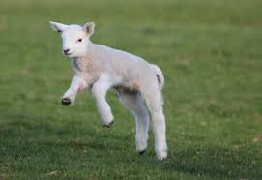
Determinants of PED – Number and closeness of substitutes
More close substitutes = greater sensitivity to price

Slide 24
Determinants of PED – Necessity
More necessary = more inelastic
Inelastic
Food
Meat
Vegetables
Beef
Chicken
Pork
Chicken nuggets
Chicken wings
Brand A nuggets
Brand B nuggets
Elastic

Slide 25
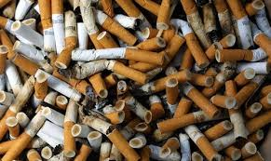
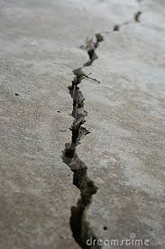
Determinants of PED – Addiction
The extreme of necessity.
Addicted people can be willing to pay almost any price.

Slide 26
Determinants of PED – The passage of time
The longer the passage of time, the more elastic demand becomes.

Slide 27
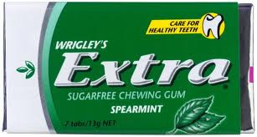
Determinants of PED – Proportion of Income
If a small proportion of income is spent on a good, e.g. pencils, chewing gum, a change in price will have negligible impact on quantity demanded.
If a large proportion of income is spent on it, demand will be more elastic.

Slide 28
Determinants of PED – Branding and advertising
Companies try to make it seem as if there are no close substitutes.

Slide 29
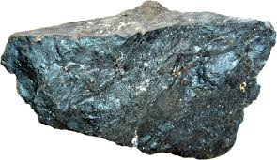
Commodities and PED
Primary products or commodities tend to have a lower PED than manufactured goods
Large investments have already been made to consume these products. e.g. established products relying on wheat.
There are high switching costs. e.g. buying an electric car, building a nuclear power plant.

Slide 30
Manufactured goods and PED
Manufactured goods are likely to have closer substitutes

Slide 31
Government intervention and PED
PED is crucial when governments consider indirect taxes.
Two aims:
1. Raise revenue
2. Change behaviour

