Slide 1
1.4 Market Failure

Slide 2
5 Characteristics of Free Markets
Little government involvement in the economy. (Laissez Faire = Let it be)
Individuals OWN resources and determine what to produce, how to produce, and who gets it.
The opportunity to make PROFIT gives people INCENTIVE to produce quality items efficiently.
Wide variety of goods available to consumers.
Competition and Self-Interest work together to regulate the economy.
The government’s job is to enforce contracts, secure property rights, and defend the country.

Slide 3
The Invisible Hand
e.g. If society wants computers and people are willing to pay high prices then…
Businesses have the INCENTIVE to start making computers to earn PROFIT.
This leads to more COMPETITION….
Which means lower prices, better quality, and more product variety.
To maintain profits, firms find most efficient way to produce goods and services.
The government doesn’t need to get involved since the needs of society are automatically met.

Slide 4
Does the Free Market ever FAIL to meet society’s needs?

Slide 5
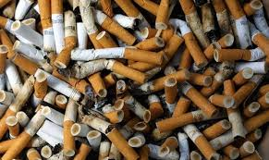
What is a market failure?
A situation in which the free-market system fails to satisfy society’s wants.
(When the invisible hand (pictured) doesn’t work.)
Private markets do not efficiently bring about the allocation of resources.
Too much of some things Not enough of others

Slide 7
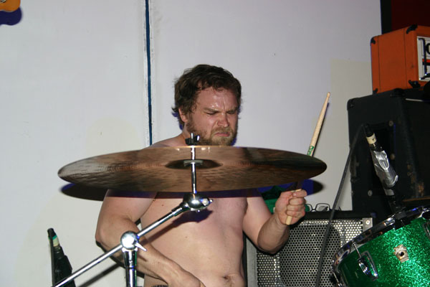
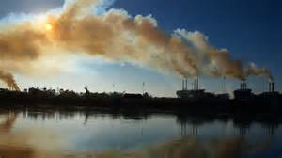
Market Failure - Externalities
Imagine you are in your room studying and suddenly your neighbour bangs on his drums for the next two hours.
You complain to him that you have an economics test the next day and that he should keep it down.
He replies “Whatever, I don’t have one.”
This is an EXTERNALITY
An externality occurs when the actions of consumers or producers give rise to negative or positive side-effects on other people who are not part of these actions, and whose interests are not taken into consideration.

Slide 8
Market Failure - Externalities
When I take my son places, he makes people smile.
The happiness that Xavi brings to people is a side-effect of me taking him places. A positive externality.
No one he meets pays for this happiness, just as the drummer doesn’t pay for the inconvenience caused.
Is this allocatively efficient?

Slide 9
Allocative efficiency
What is allocative efficiency?
social benefit = social cost

Slide 10
Market Failure – Demand and Supply revisited
MPC – Marginal Private Costs MPB – Marginal Private Benefit

Slide 11
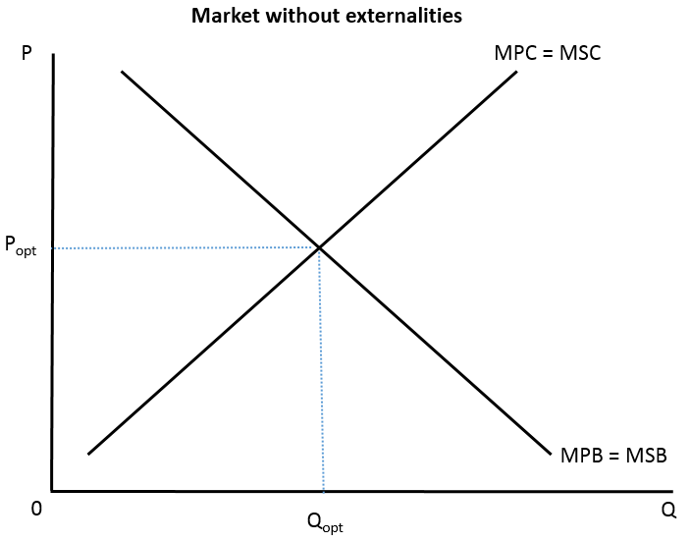
Market Failure – Demand and Supply revisited
MPC – Marginal Private Costs MPB – Marginal Private Benefit
MSC – Marginal Social Costs MSB – Marginal Social Benefit

Slide 12
Market Failure - Externalities
Externalities are a failure of the market to produce a socially optimum state where MSB = MSC
The free market, unchecked, is allocatively inefficient when externalities exist.

Slide 13
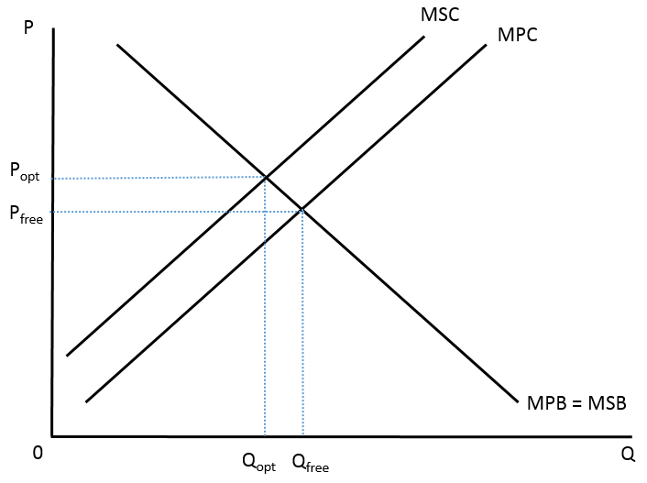
Market Failure – The Drummer
In the free market, there is too much drumming produced by the neighbour.

Slide 14
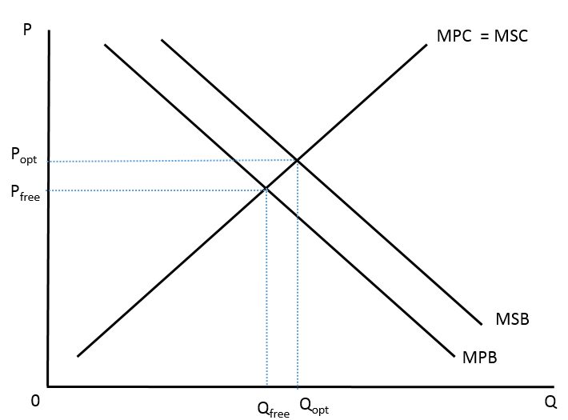
Market Failure – The Baby
In the free market, there are not enough baby outings being consumed.

Slide 15
Market Failure – some more economicy examples
In the free market, a polluting firm does not pay the full cost of its production. In an allocatively efficient market, it would produce less.
In the free market, an individual does not receive the full benefit of immunisation. In an allocatively efficient market, more would be consumed.

Slide 16
Market Failure – Negative Production Externalities
Let’s say that my Vegemite factory is releasing a toxic Vegemite by-product into the groundwater and is making people very ill.
The cost to society AS A WHOLE can be represented as my costs of production (since I am part of society) plus the costs I am making others bear.
We can represent this graphically as...

Slide 17
Market Failure – Negative Production Externalities
MSC (Marginal Social Cost)
$
MPC (Marginal Private Cost)
External
Cost
QSocial
QPrivate
Q

Slide 18
Market Failure – Negative Production Externalities
So, if I only consider my private costs (Yeast, Labour, etc), I will produce at QPrivate.
But accounting for the costs to the whole of society, I ought to produce at QSocial.
Notice that the private outcome is higher than the social outcome.
That is, I produce more Vegemite than is socially optimal.
Pollution by firms is a NEGATIVE EXTERNALITY OF PRODUCTION

Slide 19
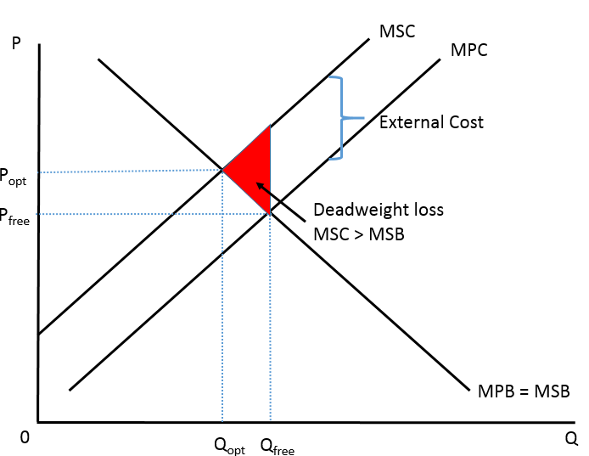
Market Failure – Welfare (Deadweight) loss
Whenever there is an externality, there is a welfare (deadweight) loss, involving a reduction in social benefits, due to the misallocation of resources.

Slide 20
Market Failure – Negative Consumption Externalities
Let’s say that the talking of a particular unnamed student disrupts the class (he produces conversation).
The Marginal Social Cost of the talking outweighs the Marginal Private Cost of the talking.
P
MSC
MPC
P_{opt}
What is the private cost?
What is the external cost?
How could this be fixed?
P_{free}
MPB = MSB
0
Q_{opt}
Q_{free}
Q

Slide 21
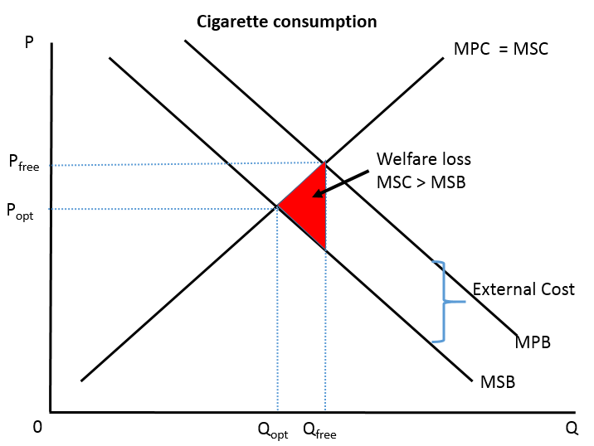
Market Failure – Negative Consumption Externalities
Classic examples
Smoking
Car use

Slide 22
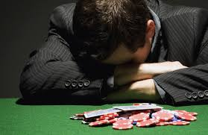
Market Failure – Demerit goods
Demerit goods:
Considered undesirable for consumers, but are over-allocated by the market.
Cigarettes
Alcohol
Gambling
Why over-allocated?
Negative consumption externalities
Ignorance of negative effects
Indifference to negative effects

Slide 23
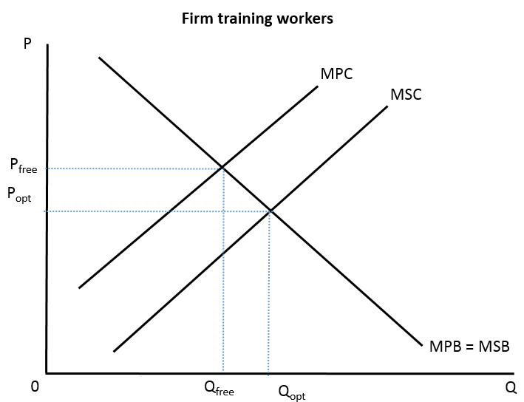
Market Failure – Positive Production Externalities
A firm trains their workers to be high quality. Later on, the employees switch jobs and work elsewhere.
The new employers and society benefit from the trained workers. (External Benefits)

Slide 24
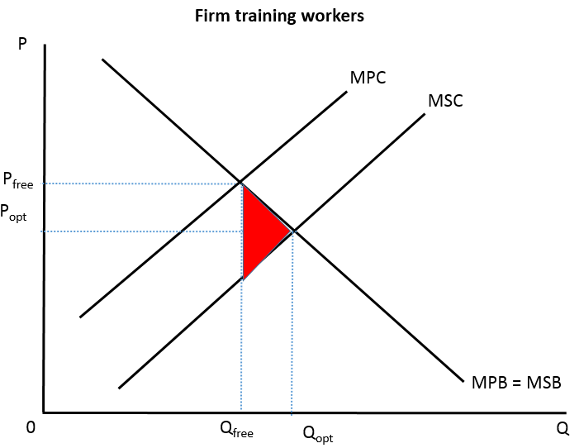
Market Failure – Positive Production Externalities
Private costs are higher than social costs. The amount of training provided is less than optimal.
Welfare loss is where MSB > MSC

Slide 25
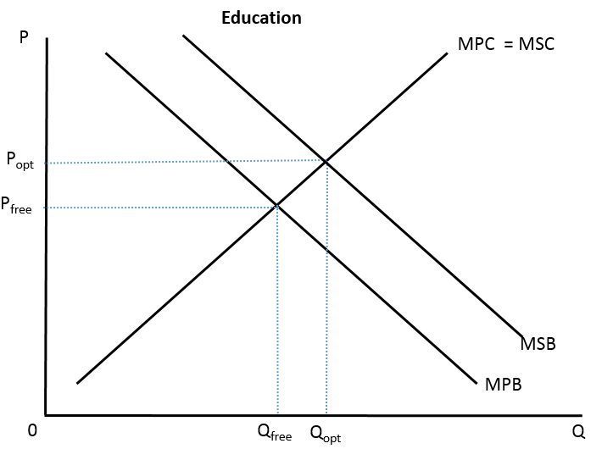
Market Failure – Positive Consumption Externalities
Education provides a benefit to the student, but also to society.
More productivity
More economic growth
Lower unemployment
Lower crime rate

Slide 26
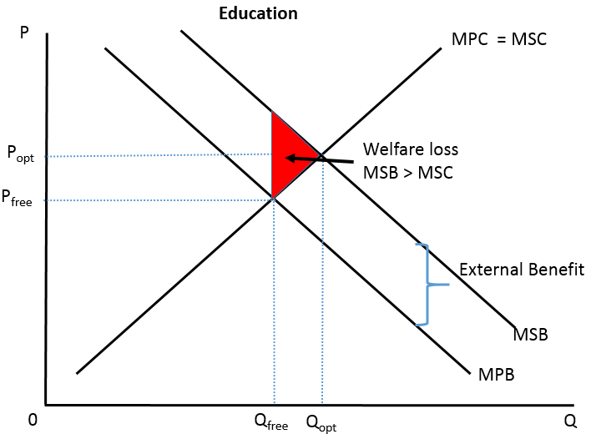
Market Failure – Positive Consumption Externalities
As MSB > MPB, not enough education is consumed
Welfare loss is where MSB > MSC for the amount of the under allocation.

Slide 27
Market Failure – Demerit goods
Demerit goods:
Considered undesirable for consumers, but are over-allocated by the market.
Cigarettes
Alcohol
Gambling
Rewrite this for merit goods
Why over-allocated?
Negative consumption externalities
Ignorance of negative effects
Indifference to negative effects

