Slide 1
1.4 Market Failure
HL content

Slide 2
Market Failure - HL
Asymmetric information
How is it a market failure?
How can governments stop it?
Abuse of market power
How is it a market failure?
How can government stop it?

Slide 3
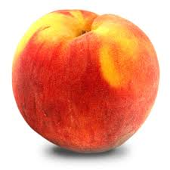
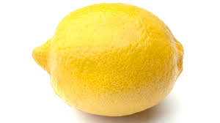
Asymmetric information
An example video
Lemons and peaches – The used car market
Only the seller knows if it’s a peach or a lemon
Cars with insidious problems apparent only to the seller
Buyers would be willing to pay $10,000
A well-functioning car
Buyers would be willing to pay $20,000

Slide 4
Asymmetric information
If there is a 50/50 chance of it being a lemon, how much should you be willing to pay?
If you know that you are selling a peach, how much should you want to sell for?
How many peaches would get sold?
(This field of research won a Nobel Prize in 2001)
How can this be applied elsewhere?

Slide 5
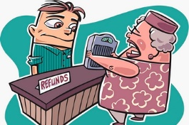
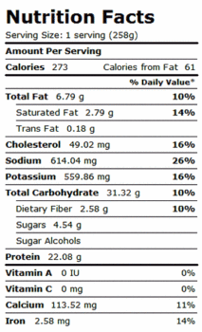
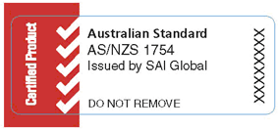
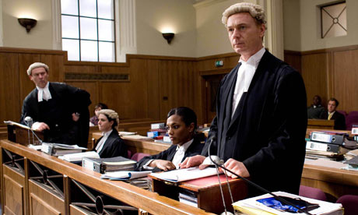
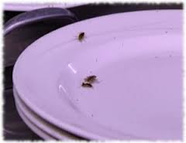
Asymmetric information – Government responses
Rights to refunds
Information
Standards
Inspectors
Licensing

Slide 6
Asymmetric Information - Evaluation
When the asymmetry is removed, peaches will be sold.
Rights to refunds → Decrease in supply
Information provision → Decrease in supply
Standards → Decrease in supply
Inspectors → Decrease in supply
Licensing → Decrease in supply
Why?

Slide 7
Abuse of Monopoly Power
Characteristics of a monopoly
Single firm
Unique product or service
High barriers to entry
What kind of demand curve would a monopoly firm face?
What incentives could this give the monopoly firm?

Slide 8
Abuse of Monopoly Power
If a monopoly raises price, show what happens to social surplus
Show what happens to allocative efficiency
(assume no externalities)

Slide 9
Abuse of Monopoly Power – Government responses
Competition policy
In Australia, the Australian Consumer and Competition Commission
Restrict mergers
Impose fines
Price controls
Monopoly break ups

Slide 10
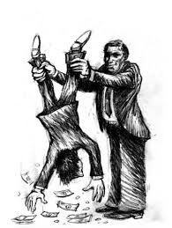
Abuse of Monopoly Power – Government responses
Taxes
Affect the huge profits
Help allocative efficiency?
Nationalisation
Government run, government set the prices
Help productive efficiency?

