Slide 1
1.4 Market Failure
Public Goods

Slide 2
Does the Free Market ever FAIL to meet society’s needs?

Slide 3
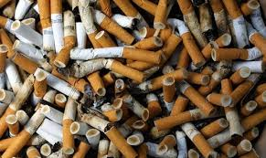
What is a market failure?
A situation in which the free-market system fails to satisfy society’s wants.
(When the invisible hand (pictured) doesn’t work.)
Private markets do not efficiently bring about the allocation of resources.
Too much of some things Not enough of others

Slide 4
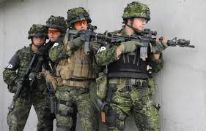
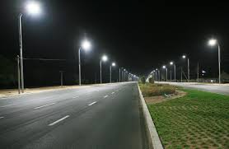
Under provision of Public Goods
Public goods – goods that are available for all to consume, regardless of who pays and who does not.
e.g. defence force, street lights

Slide 5
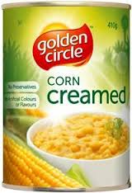
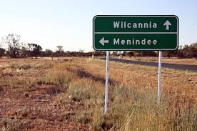
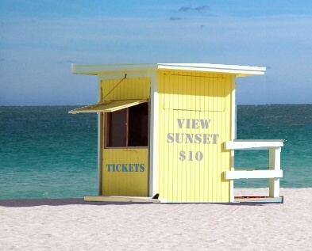
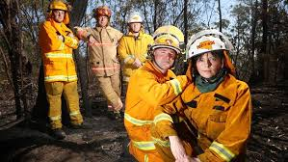
Under provision of public goods
Two conditions
Non-rivalrous – one person’s consumption doesn’t limit the ability of someone else to consume it.
counter
e.g
e.g
Non-excludable – you can’t keep anyone from consuming the good

Slide 6
Under provision of public goods
The problem with public goods
“eh, I don’t wanna pay…
… I’ll let them do it”
Free Rider problem
When people enjoy the use of something without paying for it.
Arises from non-excludability.
The reason private firms do not provide these types of goods

Slide 7
Under provision of public goods
Fire Department auction
https://www.youtube.com/watch?v=9zWcF1dDn5w&list=PLJ-Vd2UJmfxYBdPjQVW-KQBa-zOZ3LK_z&index=22

