Slide 1
1.5 Theory of the Firm and Market Structures
S₁
Production and costs

Slide 2
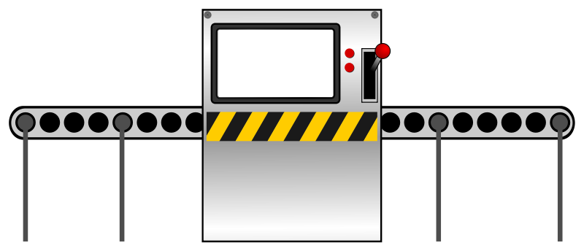
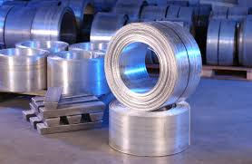
Production
Which of these inputs would be the most variable?

Slide 3
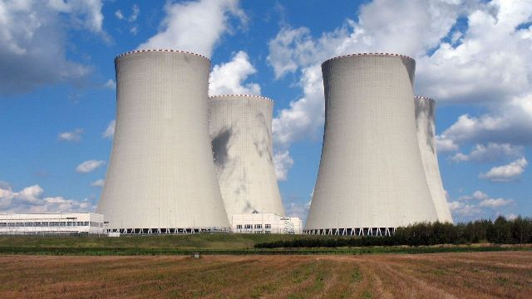
Short run vs long run
Short run:
Time period during which one or more factors of production are fixed.
Long run:
All factors are variable
(we can’t measure by time, it varies by firm/industry)

Slide 4
Short-run production
Total product:
The total quantity of output produced by a firm.
Average product:
The total quantity of output of a firm per unit of variable
input (such as labour)
Marginal product:
The extra or additional output that results from one
additional unit of a variable input (such as labour).

Slide 5
Producing tennis balls

Slide 6
Producing tennis balls
Complete the following
Quantity of labour | Total product (TP) | Average product (AP)
0 | 0 | 0
1 | 12 | 12
2 | 18 | 9
3 | 19 | 6.33
4 | 21 | 5.25
5 | 21 | 4.20
6 | 25 | 4.17
7 | 22 | 3.14
8 | 25 | 3.13
9
10
11
Marginal product (MP)
12
6
1
2
0
4
-3
3

Slide 7
Producing tennis balls
Plot the total product curve
x-axis – quantity of labour (Q_{L})
y-axis – total product (TP)
Plot the marginal and average product curves
x-axis – quantity of labour (Q_{L})
y-axis – marginal and average product
AP is maximised at the exact point where the AP curve intersects with the MP curve
AP_{max} is where MP = AP

Slide 8
Law of diminishing marginal returns
The output per additional unit of variable factor input will ultimately fall if one or more factors are fixed.
Why does this occur?
Fixed factor(s) of production.
What was fixed in the tennis ball production?

Slide 9
Short-run production
Units of variable input | Total product | Average product | Marginal product
0 | 0 | - | -
1 | 2
2 | 5
3 | 9
4 | 14
5 | 18
6 | 21
7 | 23
8 | 24
9 | 24
10 | 23
11 | 21

Slide 10
Economic costs of production
Mr Baum the painter
Paint my brother’s house = $2,000
Paint = $350
Rollers = $10
Masking tape = $8
Petrol = $25
What were my costs?

Slide 11
Economic costs of production
Explicit costs (accounting costs)
Costs of production that involve a money payment by a firm to an outsider in order to acquire a factor of production that is not owned by the firm.
Implicit costs
Costs of production involving sacrificed income arising from the use of self-owned resources by a firm.
During the painting time, I was offered 12 hours work at $23 per hour at the racetrack.
What were my economic costs?
When we talk about ‘costs’, assume economic costs are included

Slide 12
Short-run production
Fixed costs (no fixed costs in the long run)
Costs of fixed inputs
e.g. rent, loan repayments, council rates, property taxes, salaries
Fixed costs
FC
0
Output

Slide 13
Short-run production
Variable costs
Costs of variable inputs
e.g. wages, raw materials, utilities
Variable costs
VC
0
Output

Slide 14
Short-run production
Total costs (TC)
Total fixed costs (TFC) plus total variable costs (TVC)
$TC=TFC+TVC$
Total costs
VC
FC
0
Output

Slide 15
Short-run production
Average costs
Total cost divided by output
Total fixed costs (TFC)
Average fixed costs (AFC) $AFC=\frac{TFC}{Q}$
Total variable costs (TVC)
Average variable costs (AVC) $AVC= \frac{TVC}{Q}$
Total costs (TC)
Average total costs (ATC) $ATC= \frac{TC}{Q}$

Slide 16
Short-run production
Marginal costs (MC)
The extra or additional cost of producing one more unit of output
$$MC= \frac{∆TC}{∆Q}= \frac{∆TVC}{∆Q}$$

Slide 17
Short-run production
Practice
Given the following information for Xavier Pants Company
Each worker costs $500
Fixed costs are $1,000
Complete the table given to you and graph the results
Q of labour (Q_{L}) | Total output (Q)
0 | 0
1 | 40
2 | 90
3 | 130
4 | 140
5 | 130

Slide 18
Short-run production
Some notes on the diagrams
MC intersects ATC and AVC at their lowest point
When MC < AVC, AVC is falling
When MC > AVC, AVC is rising
When MC < ATC, ATC is falling
When MC > ATC, ATC is rising
Vertical distance between ATC and AVC is the same as AFC to the x-axis.
The U (ish) shape of AVC, ATC and MC is due to the law of diminishing returns
AFC falls continuously as output increase

Slide 19
Short-run production
Output AP, MP
Relationship between cost curves and product curves
Cost curves are mirror images of the product curves
As MP rises, each marginal labour unit is being more productive.
As each marginal labour unit is being more productive, the marginal cost per output unit falls.
AP
MP
Q_{Labour}
Costs AVC, MC
MC
AVC
increasing marginal returns
decreasing marginal returns
Output

Slide 20
Short-run production
Output AP, MP
Relationship between cost curves and product curves
Cost curves are mirror images of the product curves
As AP rises, each marginal output unit is made with less labour.
As each labour unit is being more productive, the cost of each output unit falls.
AP
MP
Q_{Labour}
Costs AVC, MC
MC
AVC
increasing marginal returns
decreasing marginal returns
Output

Slide 21
Long-run production
The period in which all factors of production are variable. This lowers the average cost since firms will optimise the mixture of fixed and variable costs

Slide 22
Long-run production
Constant returns to scale
As inputs increase, so output increases proportionally.
e.g. The canteen increases land,
labour and capital by 50%. Output
increases by 50%
Increasing returns to scale
As inputs increase, output increases by a proportionally larger amount.
e.g. An electrician hires an
apprentice. Input increases by
50%, output increases by 75%.

Slide 23
Long-run production
Decreasing returns to scale
As inputs increase, output increases by a proportionally smaller amount.
e.g. A fish and chip shop expands its inputs by 50%. Output grows by only 25%.

Slide 24
Long-run production
Productively efficient producing at Q.
Wants to produce at Q₁.
Increases fixed factors, buys new factory.
At Q, SRATC is at ATC*
Q_{min} required to maintain ATC
At Q₁, ATC is minimised
Costs
SRATC
ATC*
SRATC₁
ATC
ATC₁
0
Q
Q_{min}
Q₁
Output
(short-run)

Slide 25
Long-run production
Infinite SRATC curves
If increased use of fixed factors results in a lower SRATC curve
➔ Increasing returns to scale (economies of scale)
Costs
SRATC
SRATC₁
SRATC₂
SRATC₃
SRATC₄
SRATC₅
LRATC
0
Output
(long-run)

Slide 26
Long-run production
If increased use of fixed factors results in same-level SRATC curve
➔ Constant returns to scale (economies of scale)
If increased use of fixed factors results in higher SRATC curve
➔ Decreasing returns to scale (diseconomies of scale)
Average total costs
LRATC
0
Output
(short-run)

Slide 27
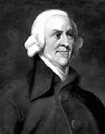
Long-run production
Economies of scale
Specialisation of labour
- labour does what it’s best at
Cost spreading
vs Baum Backyard Lemonade co.
Each take out prime time TV ads. Is the effect on average costs the same?

Slide 28
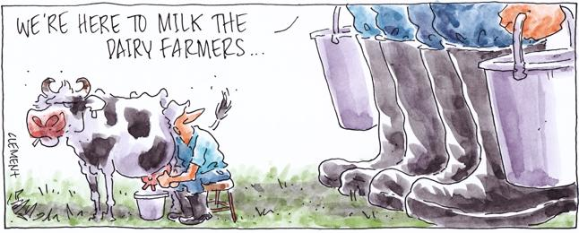
Long-run production
Economies of scale
Buying power
- can negotiate cheaper input prices
- preferential lending costs

Slide 29
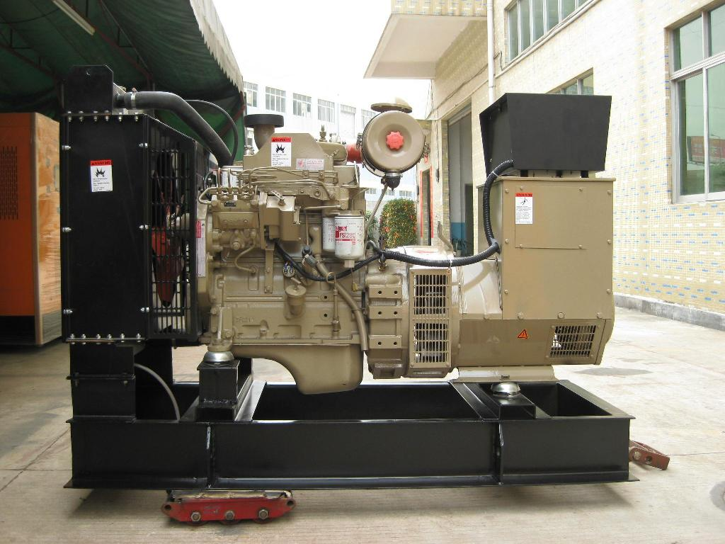
Long-run production
Economies of scale
Indivisibility of capital equipment
The full cost must be paid, regardless if it isn’t used to full capacity

Slide 30
Long-run production
Diseconomies of scale
Organisational control

