Slide 1
Macroeconomics
2.1 The Level of Overall Economic Activity

Slide 2
Key aims
How does a country’s economy work?
How do we measure an economy?
How do economies fluctuate?

Slide 3
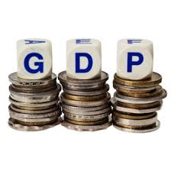
Macroeconomic Measures
Gross Domestic Product
Gross Domestic Product (GDP) is the dollar value of all final goods and services produced within a country’s borders in one year.

Slide 4
GDP
GDP = C + I + G + (X – M)
C – Consumption spending
All household purchases of final goods and services in a year

Slide 5
GDP
GDP = C + I + G + (X – M)
I - Investment
Spending by firms on capital goods.
Spending on new construction (houses and other buildings)

Slide 6
GDP
GDP = C + I + G + (X – M)
G – Government
Spending by government on factors of production (including labour)
Includes investment spending by government (schools, hospitals, roads, etc)
Does not include transfer payments

Slide 7
GDP
GDP = C + I + G + (X – M)
(X – M) – Net Exports
Total value of exports minus total value of imports
Includes investment spending by government (schools, hospitals, roads, etc)
Does not include transfer payments

Slide 8
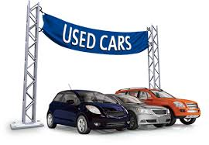
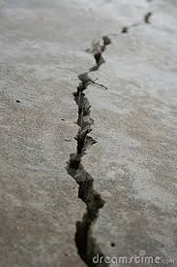
GDP
What don’t we include?
Intermediate goods
Non-production transactions
a) Financial transactions
b) Used goods
3. Non-market activities
4. Transfer Payments

Slide 9
GDP
Three ways to measure:
1. Expenditures approach-Add up all the spending on final goods and services produced in a given year.
2. Income approach-Add up all the income that resulted from selling all final goods and services produced in a given year.
3. Output approach – Add up all of the value added by all the firms in an economy.
National Output = National Income = National Expenditure

Slide 10
GDP vs GNI (GNP)
GNI – Gross National Income (formerly known as GNP(Gross National Product))
Total income earned by a country’s factors of production, regardless of where the assets are located.

Slide 11
GDP vs GNI (GNP)
A US multinational operating in India remits (sends back) its profits to the United States. The output of the multinational is produced in India, but the profit income is received by residents in the United States. Does the profit income count as Indian or US income and output?
Russian worker who lives and works in Spain, and sends a large part of her income to her family in Russia. Her output is produced in Spain, but the income she sends home is Russian income; should this income count as Russia’s or Spain’s income and output?

Slide 12
Included or not included in GDP?
For each situation, identify if it is included in GDP the identify the category C, I, G, or (X – M)
$15.00 for movie tickets
$5M Increase in Defence expenditures
$45 for used economics textbook
Holden makes new $20M factory in Lonsdale
$20K Hyundai made in Korea
$10K Profit from selling stocks
$45K car made in Australia, sold in New Zealand
$10K fees to attend University
$500 NewStart Allowance payment to Bruce
Farmer purchases new $100K tractor

Slide 13
Included or not included in GDP?
For each situation, identify if it is included in GDP the identify the category C, I, G, or (X – M)
$15.00 for movie tickets
$5M Increase in Defence expenditures
$45 for used economics textbook
Holden makes new $20M factory in Lonsdale
$20K Hyundai made in Korea
$10K Profit from selling stocks
$45K car made in Australia, sold in New Zealand
$10K fees to attend University
$500 NewStart Allowance payment to Bruce
Farmer purchases new $100K tractor

Slide 14
(Nominal) GDP vs Real GDP
Nominal GDP or GNI is the dollar total for that year.
Real GDP or GNI adjusts for inflation

Slide 15
Real vs. Nominal GDP Example
2008
10 cars at $15,000 each = $150,000
10 utes at $20,000 each = $200,000
Nominal GDP = $350,000
The GDP in year 2008 shows the dollar value of all final goods produced.
The nominal GDP in year 2009 is higher which suggests that the economy is improving.
But how much is the REAL GDP? How do you get it?
2009
10 cars at $16,000 each = $160,000
10 utes at $21,000 each= $210,000
Nominal GDP = $370,000
2009
10 cars at $15,000 each = $150,000
10 utes at $20,000 each= $200,000
REAL GDP = $350,000
Use 2008 Prices.
The Real GDP for 2009 is the same as 2008 after we adjust for inflation.

Slide 16
GDP per capita / GNI per capita
per capita – from latin, meaning ‘by heads’
GDP per capita = GDP per person
Australia’s GDP per capita
$= \frac{Australia^{′}s total GDP}{Australia^{′}s population}$

Slide 17
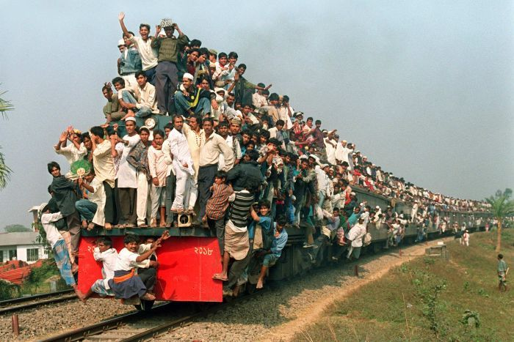
Why use per capita?
Comparing countries
Growing populations

Slide 18
What do we use these measures for?
Governments use them to develop policies
Determining whether countries have met economic objectives
Economists use them to develop models and make forecasts
Businesses use them to forecast future demand
Analysis of an economy over time (using real data)
Evaluating the standard of living
Comparing different countries

Slide 19
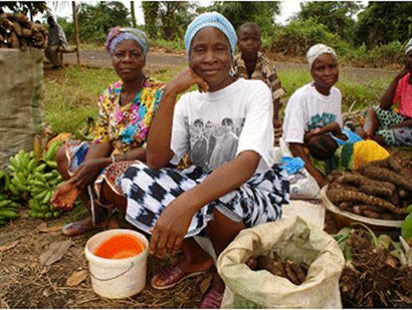
Limitations of GDP / GNI
Unrecorded / Under-recorded economic activity
Pay a painter = recorded in the stats
Paint yourself = not recorded
Subsistence farming = not recorded

Slide 20
Limitations of GDP / GNI
Unrecorded / Under-recorded economic activity
Illegal activity
Cash jobs / undeclared work
Drug trafficking
In Greece in 2002, the GDP was thought to be underestimated by 28% due to the hidden economy.

Slide 21
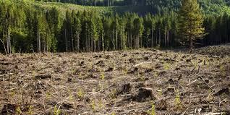
Limitations of GDP / GNI
External Costs
GDP will grow even as deforestation, air and water pollution and traffic congestion continue.
Quality of life is reduced, but not reflected in GDP.

Slide 22
Limitations of GDP / GNI
The Broken Window fallacy

Slide 23
Limitations of GDP / GNI
Other quality of life concerns
Working longer hours → More income → Higher GDP
Free activities such as volunteer work, caring for elderly or children at home are not included even though these make for a better society.
Security, peace, life expectancy, increased leisure, and political freedom are not accounted for.

Slide 24
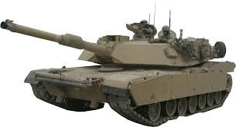
Limitations of GDP / GNI
Composition of output
Allocative efficiency.
Defence goods, capital goods do not benefit consumers.

Slide 25
Should we use these statistics?
GDP Smackdown

Slide 26
Green GDP

Slide 27
Green GDP
Cleaning up an oil spill counts towards GDP
Riding your bike instead of buying petrol does not count towards GDP

Slide 28
Green GDP
To account for what GDP does not, economist have created Green GDP
Green GDP = GDP – the value of environmental degradation – P
P = all expenditures resulting from cleaning up pollution, avoiding further environmental damage, and health care costs of pollution-induced illnesses

Slide 29
Green GDP
Implications of Green GDP
Lower ‘growth’ rates
High ‘growth’ rates would necessitate expenditure to protect and even enhance the environment
According to conventional methods of measurement, China’s real GDP has been growing at over 10% per year (for several years), whereas early results of the Green GDP method showed it to be close to zero in some Chinese
provinces.

Slide 30
GDP
A Nobel prize-winning economist’s take on the GDP statistic
Video

