Slide 1
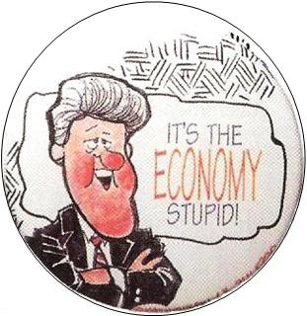
Macroeconomics
2.1 The Level of Overall Economic Activity

Slide 2
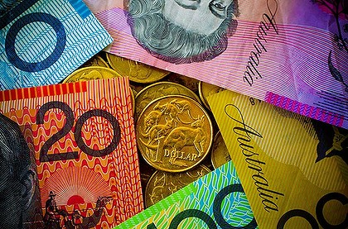
Key aims
How does a country’s economy work?
How do we measure an economy?
How do economies fluctuate?

Slide 3
Business Cycle
https://www.youtube.com/watch?v=FOGPgMsL5SU

Slide 4
Business Cycle

Slide 5
Business Cycle
Long-term growth trend in PPC form
Capital goods
Consumer goods

Slide 6
Business Cycle
Expansion (recovery) - represents a growing economy, rising employment of resources, rising price level.
Peak - represents maximum real GDP, unemployment of resources has fallen substantially, price level rising rapidly.
Contraction (recession) - represents a shrinking economy (two quarters or more is a recession), growing unemployment of resources, price level rises very slowly or falls.
Trough - represents the minimum real GDP, price level rises very slowly or falls.

Slide 7
Business Cycle
Phase | Real GDP growth | Inflation | Unemployment
Peak
Contraction (recession)
Trough
Expansion (recovery)

Slide 8
Business Cycle
Phase | Real GDP growth | Inflation | Unemployment
Peak | Overheating > 5% | Overheating > 5% | At or just below natural rate of u/e
Contraction (recession) | Negative growth < 0% | Low < 2% | Higher > 8%
Trough | Negative growth < 0% | Very low < 1% | Very high > 10%
Expansion (recovery) | Growing 3-4% | Stable 2-3% | At or just above natural rate of u/e

Slide 9
Business Cycle
Not regular or predictable
Expansions usually last longer than contractions
Correlation between employment and real GDP
Natural rate of unemployment – the unemployment that still exists when an economy is at full employment of resources.

Slide 10
Business Cycle

Slide 11
Business Cycle
Decrease in real GDP vs Decrease in real GDP growth
Decrease in real GDP
The economy shrinks, GDP growth is negative
Decrease in real GDP growth
The economy grows at a slower rate
e.g.
Year | Real GDP growth
2011 | 4.2%
2012 | 4.5%
2013 | 3% Decrease in real GDP growth
2014 | 3.25%
2015 | - 1.0% Decrease in real GDP

Slide 12
The Business Cycle - Boom

Slide 13
The Business Cycle - Downturn

Slide 14
The Business Cycle - Recession

Slide 15
The Business Cycle - Recovery

