Slide 1
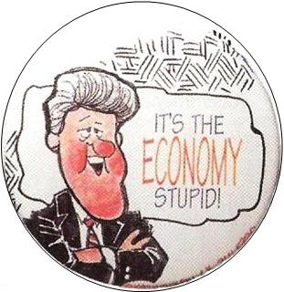
Macroeconomics
2.1 The Level of Overall Economic Activity

Slide 2
Key aims
How does a country’s economy work?
How do we measure an economy?
How do economies fluctuate?

Slide 3
How does a country’s economy work?
The Circular Flow model
Households Businesses

Slide 4
Circular Flow model
Factors of Production
Factor / Resource | Income
Land | Rent
Labour | Wages
Capital | Interest
Entrepreneurship | Profit

Slide 5
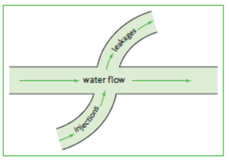
Circular Flow model
Is it this simple?

Slide 6
Financial Sector
Leakage:
Saving (S)
Y = C + S
Injection:
Investment (I)
Y = C + I
Saving: The portion of consumer income that is not spent, but saved
Notes:
Start with the 2-sector model and then build and build

Slide 7
Financial Sector
Injection:
Investment (I)
Y = C + I
Investment: Spending by firms on capital goods

Slide 8
Circular Flow model
Suppose that in an economy, Households always save 20% of their incomes and that there is constant investment of $1,000.
Month | Income (Y) | Consumption (C) | Savings (S) | Investment (I) | C + I
1 | $10,000 | $8,000 | $2,000 | $1,000 | $9,000
2 | $9,000 | $7,200 | $1,800 | $1,000 | $8,200
3 | $8,200 | 6,560 | 1,640 | $1,000 | $7,560
4 | $7,560 | $6,048 | $1,512 | $1,000 | $7,048
… | $5,000 | $4,000 | $1,000 | $1,000 | $5,000
The size of the circular flow depends on the size of the injections and leakages
injections > leakage = growth
injections < leakages = contraction

Slide 9
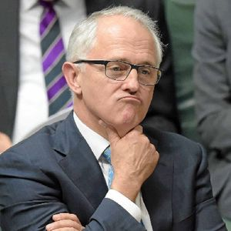
Circular Flow model
What else is missing?

Slide 10
Government Sector
Leakage:
Taxes (T)
Y = C + S + T

Slide 11
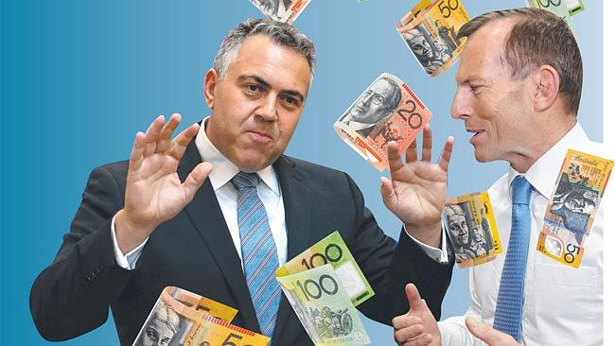
Government Sector
Injection:
Government spending (G)
Y = C + I + G

Slide 12
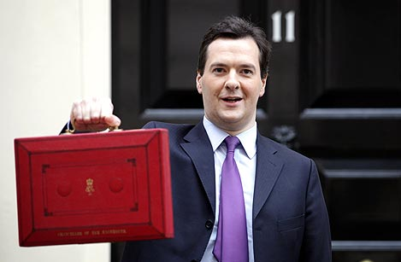
Government Sector
Government spending (G) and Taxes (T)
The Budget is the government documenting spending and taxation plans.

Slide 13
The Expenditure Multiplier
The expenditure multiplier
When money is spent in an economy, its effects are multiplied because the money is spent over and over again. This works in reverse for a decrease in spending.

Slide 14
4-Sector Circular Flow
Month | Y | C | S | I | T | G | C + I + G
1 | $10,000 | $8,000 | $1,000 | $1,000 | $1,000 | $1,000 | $10,000
2 | $10,000 | $8,000 | $1,000 | $1,000 | $1,000 | $2,000 | $11,000
3 | $11,000 | $8,800 | $1,100 | $1,000 | $1,100 | $1,000 | $10,800
4 | $10,800 | $8,640 | $1,080 | $1,000 | $1,080 | $1,000 | $10,640

Slide 15
Overseas Sector
Leakage:
Imports (M)
Notes:
Profit repatriation

Slide 16
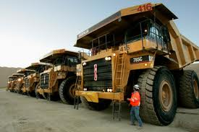
Overseas Sector
Injection:
Exports (X)
Y = C + I + G + (X - M)
Notes:
Foreign investment

