Slide 1
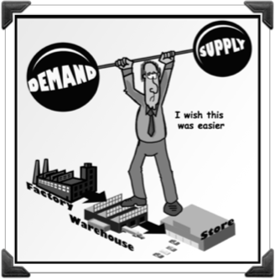
Macroeconomics
2.2 Aggregate Demand and Aggregate Supply

Slide 2
Demand and Supply review
Define Demand and the Law of Demand.
Identify the three concepts that explain why demand is downward sloping.
Identify the difference between a change in demand and a change in quantity demanded.
Identify the Shifters of Demand.
Define Supply and the Law of Supply.
Why is supply upward sloping?
Identify the Shifters of Supply.
What does it mean if there is a perfectly inelastic supply curve?

Slide 3
Core concepts
Demand → Aggregate Demand
Supply → Aggregate Supply
Markets → Economies
Prices → Price level
Quantity → Output
C + I + G + (X – M)

Slide 4
Aggregate Demand
Aggregate = all added together
Aggregate Demand = D + D + D + D + D …
Demand of everything by everyone
Who is everyone?

Slide 5
Aggregate Demand – A definition
Aggregate Demand is the total amount of real output (real GDP) that consumers, firms, the government and foreigners want to buy at each possible price level, over a particular time period.

Slide 6
Aggregate Demand – A curve
Will the AD curve slope upward or downward?
AGGREGATE DEMAND

Slide 7
Aggregate Demand – A curve
Why does it slope downward?
The Wealth Effect
Prices ↑ , real value of wealth ↓, spending ↓
Prices ↓ , real value of wealth ↑, spending ↑

Slide 8
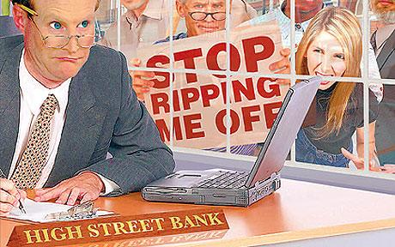
Aggregate Demand – A curve
2. The interest rate effect
prices ↑, interest rates ↑, spending ↓
If interest rates go up from 5% to 6%, are you more or less likely to borrow to improve your business?

Slide 9
Aggregate Demand – A curve
3. The International Trade effect
Prices ↑, exports ↓, X is smaller
Prices ↑, imports ↑, M is bigger
If French prices go up 5%, it costs more to buy their exports, so fewer are bought.

Slide 10
Aggregate Demand
D AD

Slide 11
Aggregate Demand
D AD
the willingness and ability of consumers to buy a single product at different possible prices of that product, over a particular time period (ceteris paribus)
the willingness and ability of all possible buyers (consumers, businesses, government and foreigners) to buy the economy’s aggregate output, or total real
GDP, at different possible price levels, over a time period (ceteris paribus)

Slide 12
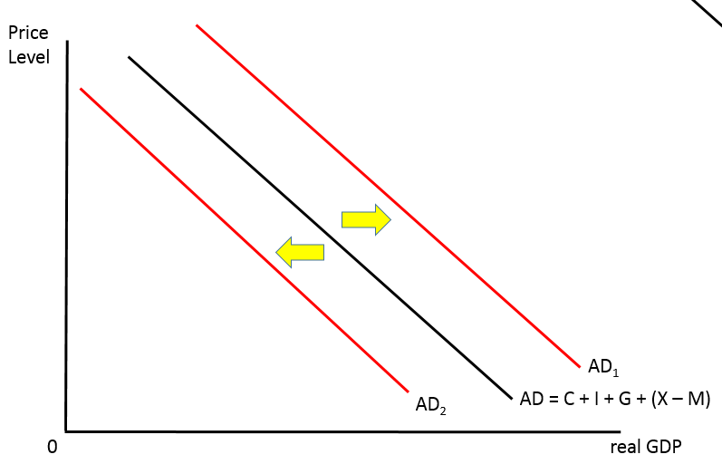
Shifting Aggregate Demand
AD = C + I + G + (X – M)
A change in one of these will shift the curve

Slide 13
Shifting Aggregate Demand
C
Changes in consumer confidence (Will things keep being this good?)
Changes in interest rates (Will it cost me more to consume? Will I have more money to consume?)
Changes in wealth (not income) (I feel richer, I’ll spend more)
Changes in income tax (They tax me more, I’ve got less disposable income)
Level of household indebtedness (I’ve got loads of debt, therefore loads of debt repayments)

Slide 14
Shifting Aggregate Demand
I
Changes in business confidence (Will things keep being this good?)
Changes in interest rates (Will it cost me more to invest?)
Changes in technology (What new tech do I need buy for the business?)
Change in corporate tax (We have more to invest, let’s invest!)
Change in corporate indebtedness (Maybe we should pay off our current debt before adding to it)
Legal changes (Can I access credit? Do I have property rights?)

Slide 15
Shifting Aggregate Demand
G
Changes in political priorities (What will keep us in power?)
Changes in economic priorities (How should we spend/save to control AD?)

Slide 16
Shifting Aggregate Demand
X - M
Changes in national income of other countries (Who could buy more of our stuff?)
Changes in exchange rates (Is our stuff more or less attractive?)
Changes in trade protection (How free is trade?)

Slide 17
Shifting Aggregate Demand
Using diagrams, show the impact of each of the following on the Aggregate Demand curve; explain what happens to AD in each case and identify the component of expenditure involved.
Decline in value of the real estate market.
Increased taxes on firms’ profits.
Consumers become optimistic about future economic conditions.
Real incomes in countries that purchase a large share of country A’s exports fall; examine the impact of AD in country A.
An NGO introduces a programme providing credit to small farmers, making it easier for them to borrow to finance the building of irrigation projects.

