Slide 1
Macroeconomics
2.2 Aggregate Demand and Aggregate Supply

Slide 2
Aggregate Supply – A definition
Aggregate Supply – the total quantity of goods and services produced in an economy (real GDP) over a particular time period at different price levels

Slide 3
Aggregate Supply
S AS

Slide 4
Aggregate Supply – the short-run (SRAS)
Short-run – Prices of final goods change, factor prices do not change.

Slide 5
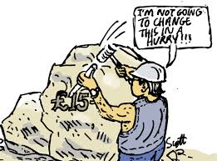
Aggregate Supply – the short-run (SRAS)
Sticky wages –.

Slide 6
Short-Run Aggregate Supply (SRAS) – A curve
Will the SRAS curve slope upward or downward?
SHORT-RUN AGGREGATE SUPPLY

Slide 7
Short-Run Aggregate Supply (SRAS) – A curve
Why does it slope upward?
A firm makes 100 units sold for $1.
Labour = $80
Prices go up 5%
A firm makes 100 units sold for $1.05.
Labour = $80

Slide 8
Shifting the SRAS
Changes in wages
If the changes are not related to price level
2. Changes in non-labour input prices
Oil, capital goods, land inputs, etc
3. Change in Government intervention
4. Supply shocks
Weather conditions, war

Slide 9
Shifting the SRAS - practice
(a) The price of oil (an important input in production) increases.
(b) Below-zero temperatures destroys agricultural output.
(c) The government lowers taxes on firms’ profits.
(d) The government eliminates subsidies on agricultural products.
(e) There is an increase in the minimum wage.

Slide 10
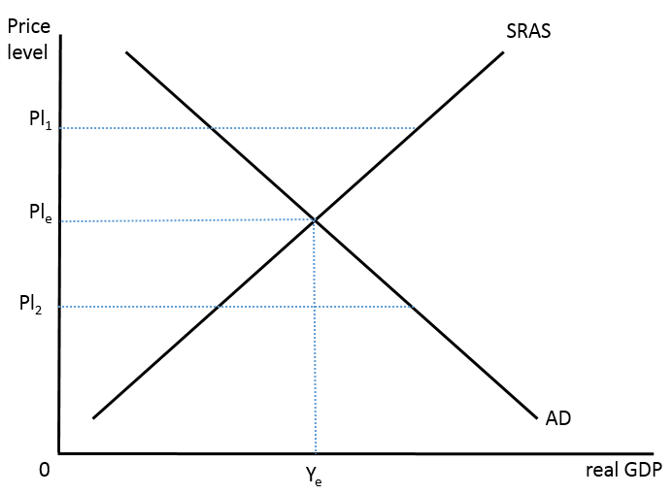
Short-run equilibrium
Short-run equilibrium is where AD and SRAS intersect.

Slide 11
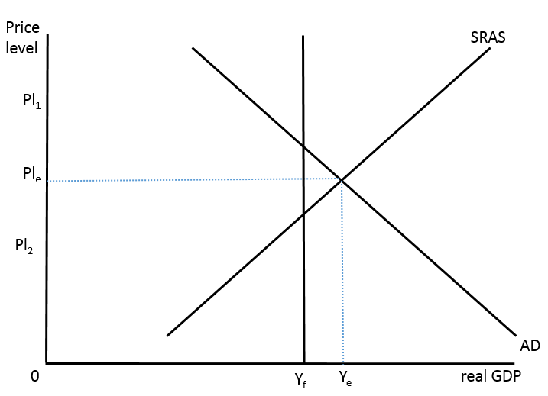
Short-run equilibrium – three types
Inflationary gap
Too much demand in the economy
Huge demand for resources
Employment increases
Upwards pressure on prices
Output beyond the full employment level

Slide 12
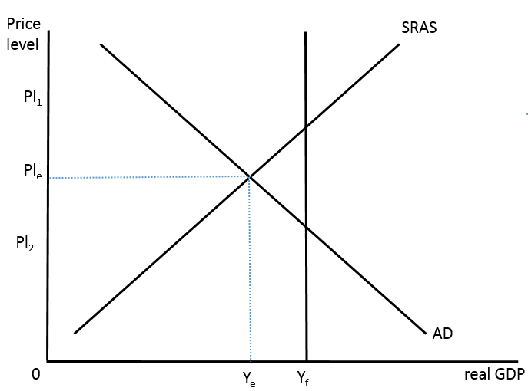
Short-run equilibrium – three types
Recessionary gap
AKA deflationary gap
AKA unemployment gap
Not enough demand in the economy
Not worthwhile to produce at capacity
Unemployment less than natural rate

Slide 13
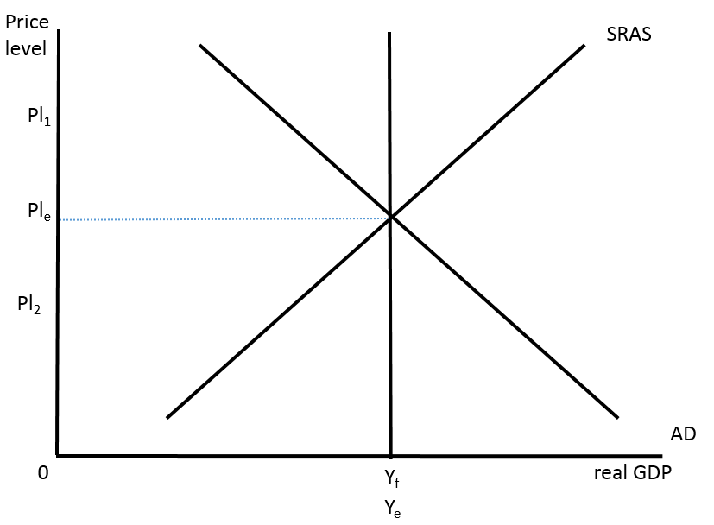
Short-run equilibrium – three types
Full employment equilibrium
Economy produces at capacity

Slide 14
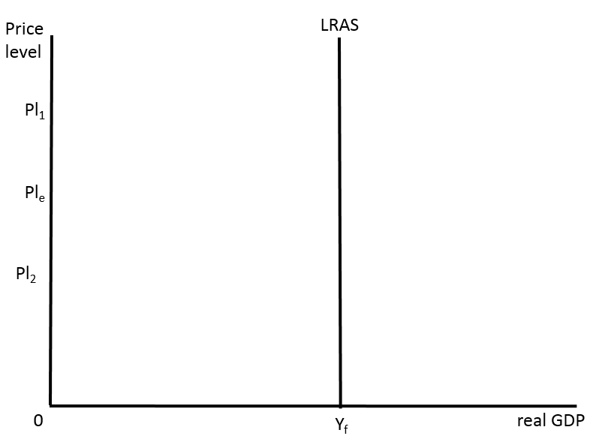
Long-run Aggregate Supply (LRAS)
LRAS is vertical – why?
New classical / monetarist model
In the long run, always produce at potential GDP (full employment)
Wages and other factor prices now change (no more sticky wages)
AD only affects Price Level in the Long run

Slide 15
AD-AS in the Keynesian model
Wages rise faster than they fall (sticky)
Minimum wage laws
Labour contracts
Workers and unions resist
Morale issues
Prices rise faster than they fall
If wages are sticky, then firms reluctant to lower prices

Slide 16
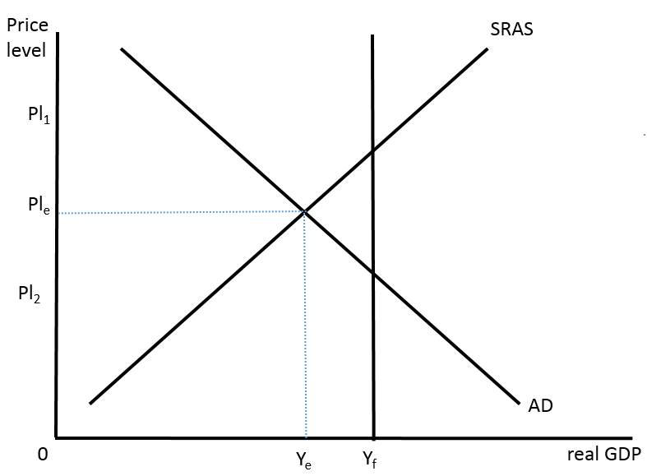
AD-AS in the Keynesian model
Stuck in the short run – if the SRAS won’t shift downwards, then the recessionary gap will stay

Slide 17
AD-AS in the Keynesian model
3 sections:
Section 1 (Depression)
Only occurs in a depression (prolonged recession)

Slide 18
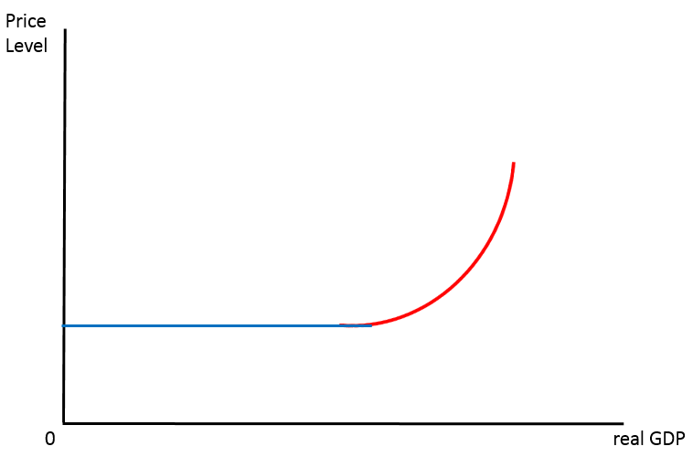
AD-AS in the Keynesian model
3 sections:
Section 2 (Normal)
Producers’ normal response to a raise in price level

Slide 19
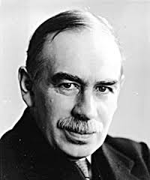
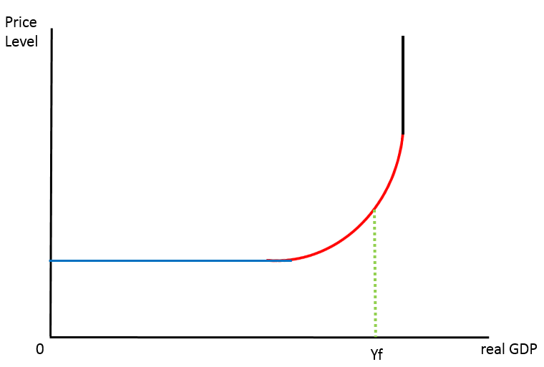
AD-AS in the Keynesian model
3 sections:
Section 3 (Physical limit)

Slide 20
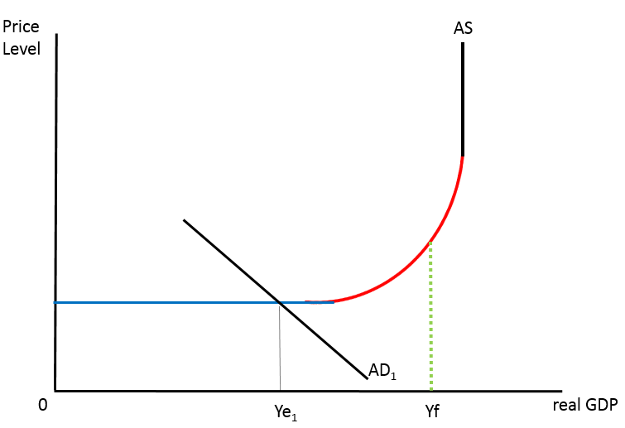
Equilibrium in the Keynesian model
3 types of equilibrium (same names, you should be able to tell which is which)

Slide 21
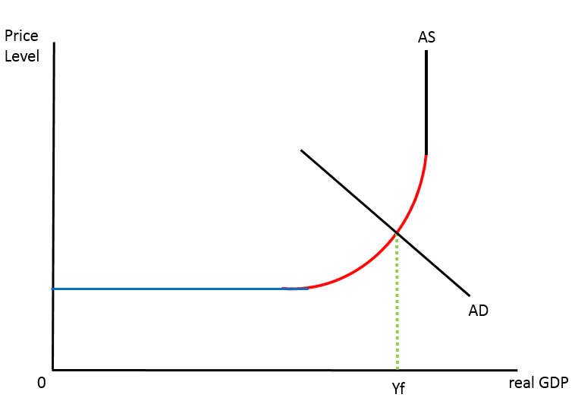
Equilibrium in the Keynesian model
3 types of equilibrium (same names, you should be able to tell which is which)

Slide 22
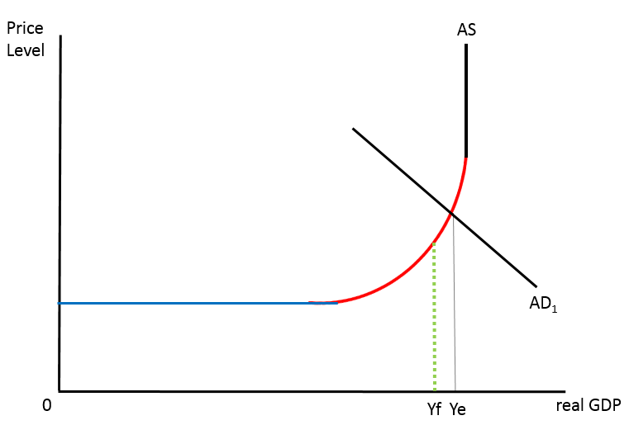
Equilibrium in the Keynesian model
3 types of equilibrium (same names, you should be able to tell which is which)

Slide 23
Keynesian model (the need to know)
Recessionary gaps can persist
Reject the notion that economies tend towards full employment
Governments must step in to increase AD
Increase in AD need not push up prices
Horizontal section

Slide 24
Shifting LRAS in the long run
Both the New Classical/Monetarist and Keynesian models can shift in the long run.
What could cause potential output to increase?
Increase in quantity of resources

Slide 25
Shifting potential output
2. Increase in quality of resources

Slide 26
Shifting potential output
3. Technology improvements

Slide 27
Shifting potential output
4. Increases in efficiency or productivity

Slide 28
Shifting potential output
5. Institutional changes
Privitisation Competition policy
Tariffs
Market power allowed

Slide 29
Shifting potential output
5. Institutional changes
Quality and amount of regulation
Price floors, price ceilings
Laws governing production methods

Slide 30
Shifting potential output
6. Decrease in the natural rate of unemployment
Linking employers to employees
Retraining

Slide 31
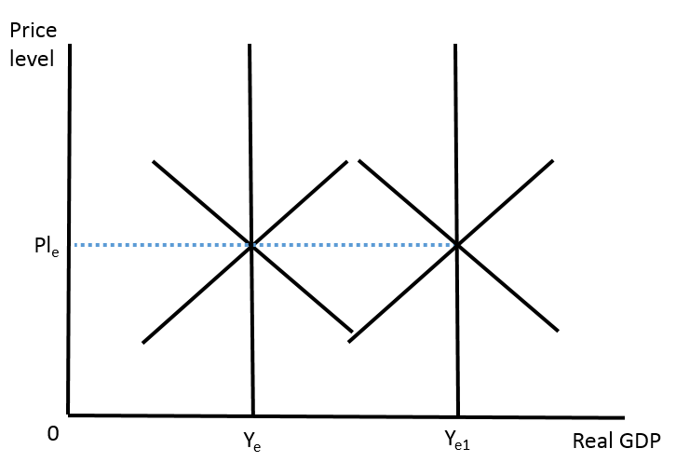
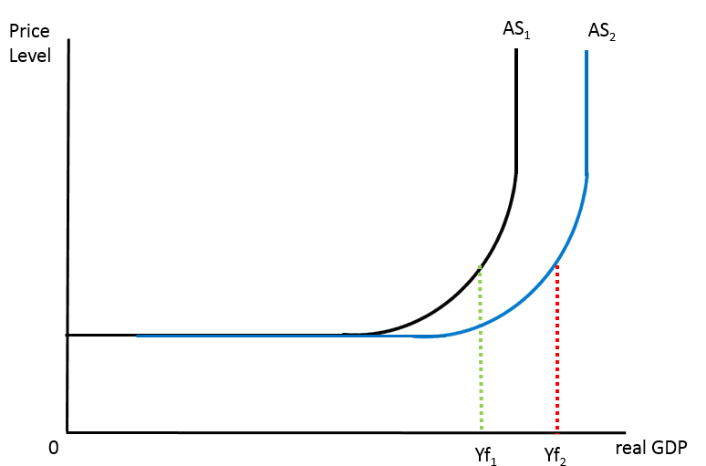
Shifting potential output
Draw in
New Classical/Monetarist Keynesian

Slide 32
Shifting potential output - practice
Illustrate diagrammatically the impacts on an economy’s LRAS and the Keynesian AS curve of the following:
(a) There is a widespread introduction of a new technology that increases labour productivity.
(b) The government provides training programmes for workers to retrain and
improve their skills.
(c) A developing country receives large amounts of foreign aid, which allows it to purchase a large quantity of capital goods.
(d) An extensive nationwide public health campaign undertaken by the government improves levels of health of the population.
(e) The government introduces anti-monopoly legislation, reducing the monopoly power of firms and increasing the economy’s productive efficiency.

