Slide 1
Macroeconomic
2.3

Slide 2
Macroeconomic Objectives
Low unemployment (as measured by the unemployment rate)
Low and stable rate of inflation (as measured by the Consumer Price Index)
Economic growth (as measured by Gross Domestic Product)
Equity in the distribution of income

Slide 3
Economic growth - Definition
Economic growth refers to an increase in real GDP, or the real quantity of goods and services produced over a period of time (typically one year)
What is the difference between real GDP and real GDP per capita?

Slide 4
Economic growth – Two sources
Capital goods
Capital goods
Consumer goods
Consumer goods
Increase in actual output
↑ productive efficiency
↓ unemployment
Increase in potential output
↑ quantity of resources
↑ quality of resources

Slide 5
Economic growth – shifting the LRAS
↑ resource quantity
↑ resource quality
↑ technology
↑ efficiency
↓ natural u/e
Institutional changes
As seen in
2.2 AD-AS
Price level
LRAS₁
LRAS
SRAS
AD
0
Y_{e}
Real GDP

Slide 6
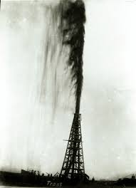
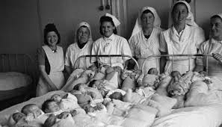
Shifting LRAS in the long run
Both the New Classical/Monetarist and Keynesian models can shift in the long run.
What could cause potential output to increase?
Increase in quantity of resources

Slide 7
Shifting potential output
2. Increase in quality of resources

Slide 8
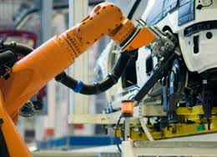
Shifting potential output
3. Technology improvements

Slide 9
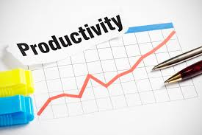
Shifting potential output
4. Increases in efficiency or productivity

Slide 10
Shifting potential output
5. Institutional changes
Privitisation Competition policy
Tariffs
Market power allowed

Slide 11
Shifting potential output
5. Institutional changes
Quality and amount of regulation
Price floors, price ceilings
Laws governing production methods

Slide 12
Shifting potential output
6. Decrease in the natural rate of unemployment
Linking employers to employees
Retraining

Slide 13
Economic growth – The importance of investment
Investment in capital
Human capital – people, skills, knowledge, health
Physical capital – capital goods
Natural capital – natural resources

Slide 14
Economic growth – The importance of investment
Human Capital
Education - ↑ education, ↑ productivity
Health - ↓ health, ↓ lost work time, ↑ productivity

Slide 15
Economic growth – The importance of investment
Physical Capital
Capital goods - ↑ capital goods, ↑ production

Slide 16
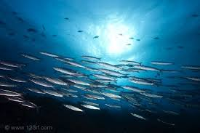
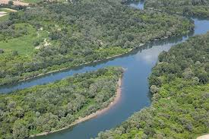
Economic growth – The importance of investment
Natural Capital
↑ environmental destruction, ↓ natural resources, ↓ GDP
↑ investment in maintaining natural resources,
↑ natural resources, ↑ GDP

Slide 17
Economic growth - questions
For each of the below, show the effect on a PPC and the LRAS.
(a) a discovery of new oil reserves
(b) a fall in natural unemployment
(c) an increase in cyclical unemployment
(d) an improvement in levels of health of the population
(e) an improvement in productive efficiency
(f) the widespread use of a new technology
(g) a violent conflict destroys a portion of a country’s factories, machines and road
system
(h) large cuts in government spending on education and health care lower levels of
education and health in a population
(i) an increase in the quantity of capital goods
(j) an improvement in the level of education and skills of workers
(k) industrial pollution destroys the environment.

Slide 18
Economic Growth - Benefits
Standard of Living

Slide 19
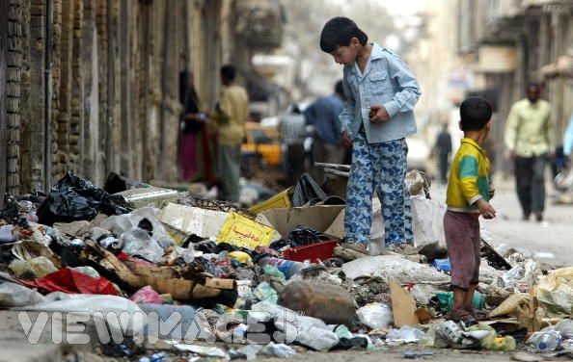
Economic Growth - Benefits
Less absolute poverty

Slide 20
Economic Growth - Benefits
Greater tax revenue

Slide 21
Economic Growth - Benefits
Higher environmental standards

Slide 22
Economic Growth - Benefits
Reduced unemployment

Slide 23
Economic Growth - Benefits
New technology

Slide 24
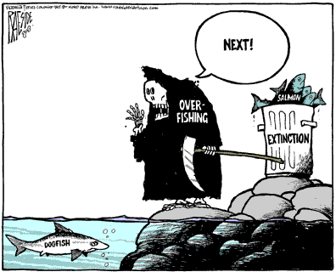
Economic Growth - Costs
Environmental degradation

Slide 25
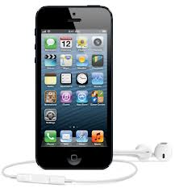
Economic Growth - Costs
Created wants https://www.youtube.com/watch?v=uEY58fiSK8E

Slide 26
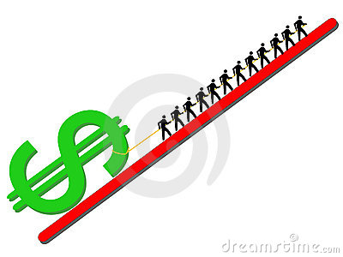
Economic Growth - costs
Demand-pull inflation

Slide 27
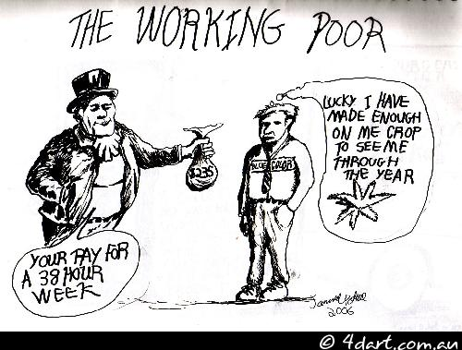
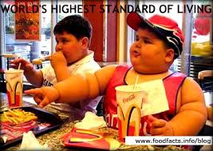
Economic Growth - Costs
Social

Slide 28
Economic Growth – Costs and Benefits
Do the benefits of economic growth outweigh the costs?

