Slide 1
Macroeconomic
2.3

Slide 2
Macroeconomic Objectives
Low unemployment (as measured by the unemployment rate)
Low and stable rate of inflation (as measured by the Consumer Price Index)
Economic growth (as measured by Gross Domestic Product)
Equity in the distribution of income

Slide 3
Equality vs Equity

Slide 4
Equality vs Equity
Equality in the distribution of income
Each person receives the same income
Equity in the distribution of income
Each person receives a fair income
What is fair?

Slide 5
Equity in the market system
For whom to produce?
Resources
Income
Stuff
(goods and services)

Slide 6
Equity in the market system
Resource ownership is highly unequal
Labour
Land
Capital
Entrepreneurship

Slide 7
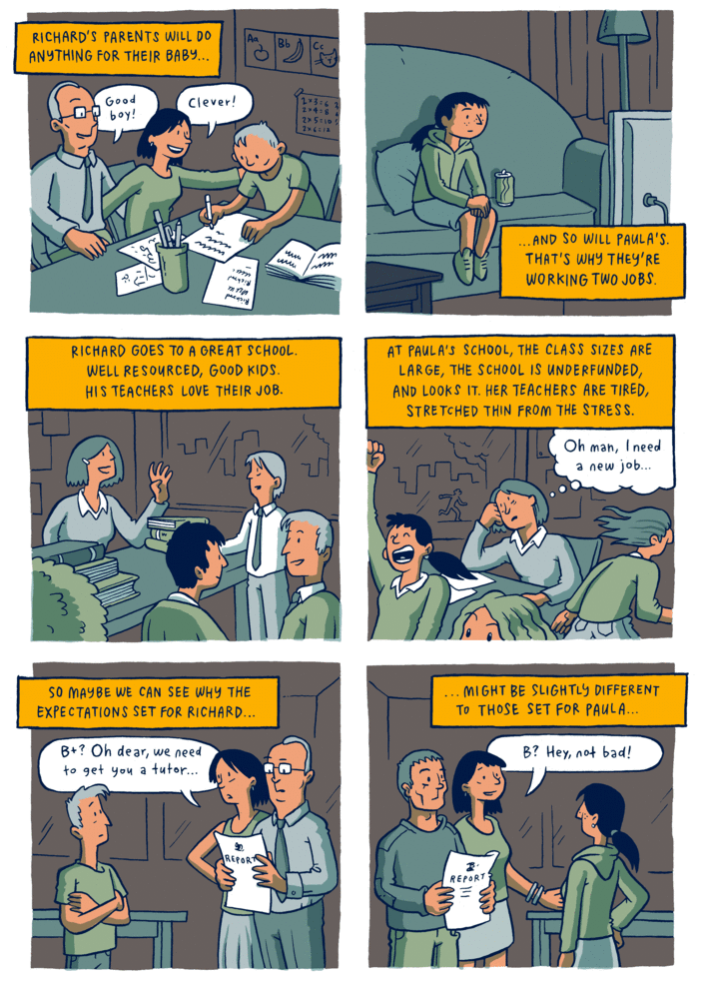
Equity in the market system
The starting point is relevant

Slide 8
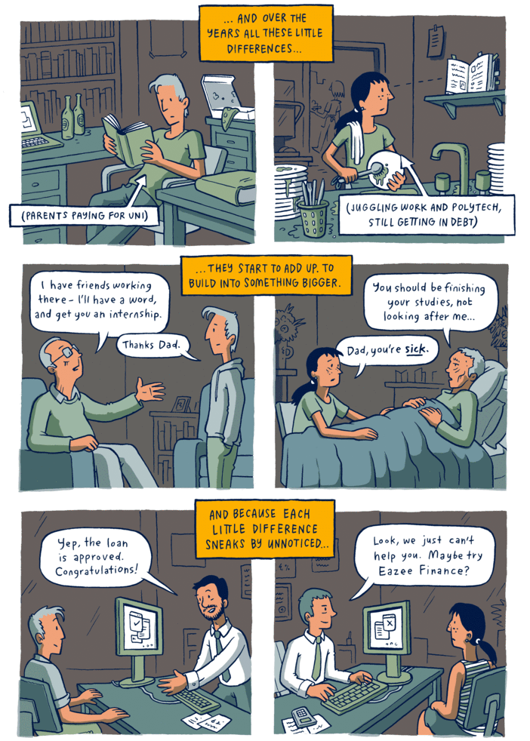

Slide 9
Equity in the market system
A pure market economy cannot guarantee income for the basic needs of all.
Those with non-valued resources will receive insufficient income.
Redistribution of income by Governments

Slide 10
Indicators of income equality/inequality
Quintiles
Deciles
Lorenz curve
Gini Coefficient

Slide 11
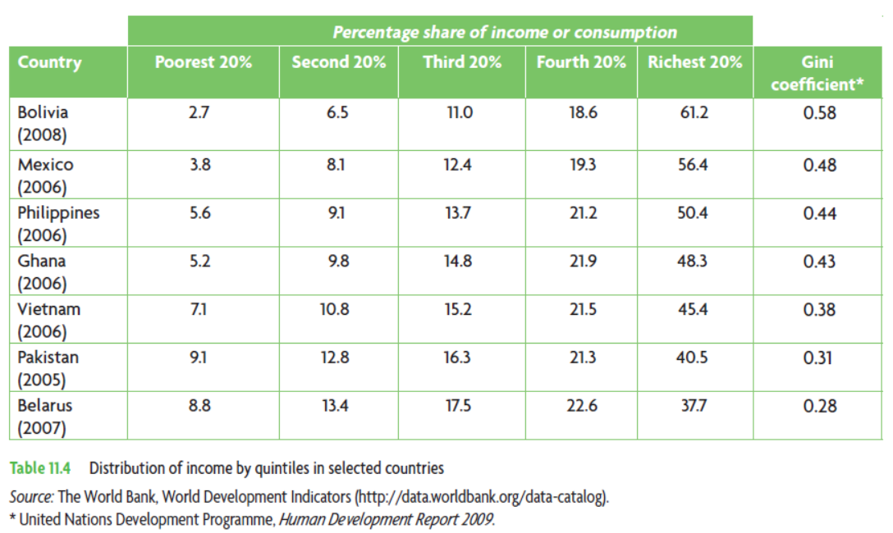
Quintiles
Deciles are the same concept, divided into tenths rather than fifths

Slide 12
Lorenz curve
100
80
60
40
20
Perfect Equality
Cumulative percentage of Income
0
20 40 60 80 100
Cumulative percentage of population

Slide 13
Lorenz curve

Slide 14
Lorenz curve
Country B
100
80
60
55
40
30
20
15
5
Lorenz Curve
(actual distribution)
Quintile | Income share
Poorest 20% | 5
Second 20% | 10
Third 20% | 15
Fourth 20% | 25
Richest 20% | 45
Perfect Equality
Cumulative percentage of income
0
20 40 60 80 100
Cumulative percentage of population

Slide 15
Lorenz curve
100
80
60
55
40
30
20
15
5
Lorenz Curve
(actual distribution)
Perfect Equality
Percent of Income
The size of the banana shows
the degree of
income inequality.
0
20 40 60 80 100
Percent of Families

Slide 16
Lorenz curve
100
80
60
55
40
30
20
15
5
After Distribution
Perfect Equality
Percent of Income
The banana gets smaller when the government re-distributes income
0
20 40 60 80 100
Percent of Families

Slide 17
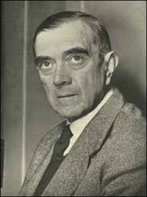
Gini coefficient
A summary of the Lorenz curve, shows the degree of income inequality.
$$Gini Coefficient= \frac{area between diagonal and Lorenz curve}{entire area under diagonal}$$
Always between 0 and 1
0 represents perfect income equality
The greater the number the greater the inequality

Slide 18
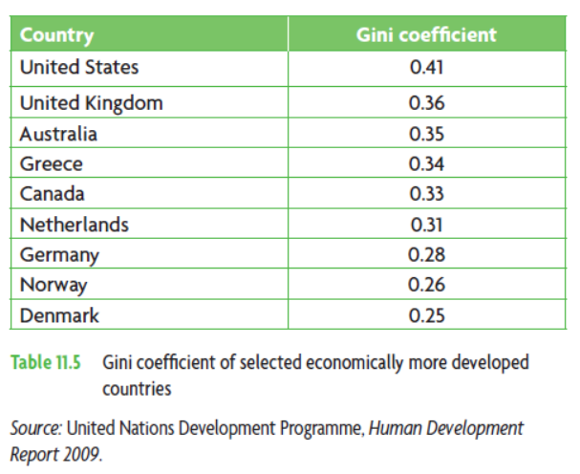
Gini coefficient

