Slide 1
Macroeconomic
2.3

Slide 2
Macroeconomic Objectives
Low unemployment (as measured by the unemployment rate)
Low and stable rate of inflation (as measured by the Consumer Price Index)
Economic growth (as measured by Gross Domestic Product)
Equity in the distribution of income

Slide 3
Equity in the distribution of income - Poverty
Absolute vs Relative
Absolute poverty is the severe deprivation of basic human needs; food, water, health, shelter, education.
Only 1.5 billion people are considered to be in absolute poverty

Slide 4
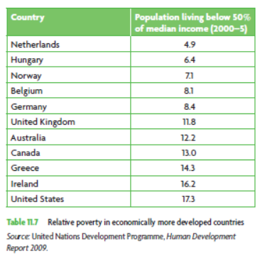
Equity in the distribution of income - Poverty
Relative poverty
Compares the income of individuals or households to the median income.
e.g. a smartphone isn’t a necessity, but you would feel relatively poor if you couldn’t afford one

Slide 5
Equity in the distribution of income - Poverty
Causes of poverty
Low income (obviously)
Unemployment (unemployment benefits are low, and in many countries, expire)
Low human capital (education, health)
Low resource ownership (labour by itself often is insufficient)
Discrimination (race, gender, sexuality)

Slide 6
Equity in the distribution of income - Poverty
Causes of poverty
Geography (lack of opportunities, inability to move)
Age (inability to work, insufficient welfare)
Lack of merit goods (government provided/subsidised health and education)
Poverty (↓ income, ↓ human capital, ↓ income, …)

Slide 7
Equity in the distribution of income - Poverty
Consequences of poverty
Work with the people around you to brainstorm

Slide 8
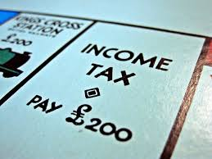
Equity in the distribution of income – redistribution
Taxes
We know what an indirect tax is. GST, alcohol, tobacco and fuel excise.
What is a direct tax?

Slide 9
Equity in the distribution of income - redistribution
Taxes are used to redistribute income.
How?
Brainstorm the different ways in groups. Explain.

Slide 10
Equity in the distribution of income - redistribution
Three concepts of tax
Progressive – as income increases, tax rate increases
Regressive – as income increases, tax rate decreases
Proportional – as income increases tax rate is constant

Slide 11
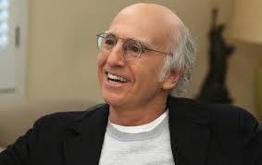
Equity in the distribution of income - redistribution
Why are indirect taxes regressive?
Consider two people, Larry and Jeff
Income: $100,000 $50,000
Purchase: Car - $20,000 Car - $20,000
GST paid: $2,000 (10%) $2,000 (10%)
Tax rate: 2% of income 4% of income
As income increases, tax rate decreases, making it a regressive tax

Slide 12
Equity in the distribution of income – Progressive tax
Australia’s personal income tax rates.
Taxable income | Tax rate | Tax paid
$0 - $18,200 | 0% | 0
$18,201 - $37,000 | 19% | 19c for each $1 over $18,200
$37,001 - $80,000 | 32.5% | $3,572 plus 32.5c for each $1 over $37,000
$80,001 - $180,000 | 37% | $17,547 plus 37c for each $1 over $80,000
$180,001 and over | 45% | $54,547 plus 45c for each $1 over $180,00

Slide 13
Equity in the distribution of income – Progressive tax
Given the below, calculate the amount of tax paid by Jerry, Elaine, George and Kramer.
Jerry’s income - $37,345 per annum
Elaine’s income - $123,978 per annum
George’s income - $186,234 per annum
Kramer’s income - $87,290 per annum
What are their average rates of tax?
Taxable income | Tax rate
$0 - $20,000 | 0%
$20,001 - $39,000 | 15%
$39,001 - $75,000 | 31%
$75,001 - $175,000 | 43%
$175,001 and over | 46%

