Slide 1
Macroeconomic
2.3

Slide 2
Macroeconomic Objectives
Low unemployment (as measured by the unemployment rate)
Low and stable rate of inflation (as measured by the Consumer Price Index)
Economic growth (as measured by Gross Domestic Product)
Equity in the distribution of income

Slide 3
Low and stable rate of inflation
Reading:
Read the following BBC article on inflation
Article
Go to Google Classroom and answer the questions

Slide 4
Low and stable rate of inflation
Inflation:
A sustained increase in the price level.
So that means the price of everything goes up?
No, it’s on average
The prices will go up for everyone?
No, it’s on average

Slide 5
Low and stable rate of inflation
Deflation:
A sustained decrease in the price level. video
Disinflation:
A decrease in the rate of inflation

Slide 6
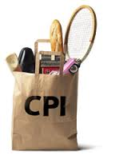
Low and stable rate of inflation - CPI
CPI – Consumer Price Index
Compares the price of a basket of goods and services from year to year.
The basket reflects the consumption
habits of an average household.

Slide 7
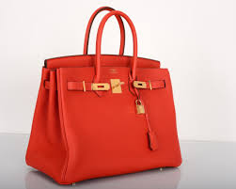
Low and stable rate of inflation
Is CPI a perfect measure?
No, it’s an average, and flawed for other reasons.
CPI differences between income classes
Private school fees
Lexus
Designer handbag
Fancy watches
Price rises in these products are unlikely to affect lower income earners

Slide 8
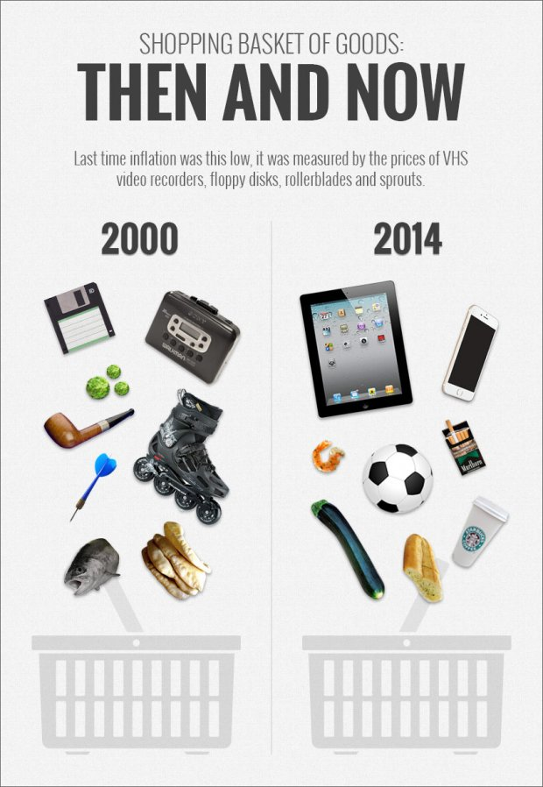
Low and stable rate of inflation
CPI flaws
Consumers often will buy at the sale price
Changes in consumption patterns
Changes in quality
International comparisons are difficult

Slide 9
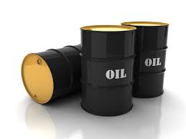
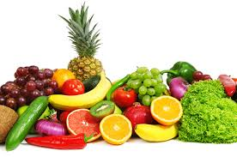
Low and stable rate of inflation – Core/underlying
Headline inflation includes the whole basket
Core (underlying) removes the volatile items
(by now we should know why food prices are volatile)
Headline vs core inflation video

Slide 10
Low and stable rate of inflation - PPI
Producer Price Index
Measures
Prices of inputs
Prices of intermediate goods
Prices of final goods at the wholesale level
What can this tell us about CPI? Show using diagrams.

Slide 11
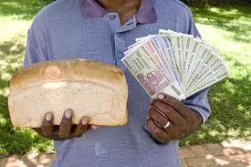
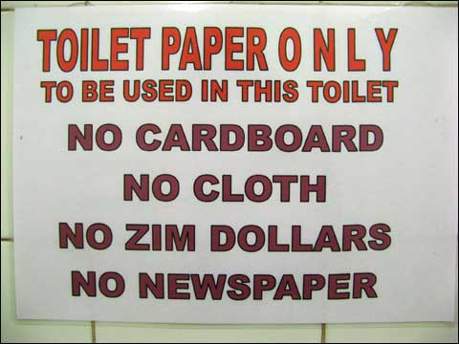
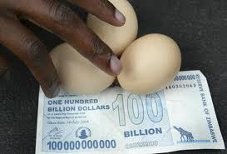
Low and stable rate of inflation
Consequences of inflation
Hyperinflation video
Inflation in Zimbabwe
video

Slide 12
Low and stable rate of inflation
Consequences of inflation – purchasing power
Larry has $60 to spend on shirts – ‘nominal income’
When shirts cost $20 he can buy three.
When inflation hits and shirts cost $30
he can only buy two.
His income hasn’t changed, but his purchasing power has. His ‘real income’ has reduced.

Slide 13
Low and stable rate of inflation
Consequence of inflation – redistributive effects
Some groups gain purchasing power, some groups lose it, purely due to inflation
LOSERS
Fixed income people
pensioners
landlords
welfare recipients
locked-in wages

Slide 14
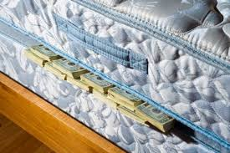
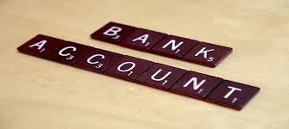
Low and stable rate of inflation
Consequence of inflation – redistributive losers cont’d
Cash holders
- ↑ inflation, real value of cash ↓
Savers
- need interest rate above inflation rate, otherwise real value of savings decreases

Slide 15
Low and stable rate of inflation
Consequences of inflation – redistributive losers cont’d
Lenders
- Lend at say 5% interest
- unexpected inflation of 6% means that lender is worse off

Slide 16
Low and stable rate of inflation
Consequences of inflation – winners
Borrowers
Payers of fixed wages, income

Slide 17
Low and stable rate of inflation
Consequences of inflation – Uncertainty
↑ inflation, harder to make plans, accurate forecasts
↑ uncertainty, ↓ I
Menu costs
The cost of changing prices.

Slide 18
Low and stable rate of inflation
Consequences of inflation
Money illusion
Nominal income increases, but real
income may not.
Poor spending decisions result.

Slide 19
Low and stable rate of inflation
Consequences of inflation
International competitiveness
↑ local inflation, ↑ price of our X, ↓ quantity of X
↑ local inflation, ↑ attractiveness of M, ↑ quantity of M
What does this do to the economy? Think about the Circular Flow model.

Slide 20
Low and stable rate of inflation – review questions
1. Explain what happens to your real income (your purchasing power) in each of the following situations:
a) your nominal income increases by 5% and the rate of inflation is 8%
b) your nominal income falls by 10%, and the rate of
inflation is 3%
c) your nominal income increases by 7% and the rate of inflation is 7%
2. Inflation results in redistribution of purchasing power. Explain who is likely to gain and who is likely to lose from the redistribution effects of inflation.
3. What are some other negative consequences of infl ation (other than redistribution)?

Slide 21
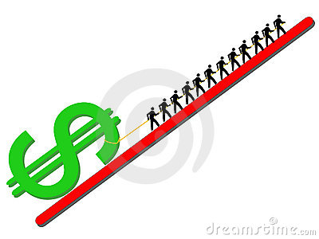
Low and stable rate of inflation – Demand-pull
“Too many dollars chasing too few goods”
Price level
LRAS
SRAS
Pl₁
Pl_{e}
AD₁
AD
0
Y_{e}
Y₁
Real GDP

Slide 22
Low and stable rate of inflation – Cost-push
SRAS₁
Price level
LRAS
SRAS
Pl₁
Pl_{e}
AD
0
Y₁
Y_{e}
Real GDP

Slide 23
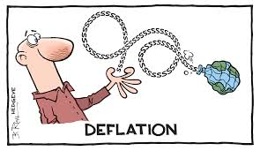
Low and stable rate of inflation - deflation
Sustained fall in the price level.
Redistribution – opposite effects
Uncertainty
Menu costs

Slide 24
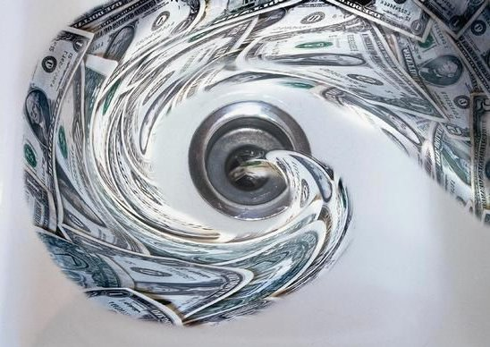
Low and stable rate of inflation - deflation
High cyclical unemployment
↓ price level
↓ incentive to consume
(wait for prices to fall further)
↓ C, ↓ I
↓ production
↑ unemployment
↓ C
↓production
↑ unemployment
…

Slide 25
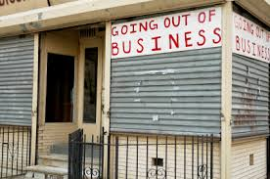
Low and stable rate of inflation - deflation
Bankruptcies
Real value of debt grows as deflation occurs
Debt is harder and harder to pay off
Lack of AD

Slide 26
Low and stable rate of inflation – revision questions
What factors could cause cost-push inflation?
Using diagrams, show the effects on the price level of the following events, and explain whether it is cost-push or demand-pull inflation:
a) Real GDP in foreign countries that trade with your country increases, leading to increased demand for your country’s exports.
b) Businesses are optimistic that a recession is about to end, and so increase investment spending.
c) An increase in housing prices makes consumers increase their consumption expenditures.
d) A sudden increase in the price of oil, a key input in production, occurs.
(a) What are some negative consequences of deflation?
(b) Why can deflation be especially serious for an economy?

