Slide 1
Macroeconomic
2.3

Slide 2
Macroeconomic Objectives
Low unemployment (as measured by the unemployment rate)
Low and stable rate of inflation (as measured by the Consumer Price Index)
Economic growth (as measured by Gross Domestic Product)
Equity in the distribution of income

Slide 3
Macroeconomic Objectives – Low and stable inflation
Now we can cover this:
Evaluate government policies to deal with the different
types of inflation.
Draw demand-pull inflation

Slide 4
Fiscal Policy – How it works
Closing an inflationary gap (Contractionary fiscal policy)
Price
level
SRAS
Pl_{e}
Pl₁
AD
AD₁
0
Y_{f}
Y_{e}
real GDP

Slide 5
Monetary– How it works
Closing an inflationary gap (Contractionary (tight) monetary policy)
Price
level
SRAS
Pl_{e}
Pl₁
AD
AD₁
0
Y_{f}
Y_{e}
real GDP

Slide 6
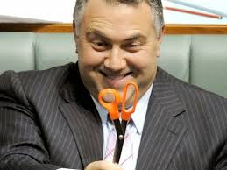
Macroeconomic Objectives – Low and stable inflation
Monetary policy vs Fiscal policy
Fiscal policy - Has a direct effect on AD
but
Political restraints
Time lags
Not as easy to change course

Slide 7
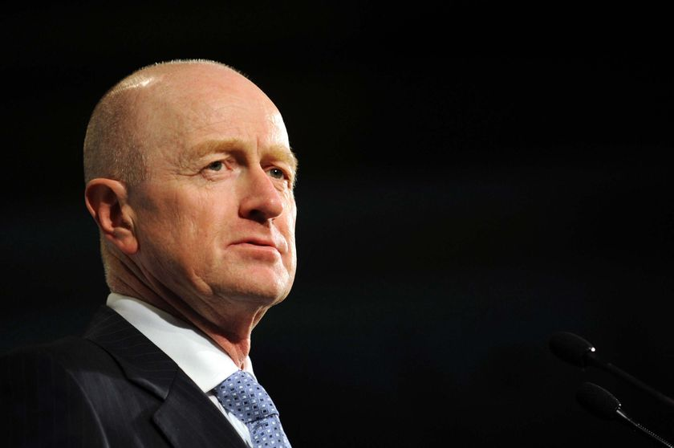
Macroeconomic Objectives – Low and stable inflation
Monetary policy vs Fiscal policy
Monetary policy - Quick implementation
No politics
Can ‘fine tune’ the economy
but
Blunt tool that hits all sectors equally
Time lags

Slide 8
Macroeconomic Objectives – Low and stable inflation
Draw cost-push inflation
Show why demand-side policies are ineffective

Slide 9
Macroeconomic Objectives – Low and stable inflation
A harder problem to solve… it depends on the cause
Wages
Policies to reduce wage growth
Supply shock
Imported

Slide 10
Macroeconomic Objectives – Low and stable inflation

Slide 11
Macroeconomic Objectives – Low and stable inflation

