Slide 1
Macroeconomic
2.3

Slide 2
Macroeconomic Objectives
Low unemployment (as measured by the unemployment rate)
Low and stable rate of inflation (as measured by the Consumer Price Index)
Economic growth (as measured by Gross Domestic Product)
Equity in the distribution of income

Slide 3
Macroeconomic Objectives – Low unemployment
Now we can cover this:
Evaluate government policies to deal with the different
types of unemployment
Draw cyclical unemployment
What types of policies can deal with this?

Slide 4
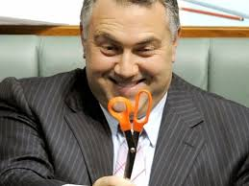
Macroeconomic Objectives – Low unemployment
Monetary policy vs Fiscal policy
Fiscal policy - Has a direct effect on AD
Can pull economy out of recession
but
Political restraints
Time lags
Not as easy to change course
Tax cuts less effective than
spending
Crowding out

Slide 5
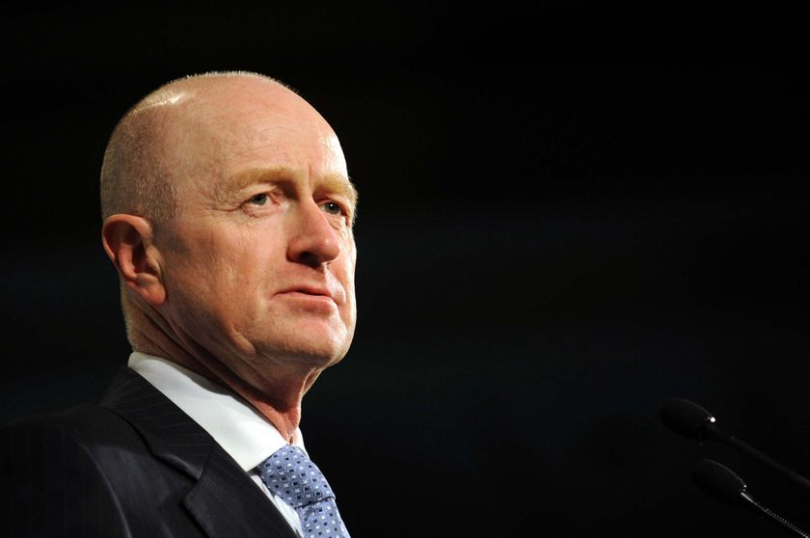
Macroeconomic Objectives – Low unemployment
Monetary policy vs Fiscal policy
Monetary policy - Quick implementation
No politics
Can ‘fine tune’ the economy
but
Blunt tool that hits all sectors equally
Time lags
Will it be effective in a severe recession?

Slide 6
Macroeconomic Objectives – Low unemployment
Reducing the natural rate
Supply-side policies
Interventionist
Market-based

Slide 7
Macroeconomic Objectives – Low and stable inflation
Draw cost-push inflation
Show why demand-side policies are ineffective

Slide 8
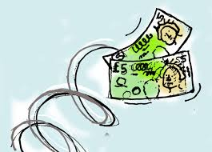
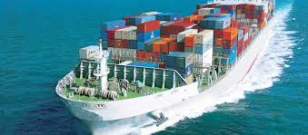
Macroeconomic Objectives – Low and stable inflation
A harder problem to solve… it depends on the cause
Wages
Supply shock
Imported

