Slide 1
Macroeconomic
2.3

Slide 2
Macroeconomic Objectives
Low unemployment (as measured by the unemployment rate)
Low and stable rate of inflation (as measured by the Consumer Price Index)
Economic growth (as measured by Gross Domestic Product)
Equity in the distribution of income

Slide 3
The meaning of unemployment
Definition:
Write your own definition of an unemployed person on your computer
A person of working age who is actively looking for work but who is not employed.
Are you unemployed? video

Slide 4
The meaning of unemployment
Calculating the unemployment rate:
Labour force = Those working at least one hour per week
+
Those actively seeking work
Does not include:
Children, retired, students, ill or disabled, people who can’t be bothered people

Slide 5
The meaning of unemployment
Unemployment rate $= \frac{Total number unemployed}{Labour force} ×100$
e.g.
$\frac{850,000}{11.7m+850,000} ×100=6.7\%$

Slide 6
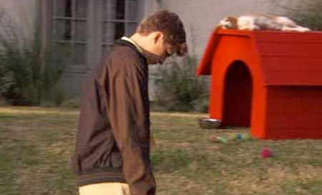
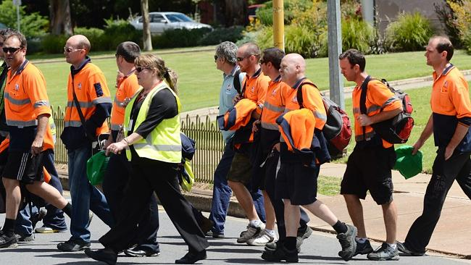
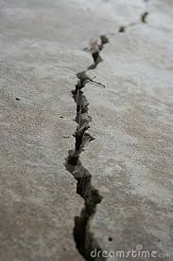
The meaning of unemployment
Hidden unemployment
Discouraged workers
Part-time but want full-time
Walmart
Skilled but working low-skilled
Redundant and retraining
Underground economy

Slide 7
The meaning of unemployment
Lack of specificity
region
gender
ethnicity
age Spain youth unemployment
educational attainment / occupation

Slide 8
The consequences of unemployment - economic
Loss of real GDP
Draw unemployment on a PPC
Draw unemployment on a New Monetarist / Classical AD-AS diagram
Unemployment of resources means that an economy is not producing at its potential

Slide 9
The consequences of unemployment - economic
2. Reduced individual income
No work = ↓ Income
Still make some income – unemployment benefits

Slide 10
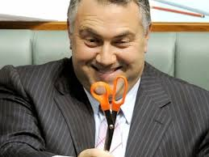
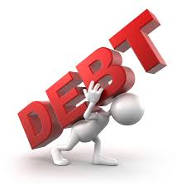
The consequences of unemployment - economic
3. Loss of tax money for the government
May mean spending cuts
May mean increased debt

Slide 11
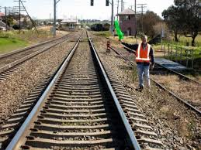
The consequences of unemployment - economic
4. Cost of unemployment benefits
Unemployment ↑, transfer payments ↑
Less government money for other purposes

Slide 12
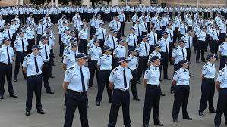
The consequences of unemployment - economic
5. Funding solutions to social problems
Drug programs
Crime prevention

Slide 13
The consequences of unemployment - economic
6. Increased inequality
Unemployed, ↓ income
Employed, maintained income
Unemployed more likely to be disadvantaged already

Slide 14
The consequences of unemployment - economic
7. Unemployed → hardcore unemployed
Easiest time to get a job is when you have one

Slide 15
The consequences of unemployment - social
Scenario: Mr Baum loses his job
“Where will I get another job?”
“How will I pay the mortgage?”
“How much is the New Start Allowance? Will this do?”
Stress

Slide 16
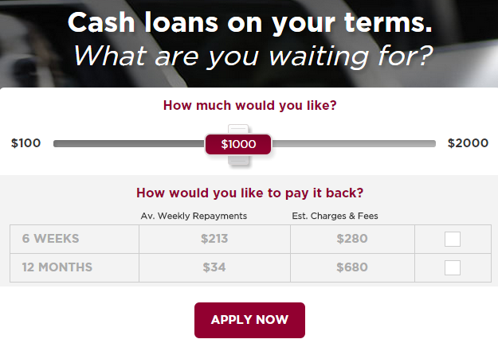
The consequences of unemployment - social
Scenario: Mr Baum loses his job
“Where can I get more money?”
“I saw that ad for Cash Converters?”
“Yep, this seems fair.”
Increased Indebtedness

Slide 17
The consequences of unemployment - social
Scenario: Mr Baum loses his job
Mrs Baum: “This is not the life to which I have become accustomed.”
“You need to get a job and support us.”
“You got a Cash Converters loan? Exactly how stupid are you?”
“Xavi and I are leaving.”
Family breakdown

Slide 18
The consequences of unemployment - social
Scenario: Mr Baum loses his job
“My life sucks.”
“I need a pick me up.”
Drug abuse

Slide 19
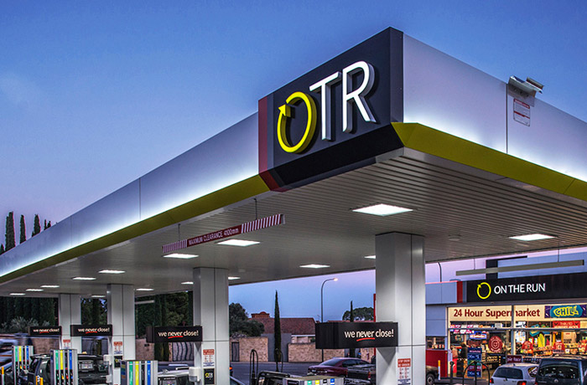
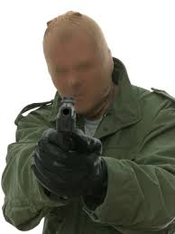
The consequences of unemployment - social
Scenario: Mr Baum loses his job
“I’m in over my head, I need money.”
“That On The Run is poorly guarded.”
Crime

Slide 20
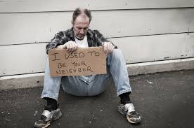
The consequences of unemployment - social
Scenario: Mr Baum loses his job
Mother and Father Baum: “Get out of our house.”
Rental Agent “No income, no rental.”
Friends: “You’re not staying here.”
Homelessness

Slide 21
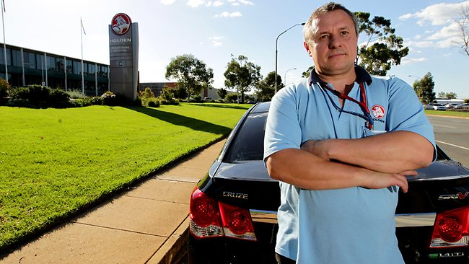
Types and causes of unemployment
Steven Structural
“I just got laid off by Holdens. They were the last car maker. Who’s going to employ me now?”
Occurs when the structure of the
economy changes
Can last months or years
Often result of technological change
Can also be geographical
Certain amount is inevitable in a dynamic, growing economy

Slide 22
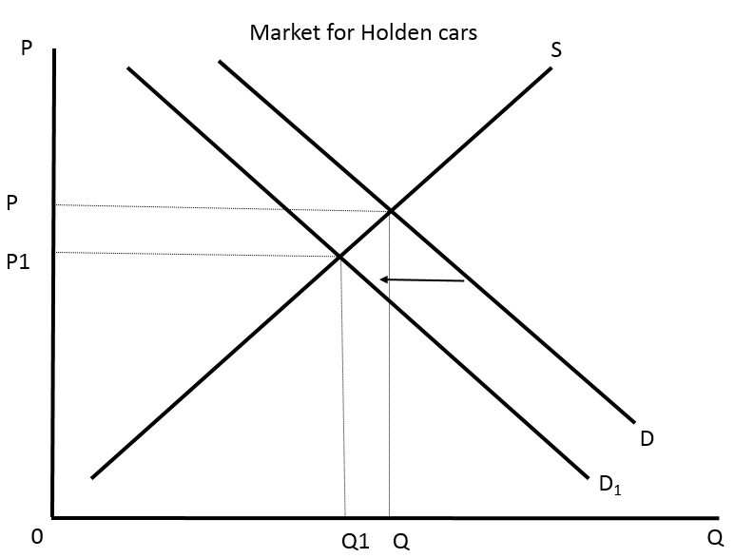
Types and causes of unemployment
Structural unemployment diagrammatically
↓ Demand
Relocating industry
Less Q
Workers fired

Slide 23
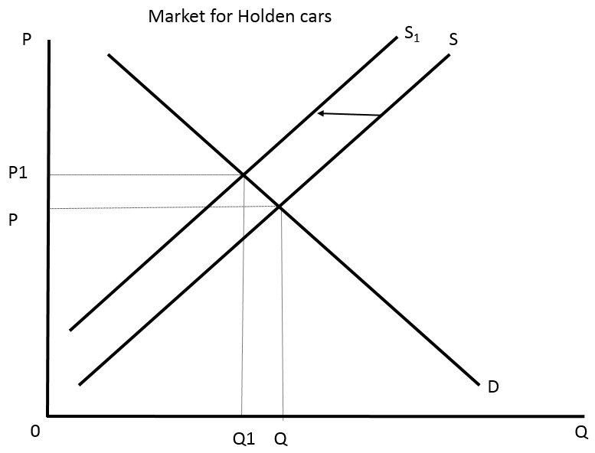
Types and causes of unemployment
Labour market rigidities
Lead to an increase in production costs
Employers hire fewer workers

Slide 24
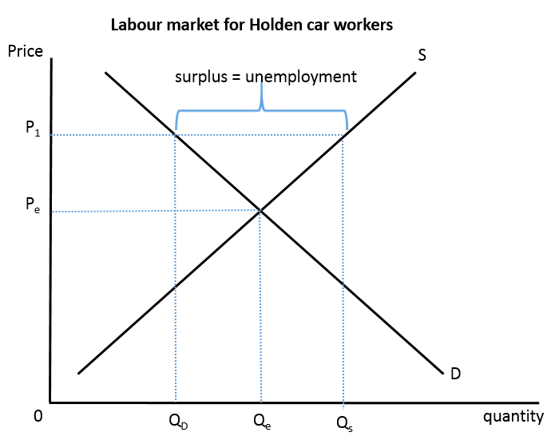
Types and causes of unemployment
Demand and supply can’t function as normal to reach equilibrium. Labour market rigidities (min. wage, union bargaining) keep wages high. Unemployment rather than lower wages.

Slide 25
Types and causes of unemployment
Freddie Frictional
“I’ve just started looking for work after finishing my Economics degree.”
People between jobs
New job seekers (school, uni or TAFE graduates)
People returning to the workforce (mothers, travellers)
Certain amount is inevitable

Slide 26
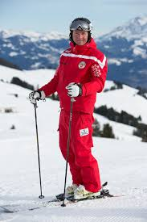
Types and causes of unemployment
Sven Seasonal
“12 hour days in the snow season, then nothing the rest of the year.”
Temporarily unemployed between seasons
Will always exist in some industries
(tourism, agriculture)

Slide 27
Types and causes of unemployment
Susie Cyclical
“I’m an IT Consultant. It’s no surprise that the project is on hold with the way the economy is going. I’ll find something else when things pick up again.”
Caused by lack of demand
↓ demand (products) → ↓ production → ↓ demand (workers)
‘cyclical’ because it goes with the business cycle
AKA ‘demand-deficient’ unemployment
Reflected in AD-AS by a recessionary gap
Draw in both models

Slide 28
Full employment
Full employment does NOT mean 0% unemployment
Four types of unemployment:
Structural
Seasonal
Frictional
Cyclical
Natural rate of unemployment – The unemployment that exists when an economy is operating at full potential.
Estimated to be 5-6%
Natural rate of unemployment

Slide 29
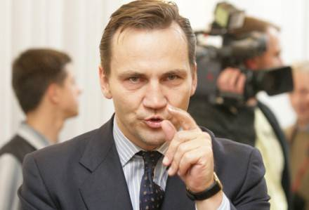
Lie, Damn Lies and Statistics
100 people are lined up at Centrelink to claim their Newstart Allowance.
The Federal member for Arrs Hatt, uses the opportunity to hold a press conference in the Centrelink Office and lambast these “pathetic lazy scum leeching off of society”.

Slide 30
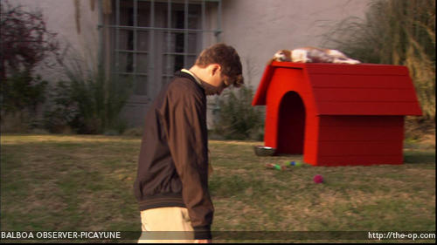
Lie, Damn Lies and Statistics
50 of the people lined up head home in shame, never to seek work again. Thousands more around the country do the same
Ceteris paribus, what happens to the unemployment rate?

Slide 31
Unemployment
Evaluate government policies aimed at reducing unemployment
This and more in sections 2.4, 2.5 and 2.6 of the course

