Slide 1
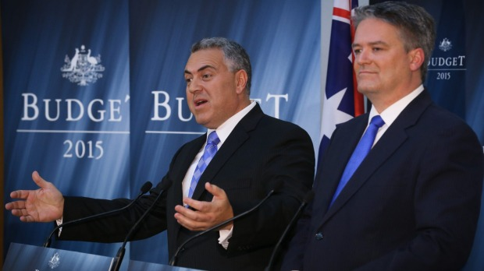
Fiscal Policy
2.4

Slide 2
Fiscal Policy
Definition
Purpose (demand-side management)
The Budget (source of revenue, types of spending, classification)
How it works
Evaluation of Fiscal Policy

Slide 3
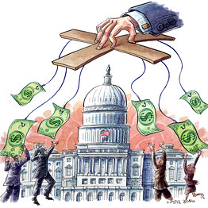
Fiscal Policy - Definition
The spending and taxation plans of government.

Slide 4
Fiscal Policy - Purpose
A demand-side policy
Shifts the AD curve (G is a component of AD)
Draw two AD-AS diagrams, one indicating an inflationary gap, one indicating an unemployment gap

Slide 5
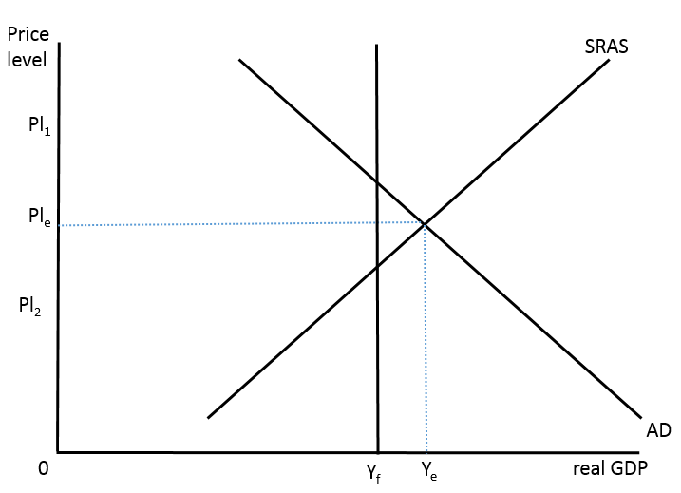
Fiscal Policy - Purpose
Inflationary gap
Too much demand in the economy
Huge demand for resources
Employment increases
Upwards pressure on prices
Output beyond the full employment level

Slide 6
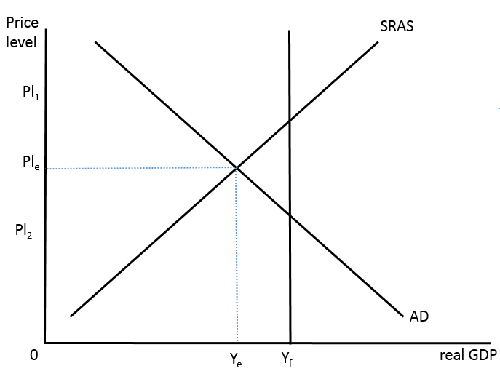
Fiscal Policy - Purpose
Recessionary gap
Not enough demand in the economy
Not worthwhile to produce at capacity
Unemployment less than natural rate

Slide 7
Fiscal Policy
Fiscal policy is the government’s spending plans, so where does the money come from?
Brainstorm

Slide 8
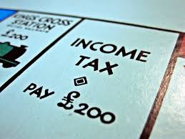
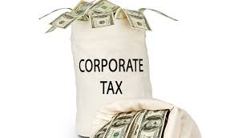
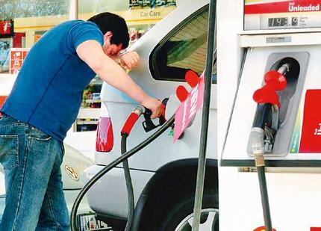
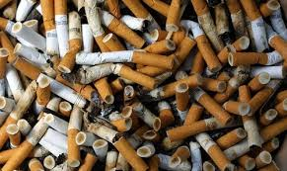
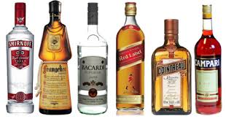
Fiscal Policy – where does the money come from?
Taxes
Direct
Personal income tax
Corporate tax
Wealth taxes
Indirect
Excises
GST

Slide 9
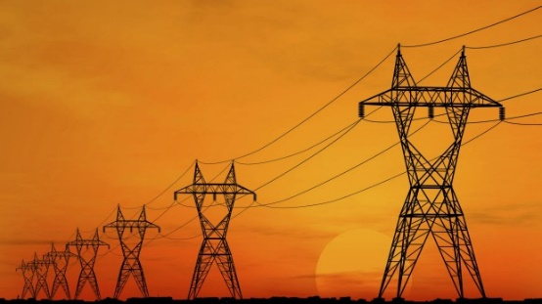
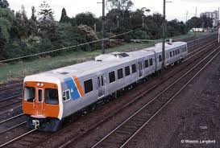
Fiscal Policy – where does the money come from?
Government-owned enterprises
Governments provide public goods but also some user-pays goods and services.
Utilities (water, electricity, gas)
(decreasingly so in Australia)
Transport (rail, bus)
Telecommunications
Post

Slide 10
Fiscal Policy – where does the money come from?
Selling government assets
The sale of government-owned enterprises is known as ‘privatisation’, assets go from public ownership to private ownership.

Slide 11
Fiscal Policy – where does the money come from
Selling government assets
Selling government-owned buildings, then renting them back.
Story

Slide 12
Fiscal Policy – Types of government expenditures
Three types
Current expenditures
Ongoing commitments (salaries, equipment)
Can include ongoing education, health spending
Other services (public lighting, emergency services)
Think of it as ‘consumption’ spending
Capital expenditures
Public investment for the future (hospitals, roads, rail, school buildings, ports)
Physical capital
Infrastructure
Think of it as ‘investment’ spending

Slide 13
Fiscal policy – Types of government expenditures
Transfer payments
Cash payments directly to people
NewStart allowance, Youth Allowance, Austudy
Current
Capital
Transfers
Counted in GDP as ‘G’ (C + I + G + (X – M)
Not counted in GDP as no good or service was produced

Slide 14
Fiscal policy - classification
The budget
revenues > expenditures, budget surplus
revenues < expenditures, budget deficit
revenues = expenditures, balanced budget
Budget deficit, ↑ government (public) debt
(governments must borrow to finance the shortfall)
Budget surplus, ↓ government (public) debt
(governments can use the surplus to repay debt)

