Slide 1
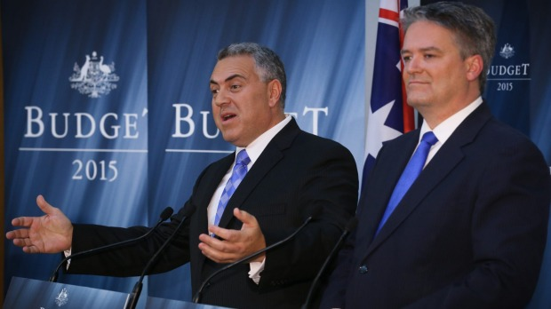
Fiscal Policy
2.4

Slide 2
Fiscal Policy
Definition
Purpose (demand-side management)
The Budget (source of revenue, types of spending, classification)
How it works
Evaluation of Fiscal Policy

Slide 3
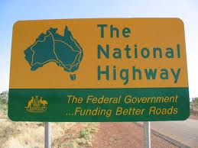
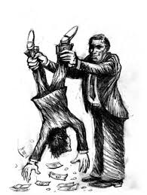
Fiscal Policy – How it works
Changes AD
Fiscal policy can affect C, I, and G
G is changed directly by the government
e.g. spend $6 billion on roads
C can be changed by taxation changes
e.g. an increase in tax reduces disposable income
↓ C

Slide 4
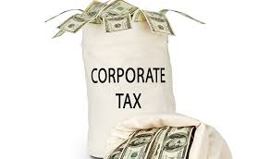
Fiscal Policy – How it works
Changes in AD
I (investment) can be affected by changes in corporate tax
e.g. ↓ corporate tax rate
↑ return on investment
↑ I

Slide 5
Fiscal Policy – How it works
Closing a recessionary gap (Expansionary fiscal policy)
Price
level
SRAS
Increase in AD
↑ Consumption
Personal income tax cut
Transfer payment (welfare) increase
↑ Investment
Business tax cut
↑ Government
Increase in current expenditures
Increase in capital expenditures
Pl₁
Pl_{e}
AD₁
AD
0
Y_{e}
Y_{f}
real GDP

Slide 6
Fiscal Policy – How it works
Closing a recessionary gap (Expansionary fiscal policy)
Model differences
Moneterarist/New Classical
↑ AD, ↑ Price level Always
Keynesian
↑ AD, ↑ Price level Not always
Price
Level
AS
Pl₁
Pl_{e}
AD₂
AD₂
AD₁
AD₁
0
Ye
Ye₂
Ye
Yf
real GDP

Slide 7
Fiscal Policy – How it works
Closing an inflationary gap (Contractionary fiscal policy)
Price
level
Decrease in AD
↓Consumption
Personal income tax rise
Transfer payment (welfare) decrease
↓ Investment
Business tax rise
↓ Government
Decrease in current expenditures
Decrease in capital expenditures
SRAS
Pl_{e}
Pl₁
AD
AD₁
0
Y_{f}
Y_{e}
real GDP

Slide 8
Fiscal Policy – How it works
Closing an inflationary gap (Contractionary fiscal policy)
Model differences
Keynesian
↓ AD, effect on real GDP depends on position on AS
Same decrease in AD, significant difference in real GDP decrease
Price level not always affected
Price
Level
AS
Pl_{e}
Pl₁
AD₁
AD₁
AD₂
AD₂
0
Y₂
Y₁
Ye
real GDP
Yf

Slide 9
Fiscal Policy – How it works
Closing an inflationary gap (Contractionary fiscal policy)
Model differences
Keynesian
↓ AD, effect on real GDP depends on position on AS
Price
Level
AS
Pl_{e}
Pl₁
AD₁
AD₂
0
Ye
real GDP
Yf

Slide 10
Fiscal Policy – How it works
Predominantly a demand-side policy, but can affect supply
Impact on potential output
Indirect impacts
Fiscal policy is used to lessen short-term fluctuations. A more stable economy inspires confidence for investment in technology and capital goods.

Slide 11
Fiscal Policy – How it works
Impact on potential output
Direct impacts
- Government money allocated to infrastructure and research & development
- Government money to invest in human capital

Slide 12
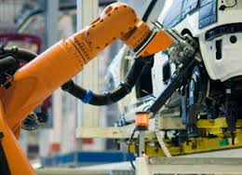
Fiscal Policy – How it works
Impact on potential output
Direct impacts
- Lower business taxes to encourage investment in research and development

Slide 13
Fiscal Policy – How it works
Both Demand and Supply Increase
Price level
LRAS
LRAS₁
SRAS₁
Pl_{e}
AD
AD₁
0
Y_{e}
Y_{e1}
Real GDP

Slide 14
Fiscal Policy – How it works
Both Demand and Supply Increase
Price
Level
AS₁
AS₂
AD₂
AD₁
0
Yf₁
Yf₂
real GDP

Slide 15
Fiscal Policy – How it works
Automatic stabilisers
Factors that help stabilise the economy without the government having to pull any policy levers
Unemployment benefits
As ↓AD, ↓ production, ↓ real GDP, ↓ employment, ↓ C
BUT
↑ unemployment benefits, lessens impact of ↓ C

Slide 16
Fiscal Policy – How it works
Automatic stabilisers
Factors that help stabilise the economy without the government having to pull any policy levers
Progressive income taxes
As ↑AD, ↑ tax revenues
disposable income does not ↑ as much as ↑Y
Progressive taxes automatically stabilise growth

Slide 17
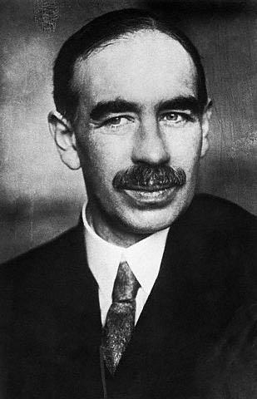
Fiscal Policy – Evaluation
Strengths
Recession busting
Low AD can keep economies in recession due to sticky wages and prices
↑ G and/or ↓ T required to ↑ AD
With the aid of a diagram, explain how Monetarist/New Classical economists believe an unemployment gap is eliminated

Slide 18
Fiscal Policy - Evaluation
Strengths
Deals with demand-pull inflation
When the price level rises too rapidly, contractionary fiscal policy can keep inflation manageable
What is the Reserve Bank of Australia’s stated inflation target?

Slide 19
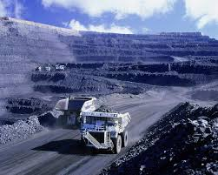
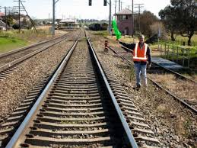
Fiscal Policy - Evaluation
Strengths
Specificity
Can target specific areas of the economy.
e.g. Can raise taxes on certain products/sectors, rather than economy wide.
Can amend spending on certain sectors

Slide 20
Fiscal Policy - Evaluation
Strengths
Directly affects AD
↑ G, ↑ AD, ceteris paribus
↓ G, ↓ AD, ceteris paribus
Can shift potential output

Slide 21
Fiscal Policy - Evaluation
Weaknesses
The multiplier effect
It can be difficult to know the Keynesian multiplier when implementing policy

Slide 22
Fiscal Policy - Evaluation
How much should the government spend to reach Yf?
Price
Level
The government should NOT spend $100b
AS
AD₂
AD₁
0
$400
$500
real GDP
(billions)

Slide 23
Fiscal Policy - Evaluation
Why not $100 billion?
Once money enters the circular flow, a portion of it is spent again and again.
Jerry receives $200 extra income.
Jerry spends $100 on Elaine’s product.
Elaine spends $50 on George’s product.
George spends $25 on Larry’s product.
Larry spends $12.50 on Jeff’s product.
Jeff spends $6.25 on Susie’s product.
There is not perfect knowledge of the Keynesian multiplier

Slide 24
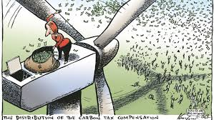
Fiscal Policy - Evaluation
Weaknesses
Time lags
Identify problem
Identify solution
Implement solution
Some fiscal solutions take longer to implement than others
e.g. Infrastructure vs cash giveaway
These take time

Slide 25
Fiscal Policy - Evaluation
Weaknesses
Politics
Two restraints
Must pass parliament
Must be suitably popular so as to remain in government
Tax hikes unpopular
Spending cuts unpopular
Government debt unpopular
Good luck!

Slide 26
Fiscal Policy – Evaluation
Weaknesses
Supply-side ineffectiveness
Tackling supply-side problems with demand-side solutions is problematic
Draw cost-push inflation
Do we use contractionary or expansionary fiscal policy?

Slide 27
Fiscal Policy – Evaluation
Weaknesses
Do tax cuts always work?
If confidence is too low, tax cuts won’t change consumption

Slide 28
Fiscal Policy – Evaluation
Weaknesses
Crowding out (disputed)
When governments borrow to finance spending, they demand loanable money.
This increases the price of loanable money (interest rate)
If ↑ i.r, ↓ I (it is more expensive)
↑ G, rightward shift of AD
↓ I, leftward shift of AD
Crowding out can be partial or complete

Slide 29
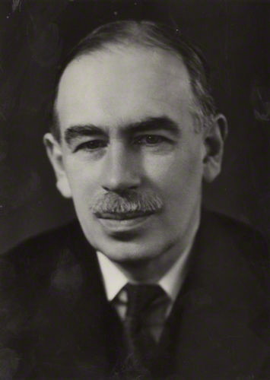
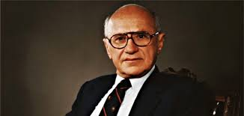
Fiscal Policy - Evaluation
Keynesian view
↑ G, ↑ C
↑ business confidence
↑ I (despite ↑ i.r)
New Classical/Monetarist
↑ G, ↑ i.r, ↓ I

