Slide 1
Macroeconomics
2.6 Supply-side policies (market-based)

Slide 2
Supply-side policies
Role of supply-side policies
Interventionist supply-side policies
Market-based supply-side policies
Evaluation of supply-side policies

Slide 3
Supply-side policies – Market-based
Getting out of the way of the
free market
Letting competition occur
Letting the labour market be a market
Letting incentives do their thing

Slide 4
Supply-side policies – Market-based
Encouraging competition
↑ competition, ↑ efficiency, ↑ productivity
Draw the effect that greater efficiency and productivity will have on an economy (both AD-AS models)

Slide 5
Supply-side policies – Market-based
Encouraging competition
Examples: Privatisation
The selling of government-owned enterprises to the private sector
Why?
Profit motive
(there are incentives for efficiency
and productivity)

Slide 6
Supply-side policies – Market-based
Encouraging competition
Examples: Privatisation
In South Australia, most government-owned enterprises have already been sold (privatised)

Slide 7
Supply-side policies – Market-based
Encouraging competition
Examples: Privatisation
Outsourcing of government operations
Cleaning
Accounting
Legal services
Property management

Slide 8
Supply-side policies – Market-based
Encouraging competition
Examples: Deregulation
Regulation is a form of government intervention, it therefore distorts free-market outcomes.
Economic – Price controls, command economy
Social - Consumer/Society protection

Slide 9
Supply-side policies – Market-based
Encouraging competition
Examples: Deregulation
Cutting the red tape
Current Aus government priority site
e.g. quicker environmental approvals
carbon tax and mining tax repeals
streamlining NHMRC grants process

Slide 10
Supply-side policies – Market-based
Encouraging competition
Examples: Deregulation
Removal of competition barriers

Slide 11
Supply-side policies – Market-based
Drawbacks of deregulation
Consumer protection
Environmental protection
Worker safety

Slide 12
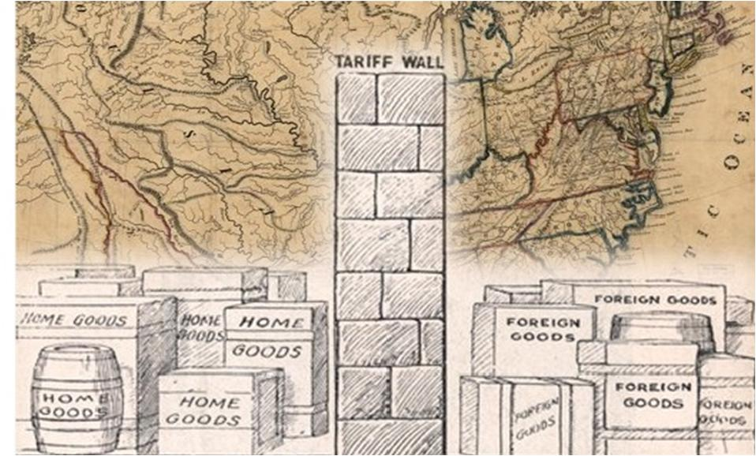
Supply-side policies – Market-based
Encouraging competition
Examples: Trade liberalisation (tariff reform)
The lower the tariffs, the more competition for local industries
A ‘tough love’ policy
Encourages innovation, use of new technology
Reduces cost of imports of capital goods

Slide 13
Supply-side policies – Market-based
Labour market reform
Examples: Minimum wage reform
Draw a demand and supply diagram showing the effects of a minimum wage
↑ firm profits
Increased investment in technology, training, research

Slide 14
Supply-side policies – Market-based
Labour market reform
Examples: Reducing unemployment benefits
↓ income, ↑ incentive to find work
Reducing job security
↓ security, ↓ risk taken by employer
↓ costs, ↑ firm profits, ↑ investment
e.g. University of Adelaide redundancy payments
The voluntary redundancy payment will be calculated as follows:
payment of severance pay calculated on the basis of three (3) weeks salary for every year of completed service with this University to a maximum of 56 weeks

Slide 15
Supply-side policies – Market-based
Incentivising the economy
Examples: Lowering income tax
↑ profits, ↑ willingness to invest
↑ incentive to work
↑ incentive to strive for promotion
↓ incentive to retire

Slide 16
Supply-side policies - Evaluation
Low-inflation growth
Increasing potential output allows room for AD to increase without inflationary pressure.
Efficiency and reduced labour costs keep firms’ costs of production down, flowing through to prices.
However, in the short term, interventionist policies will increase AD.

Slide 17
Supply-side policies - Evaluation
Budget impact
How do Interventionist and Market-based supply-side policies affect the budget?
Interventionist
Programs cost money (education, health, infrastructure)
Market-based
Tax policies mean governments forgo revenue
Or do they?

Slide 18
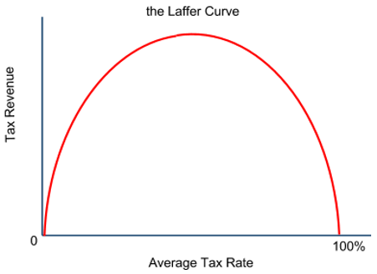
Supply-side policies - Evaluation
Budget impact

Slide 19
Supply-side policies – Evaluation
Interventionist Market-based
Market failure exists, resources aren’t always allocated efficiently
Provide things that the free market will not
Investments in human capital
Investments in infrastructure
Why won’t the free market provide these things?
Require high taxes for funding
The invisible hand will guide us to an efficient allocation of resources.
Government involvement messes with the invisible hand
Why shouldn’t the government involve itself?

Slide 20
Supply-side policies - Evaluation
Equity
How does investment in health and education affect the objective of equity?
Reducing the natural rate of unemployment?
Reducing/abolishing the minimum wage?
Increasing labour market flexibility?
Incentive-related policy?
Privatisation?

Slide 21
Supply-side policies - Evaluation
Environment
Less regulation could lead to degradation
Greater competition can
incentivise firms to find an
‘edge’

