Slide 1
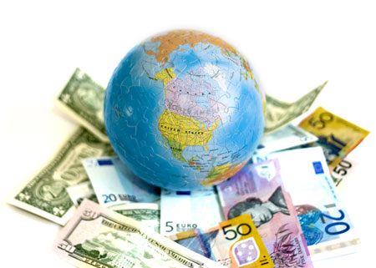
Section 3: International Economics

Slide 2
International Economics
3.1 – International Trade
3.2 – Exchange Rates
3.3 – Balance of Payments
3.4 – Economic Integration
3.5 – Terms of Trade (HL only)

Slide 3
International Trade
Why do we trade?
What does the World Trade Organization do?
How do countries ‘protect’ their industries/companies from free trade?

Slide 4
Why do we trade?
With the people around you, make a list of the last 10 things that you have bought.
Which of these were made overseas?
Why? (i.e. why do we trade?)

Slide 5
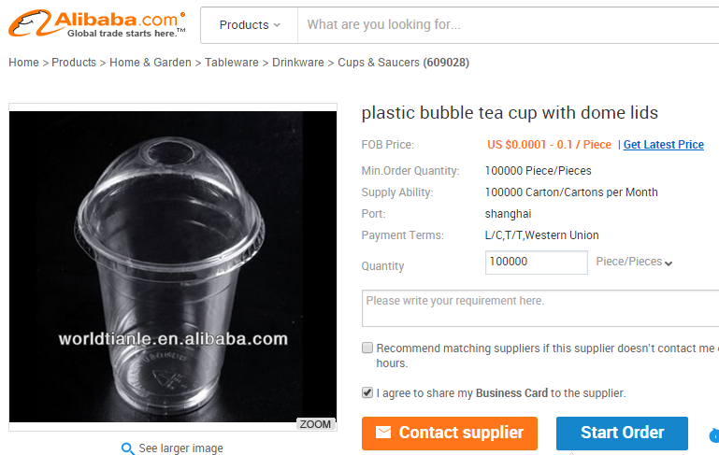
Why do we trade?
Economies of scale
The bigger the operation, the lower the average cost per unit.
e.g.
The Chinese Club want to make bubble tea. If they had a bigger market, their average costs could be much lower.

Slide 6
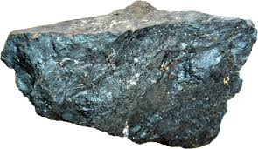
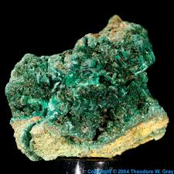
Why do we trade?
To acquire the resources we need
Where did those bubble tea cups come from?
Trade allows access to needed resources.
e.g. China needs our iron ore
India needs our uranium

Slide 7
Why do we trade?
Lower prices
How much did those bubble tea cups cost?
Countries are able to make certain goods or services at a lower cost.
Specialisation
Trade, by opening up larger markets, allows for specialisation by those who can produce efficiently.
What benefits might there be for a country that specialises?

Slide 8
International Economics
Price
S_{d}
CS
P_{d}
PS
D_{d}
0
Q₁
Quantity

Slide 9
International Economics
Price
S_{d}
CS
P_{d}
P_{w}
S_{w}
PS
D_{d}
0
Q₁
Q₂
Q₃
Quantity

Slide 10
Why do we trade?
Choice
The smaller the market, the smaller the choice
Through trade, I can buy TV shows from overseas
Through trade, students can study overseas

Slide 11
Why do we trade?
Increased competition
…and therefore efficiency
The more access local consumers have to imports, the more competition is in the market.
Local producers must become more efficient in order to survive
What would this increased efficiency / productivity look like?

Slide 12
Why do we trade?
Source of foreign exchange
When we sell goods/services we receive foreign currency, which can be used to buy other goods/services.
Reduced likelihood of war
If countries become interdependent due to trade, there is greater disincentive to go to war.

Slide 13
Why do we trade?
Increased transfer of ideas and technology
As more goods and services move around the globe, so does knowledge.
Reverse engineering
Education

Slide 14
Benefits of trade
Draw up a table in your book, explaining how the following groups benefit from trade
Group | How they benefit from trade
Consumers
Producers
Domestic economy and society
Global economy and society

Slide 15
What does the WTO do?
…overriding purpose is to help trade flow as freely as possible – so long as there are no undesirable side effects…
wto.org
161 members
Latest round of negotiations (Doha) ongoing since 2001

Slide 16
What does the WTO do?
Functions
Forum for negotiations
Resolve trade disputes
Monitoring of countries’ trade policies
Technical assistance and training
Based on the principles of:
Non-discrimination – members each receive same trade access
Predictability of trade policies – Why is this important?

Slide 17
What does the WTO do?
Based on the principles of:
Non-discrimination – members each receive same trade access
Predictability of trade policies – Why is this important?
Removal of non-tariff protection
Lowering of tariffs

