Slide 1
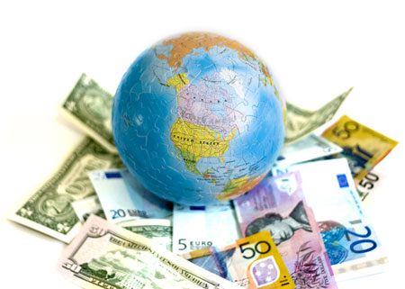
Section 3: International Economics

Slide 2
International Trade
Price
S_{d}
CS
P_{d}
PS
D_{d}
0
Q₁
Quantity

Slide 3
International Trade
Price
S_{d}
CS
P_{d}
P_{w}
S_{w}
PS
D_{d}
0
Q₁
Q₂
Q₃
Quantity

Slide 4
Tariffs
Price
S_{d}
P_{d}
P_{w+t}
S_{w+t}
P_{w}
S_{w}
D_{d}
0
Q₁
Q₂
Q₃
Q₄
Quantity

Slide 5
Quota
Price
S_{d}
S_{d + quota}
P_{d}
P_{q}
P_{w}
P_{w}
S_{w}
quota
D_{d}
0
Q₁
Q₂
Quantity
200
270
520
600

Slide 6
Subsidies
Price
S_{d}
S_{d + subsidy}
P_{s}
subsidy
P_{d}
P_{w}
P_{w}
S_{w}
D_{d}
0
Q₁
Q₃
Q₂
Quantity

