Slide 1
Section 3: International Economics

Slide 2
Trade Protection (Administrative protections)
– Embargoes
– Quarantine
– Standards

Slide 3
Trade Protection (Administrative protections)
Types of protection
Embargo – a ban on importing certain goods to protect local industry
Can be implemented for non-protection reasons
Australia previously had an embargo on foreign sugar

Slide 4
Trade Protection (Administrative protections)
Types of protection
Quarantine – isolation of plants and animals to stop spreading of disease
Limits import viability
Protects local country

Slide 5
Trade Protection (Administrative protections)
Technical specifications – standards that products must meet
Increases costs for foreign producers
Draw the effect of Australia’s requirement for right-hand-drive vehicles on a foreign car maker.
Administrative protections are generally used to protect the health, safety and environment of the local country, rather than the local industries.
There is however the opportunity to use them as industry protection.

Slide 6
Trade Protection – Arguments for
More local production → more local employment
Infant industries require shelter from competitive pressure

Slide 7
Trade Protection – Arguments for
Strategic trade policy
Governments can selectively protect industries with high potential value, generally technology-based.
Japan protected their semiconductor industry to gain comparative advantage

Slide 8
Trade Protection – Arguments for
National security
In times of war, countries argue that they need to have sufficient industry to defend themselves
Arguments extend into protecting secondary industries like steel.
ASC – Adelaide-built warships

Slide 9
Trade Protection – Arguments for
Health, safety and the environment
Good governments try to avoid hurting their people or country
Government revenue from tariffs

Slide 10
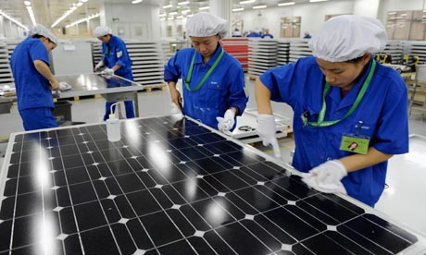
Trade Protection – Arguments for
To prevent ‘dumping’
EU concerned about dumping of Chinese solar panels
Video
How do you prove dumping?

Slide 11
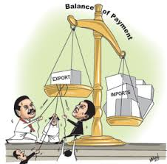
Trade Protection – Arguments for
Fixing the balance of payments
(we learn more about what the balance of payments is in 3.3 – Balance of Payments)
Too much money flowing out to buy imports, not enough flowing in to buy exports

Slide 12
Trade Protection – Arguments against
High consumer prices
Two reasons
1) Imported consumer products subject to quotas / tariffs / standards / quarantine
2) Imported inputs subject to protection also
(Draw this)

Slide 13
Trade Protection – Arguments against
Trade wars
Protection from one country leads to protection from their trade partner

Slide 14
Trade Protection – Arguments against
Corruption
Restrictions on imports can incentivise corruption.
Corruption in Guam

Slide 15
Trade Protection – Arguments against
Reduced export competitiveness
Protection can hurt competitiveness.
e.g. If the local industry is protected from imports, it may not operate as efficiently as possible.
If the factors of production are imported, protection may make these factors more expensive. This would raise the costs for industry.

