Slide 1
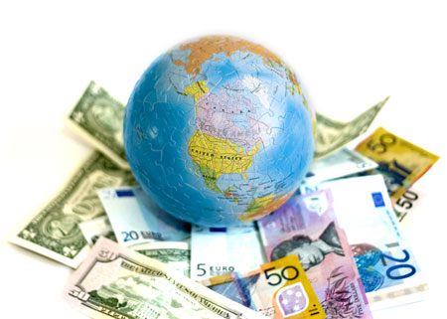
3.2 Exchange Rates

Slide 2
Effects of exchange rate fluctuations
What do exchange rate fluctuations do to inflation?
Producers buy inputs from overseas, a depreciation in the exchange rate makes these more expensive.
Draw this effect
What do we call this type of inflation?

Slide 3
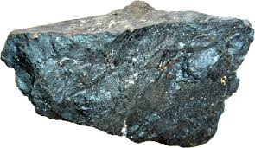
Effects of exchange rate fluctuations
What do exchange rate fluctuations do to inflation?
Depreciation makes imports relatively more expensive, meaning consumers are more likely to switch to domestic consumption.
What happens to our exports?
Draw this effect
What do we call this type of inflation?

Slide 4
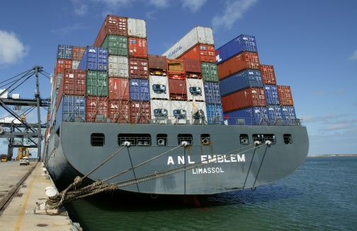
Effects of exchange rate fluctuations
What do exchange rate fluctuations do to growth?
We just saw that net exports increase with a depreciation.
What happens with an appreciation?
Draw this effect

Slide 5
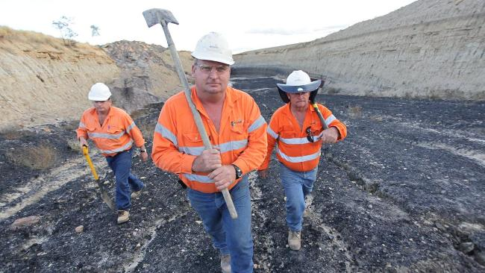
Effects of exchange rate fluctuations
What do exchange rate fluctuations do to employment?
Very much related to growth. A depreciation will reduce cyclical unemployment
What will happen if the economy is already at full employment?

Slide 6
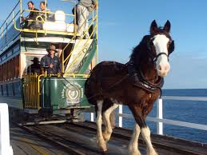
Effects of exchange rate fluctuations
What do exchange rate fluctuations do to the current account?
I last went to Europe in 2012 (Feb and July-Oct).
How many Euros did one Australian dollar buy then?
How many Euros does one Australian dollar buy today?
How does this affect my likelihood to travel?
(ceteris paribus, i.e. forget that I now have a baby/job)

Slide 7
Effects of exchange rate fluctuations
What do exchange rate fluctuations do to the current account?
This effect will occur with many other Australians.
Will more or less money flow out of Australia?
This will also effect the imports of goods
What about our exports? How are they affected by the depreciation?

Slide 8
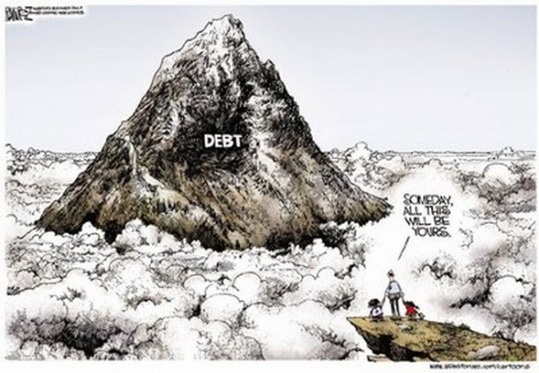
Effects of exchange rate fluctuations
What do exchange rate fluctuations do to the foreign debt?
Let’s say that Australia owes €1b.
If the exchange rate appreciates from $1AUD buying 0.65 euros, to buying 0.80 euros, how is our level of debt affected?

