Slide 1
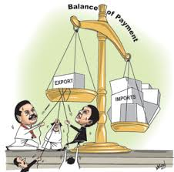
3.3 Balance of Payments

Slide 2
Balance of Payments
What are the balance of payments accounts?
What are the components of these accounts?
What does this have to do with the exchange rate?
HL content will be tackled later

Slide 3
Balance of payments accounts
The IB version…
Current Account
Capital Account
Financial Account
Balance of trade in goods
Balance of trade in services
Income
Current transfers
Capital Transfers
Transactions in non-produced, non-financial assets
Direct investment
Portfolio investment
Reserve assets

Slide 4
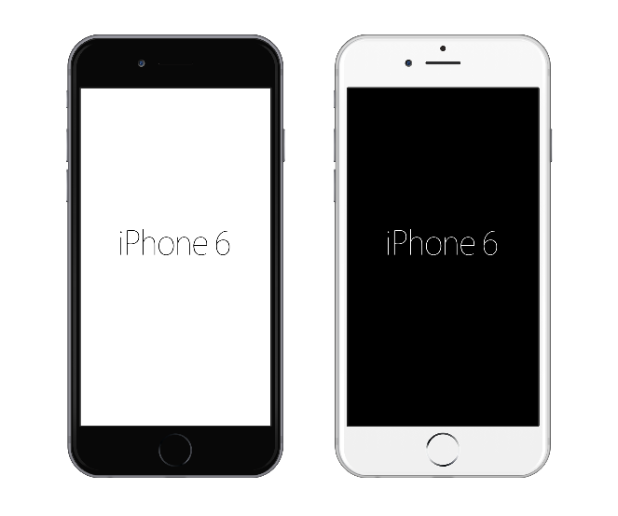
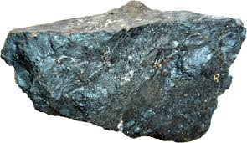
Current Account
Balance of trade in goods
Imports
debit (-) in the current account
Exports
credit (+) in the current account

Slide 5
Current Account
Balance of trade in services
Imports
debit (-) in the current account
Exports
credit (+) in the current account

Slide 6
Current Account
Income
A firm in Australia makes profit and repatriates it to the home country
debit (-) in the current account
An Australian owns foreign shares and
receives dividend earnings
credit (+) in the current account

Slide 7
Current Account
Transfers
An Aussie studying on exchange overseas receives Austudy payments
debit (-) in the current account
British migrants receive their UK pension
credit (+) in the current account

Slide 8
Current Account balance
Consider the current account of the small country of Baumania
Current account | $m
Exports of goods | 85
Imports of goods | 48
Exports of services | 79
Imports of services | 82
Income from abroad | 56
Income payments abroad | 88
Current transfers from abroad | 5
Current transfers paid abroad | 6
Current account balance
positive = current account surplus
negative = current account deficit

Slide 9
Capital Account
Capital transfers
Mostly debt forgiveness
Investment grants
Non-produced and non-financial assets
Forestry leases
Fishing permits
Airspace
Mineral rights
Land rights
Capital account is generally the smallest of the three

Slide 10
Financial Account
Foreign Direct Investment (FDI)
An Australian firm buys factories
in Asia to make their product
Portfolio investment
Foreigners buying shares
in Australian companies
Real estate, government bonds
Reserve assets
Reserves of foreign currency
If RBA sells Pounds for $AUD – credit (+)
If RBA sells $AUD for Pounds – debit (-)
Owning more than 10% of a firm counts as FDI

Slide 11
Errors and omissions
Millions of daily transactions between one country and the rest of the world
Accounting time lags
Undeclared income
Illegal trade
Statistical errors
To ensure balance, a number is added to balance the figures.

Slide 12
Balance of payments
Current Capital Financial Errors and
Account + Account + Account + Omissions = 0
Current Capital Financial Errors and
Account = Account + Account + Omissions

Slide 13
Practice – balance of payments – Australia--Spain
An Andalusian farmer sells $2,500 of green olives to Viva Fine Foods at Burnside Village.
Mr Baum rents a room in a ‘pension’ in Granada for a month for $2,000.
Rafael Nadal retires from tennis and puts $6,000 into starting a tennis academy in Adelaide.
Mr Baum’s brother-in-law spends a semester studying in Valencia, receiving $3,000 in Austudy.
Juan from Barcelona buys shares in Telstra for $3,500
Wendy from Adelaide puts $6,500 into a bank account in Majorca.
Nadal repatriates $500 in profits from his new venture back to Spain.
A Perth pig farmer sells $5,000 worth of suckling pig to a restaurant in Segovia.

Slide 14
Interdependence between current and financial accounts
Current account deficit (CAD)
Exports < Imports
How does the country pay for all the imports?
Financial account surplus
Current account surplus
Exports > Imports
What happens with all the export income?
Financial account deficit
Australia, with persistent CADs, receives a lot of portfolio and direct investment
China uses its current account surpluses to invest heavily in overseas firms and property

Slide 15
The Current Account and the exchange rate
Current account deficit (CAD)
More money flowing out than flowing in.
Price of rupees in US$
Market for rupees
Increase in imports
(ceteris paribus)
Depreciation
Decrease in exports
(ceteris paribus)
Depreciation
S
S₁
e
e₁
D₁
D
0
q₂
q
q₁
Q

Slide 16
The Current Account and the exchange rate
Current account surplus (CAD)
More money flowing out than flowing in.
Price of rupees in US$
Market for rupees
Decrease in imports
(ceteris paribus)
Appreciation
Increase in exports
(ceteris paribus)
Appreciation
S₁
S
e₁
e
D₁
D
0
q₁
q
q₂
Q

