Slide 1
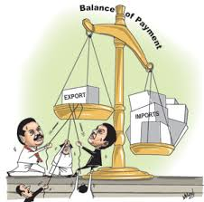
3.3 Balance of Payments

Slide 2
Balance of Payments
Calculate elements of the balance of payments
Discuss implications of a persistent current account deficit
Correct a persistent current account deficit
Understand the Marshall-Lerner condition
Understand the J-curve
Discuss implications of a persistent current account surplus

Slide 3
Calculate elements of the balance of payments
Current Account
Export of goods | + 420
Imports of goods | 635
Balance of trade in goods
Exports of services | + 87
Imports of services | - 103
Balance of trade in services
Balance of trade in goods and services
Income | + 47
Current transfers | + 52
Capital account
Capital transfers | - 15
Transactions in non-produced, non-financial assets | + 21
Balance on capital account
Financial account
Direct investment | + 120
Portfolio investment | + 18
Reserve assets | 7
Balance on financial account
Errors and omissions
Balance

Slide 4
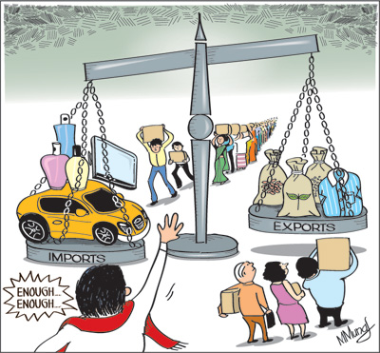
Implications of a persistent current account deficit
Exchange rates
Interest rates
Indebtedness
Credit ratings
Demand
Foreign ownership

Slide 5
Implications of a persistent current account deficit
Price of rupees in US$
Market for rupees
Increase in imports
(ceteris paribus)
Depreciation
Decrease in exports
(ceteris paribus)
Depreciation
S
S₁
e
Can lead to imported inflation How?
Can lead to stagflation Draw
Excessive borrowing can lead to a default risk – currency leaves the country
Debt servicing difficulties
e₁
D₁
D
0
q₂
q
q₁
Q

Slide 6
Implications of a persistent current account deficit
Higher interest rates
Induce foreign financial (portfolio) investment
What effect might this have on the exchange rate?
What negative effects might this have?

Slide 7
Implications of a persistent current account deficit
Indebtedness
CADs are often financed through foreign debt
Debt repayments must be made
Lower living standards in the future
Risk of default

Slide 8
Implications of a persistent current account deficit
Poor credit rating
Higher interest on loans
Higher debt repayments
Lower living standards in the future
Foreign debt no longer an option

Slide 9
Implications of a persistent current account deficit
Can borrowing from abroad be good?

Slide 10
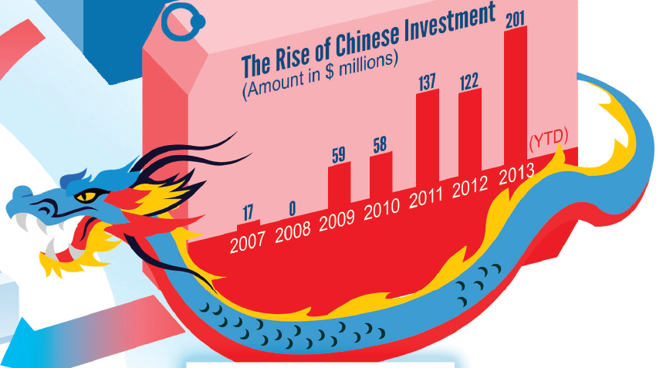
Implications of a persistent current account deficit
Foreign ownership of assets
Foreign investment can balance CADs
The ‘debt’ is that these assets do not produce local income

Slide 11
Correcting a persistent current account deficit
Expenditure-reducing policies
Reducing AD
How do governments do this?
Draw it
What are the disadvantages of this approach?
AD

Slide 12
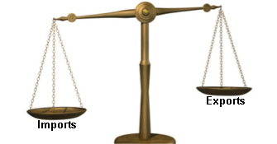
Correcting a persistent current account deficit
Expenditure-switching policies
How can governments achieve this?
What are the disadvantages?

Slide 13
Correcting a persistent current account deficit
Supply-side policies
Market-based Interventionist
What are the disadvantages of these?

Slide 14
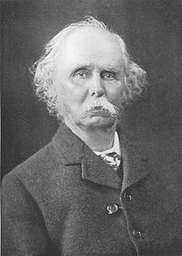
The Marshall-Lerner Condition
For a currency devaluation/depreciation to have a positive impact on trade balance, the sum of price elasticity of export and imports must be greater than 1.

Slide 15
The Marshall-Lerner condition
Price elasticity of demand for imports (PED_{m})
PED_{m} > 1
Depreciation
= fewer M
P
Import basket A
P₁
New M expenditure
P
D
Ceteris paribus, what is the effect on the current account?
Lost M expenditure
Q₁
Q
0
Q

Slide 16
The Marshall-Lerner condition
PED_{m} < 1
Depreciation
= more M
Import basket B
P
P₁
New M expenditure
P
Ceteris paribus, what is the effect on the current account?
Lost M expenditure
D
Q₁
0
Q
Q

Slide 17
The Marshall-Lerner condition
Price elasticity of demand for exports (PED_{x})
PED_{x} > 1
Depreciation
= more X
P
Export basket C
P
Lost X revenue
P₁
D
Ceteris paribus, what is the effect on the current account?
New X revenue
Q₁
Q
0
Q

Slide 18
The Marshall-Lerner condition
PED_{x} < 1
Depreciation
= more X
Export basket D
P
P
Lost X revenue
P₁
Ceteris paribus, what is the effect on the current account?
New X revenue
D
Q₁
0
Q
Q

Slide 19
The Marshall-Lerner condition
Can be a positive effect on current account balance even if PED_{x} and PED_{m} are inelastic as long as:
PED_{x} + PED_{m} > 1
Remember, export prices don’t actually fall
Export revenue will always increase

Slide 20
The J-curve effect
Current account balance
Even if Marshall-Lerner condition holds, PED_{x} + PED_{m} >1, trade balance can worse in the short-term
Current account surplus
Time of devaluation / depreciation
0
Time
Current account deficit

Slide 21
The J-curve effect
Why?
PED is more inelastic in the short run
Consumption habits are habits
Substitute imports need to be found
PES (sort of)
Exporters may take time to take advantage

Slide 22
Implications of a persistent current account surplus
Outward foreign investment
Asset for years to come
article

Slide 23
Implications of a persistent current account surplus
Current vs future living standards
Lack of I
Currency appreciation

