Slide 1
3.4 Economic Integration

Slide 2
Economic Integration
What is economic integration?
Preferential trade agreements
Trading blocs
Monetary unions

Slide 3
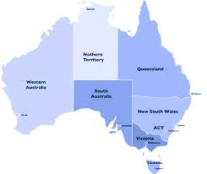
What is economic integration?
The unification of economic policies through the reduction or removal of tariffs and other trade protection methods.
Australian states have unified economic policies. There are no tariffs or trade protection
The more economically
integrated countries become
with each other, the more
they become like one country

Slide 4
Preferential trade agreements
Free Trade Agreements
An agreement between countries, to the exclusion of others, to reduce the barriers to free trade.
“countries cannot discriminate between their trading partners”
Bilateral and Multilateral free-trade agreements are an exception

Slide 5
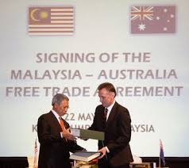
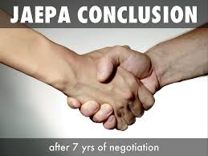
Australia’s free trade agreements
Bilateral
One missing

Slide 6
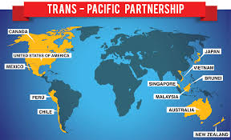
Australia’s free trade agreements
Multilateral

Slide 7
Trading blocs
Distinguish between a free trade area, a customs union and a common market.
Free trade area = a group of countries operating under a
multilateral FTA
Each free to pursue their
own agreements with other
countries

Slide 8
Trading blocs
Distinguish between a free trade area, a customs union and a common market.
Re-export tariffs or ‘rule-of-origin’ - Beef
ASEAN
2%
TAFTA
5%
No agreement
WTO tariffs apply
(say 10%)

Slide 9
Trading blocs
Customs union
A beefed up free-trade area.
The union treats all non-members equally
Negotiate with non-members
as a group
Cannot reach an FTA with a single member

Slide 10
Trading blocs
Common market
Further integration from a customs union.
Factors of production are movable between member countries
No restrictions on labour mobility, capital mobility, land purchasing

Slide 11
Trading blocs
Common market
Requires greater policy coordination
e.g. product specifications and technical standards
EU – if accepted in one country, accepted by all
with free mobility, labour, competition and financial rules must converge
Central power to make decisions

Slide 12
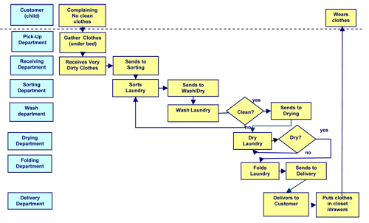
Why move towards a trading bloc?
Less market distortion
increased consumer welfare
Increased competition
domestic producers must compete
with lowest-cost competitor in the bloc
Improved resource allocation
A glut of engineers in Italy could fill a shortage in France
Spread of technology and innovation
due to labour and capital mobility
Peace
Interdependence
Scale
Larger, protection-free market

Slide 13
Why keep out of a trading bloc?
Loss of political and economic sovereignty
increased central decision making
e.g. What would happen if one country wants to introduce a higher tobacco tax?
environmental laws and regulations could reduced to the lowest common denominator
Freer mergers and acquisitions
Could lead to abuse of market power by monopolies and oligopolies

Slide 14
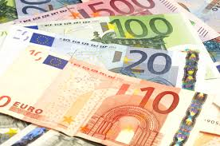
Monetary unions
Even greater economic integration
Common currency and central bank

Slide 15
Monetary unions - advantages
Exchange rate certainty
Can set up trade with confidence
Exchange rate costs
At least 1-2% is common for foreign exchange. Estimated to have saved 1% of Eurozone GDP.
Price transparency
Can compare prices easily between
countries. Sparks competition.

Slide 16
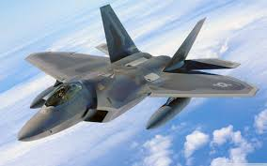
Monetary unions - advantages
Inward investment
Exporters face currency risk.
Setting up in a monetary union
provides a large market with no
currency risk.
Shared international perspective
Can share defence costs, foreign policy. Increased interdependence
leads to increased harmony.

Slide 17
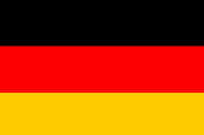
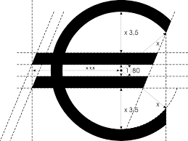
Monetary unions - disadvantages
Economic asymmetry
Sharing a currency =/= sharing
economic outcomes
Loss of monetary policy
Divergent inflation figures need
different policy responses.
Reduced fiscal policy independence
Deficit and debt limits
Exchange rates can’t stabilise trade deficits
Transition costs

