Slide 1
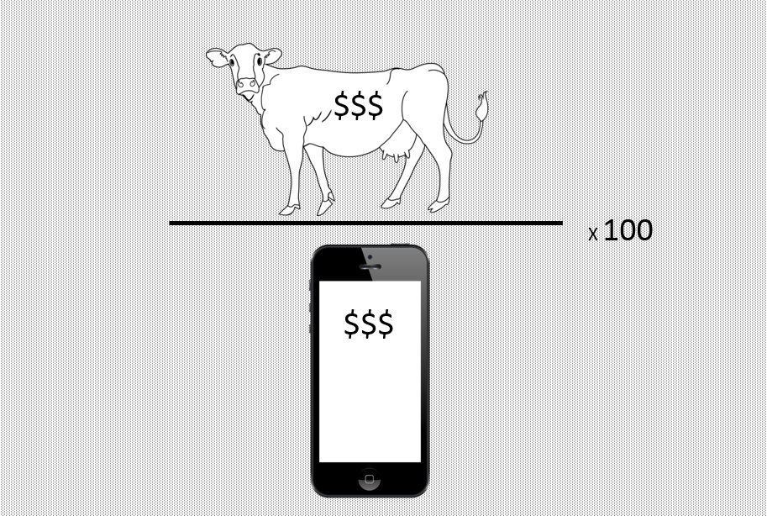
3.5 Terms of Trade
HL content

Slide 2
Terms of Trade
A ratio of average export prices to average import prices
How many iphones does Australia
get for a tonne of wool?
$$Terms of Trade= \frac{weighted average of export prices}{weighted average of import prices} ×100$$
Put together in indices much like CPI (section 2.3 HL)
Calculated from a base year (100)

Slide 3
Terms of Trade
Fill in the missing values below (2007 base year)
Terms of Trade for Baumistan
Have the terms of trade for Baumistan improved or deteriorated?
 | 2007 | 2008 | 2009 | 2010
Average price of X |  | 112 | 119 | 123
Average price of M |  | 115 |  | 125
Index of ToT | 100 |  | 101.7

Slide 4
Terms of Trade
Improvement in the Terms of Trade:
When export prices increase relative to import prices
Deterioration in the Terms of Trade:
When export prices fall relative to import prices

Slide 5
Causes of changes in the Terms of Trade
Short-term changes
Exchange rates
Draw a depreciation in the Australian dollar relative to the US dollar
What does this do to Australian import prices?
What does this do Australia’s Terms of Trade?

Slide 6
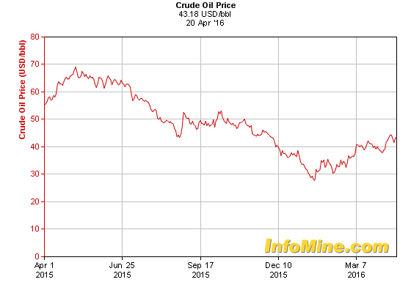
Causes of changes in the Terms of Trade
Short-term changes
Supply and Demand
How does this situation affect Saudi Arabia’s Terms of Trade?

Slide 7
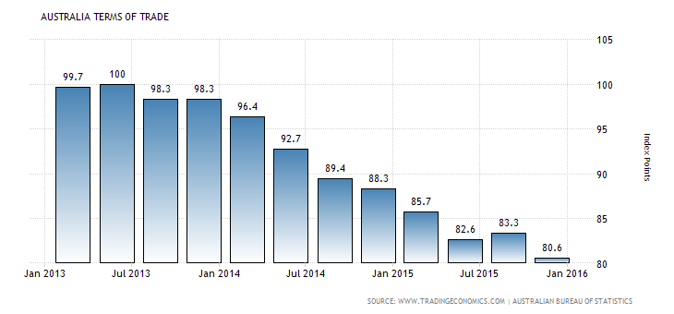
Causes of changes in the Terms of Trade
Explain why this has happened
Answer on Google Classroom

Slide 8
Causes of changes Terms of Trade
Short-term changes
Inflation
South Korea’s inflation increases by 6%
Japan, a major trading partner, has inflation of 0.5%
What does this do to Korea’s Terms of Trade?
Japan’s?

Slide 9
Causes of changes in the Terms of Trade
Long-term changes
Productivity
Draw an increase in productivity in an AD-AS diagram
How will this impact this country’s Terms of Trade?

Slide 10
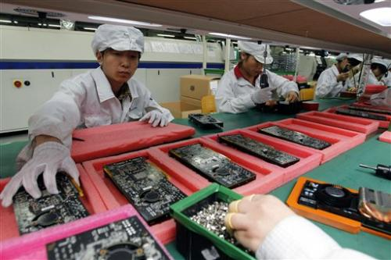
Causes of changes in the Terms of Trade
Long-term changes
Long-term growth rates
Which has a higher YED?
Primary goods Manufactured goods
What does this imply for the relative prices of these goods?
What does this imply for Terms of Trade for LDCs?

Slide 11
Effects on Terms of Trade
(a) There is a fall in global demand for country X’s main exports.
(b) There is an increase in incomes of a country X’s main trading partners, influencing the demand for country X’s exports of manufactured products (with a YED > 1).
(c) Drought reduces the global supply of wheat, and country X is a wheat exporter.
(d) OPEC restricts the supply oil, and country X is an oil importer.
(e) There is an increase in labour productivity in country X, affecting country X’s export industries.
(f) Expansionary fiscal policy in country X leads to an increase in aggregate demand causing an increase in the rate of inflation relative to other countries.
(g) The European Union and the United States decide to eliminate subsidies on agricultural products, which country X produces for export.

Slide 12
Consequences of changes in the Terms of Trade
Global income redistribution
Countries with improving Terms of Trade:
Countries with deteriorating Terms of Trade:

Slide 13
Consequences of changes in the Terms of Trade
Current account
A change in the terms of trade leads to an improvement in the balance of trade (a smaller trade deficit or a larger trade surplus) if it causes an increase in the value of exports or a decrease in the value of imports.
If Baumistan export prices decrease, ceteris paribus, will this worsen the current account balance?
Not necessarily. It depends on elasticities.

Slide 14
Consequences of changes in the Terms of Trade
PED
Baumistan exports corn
Draw the effects of a bumper world crop of corn
What happens to their current account?
Japan exports computers. Indonesia boosts its computer production, lowering the world price.
Draw this effect
What happens to Japan’s current account?

Slide 15
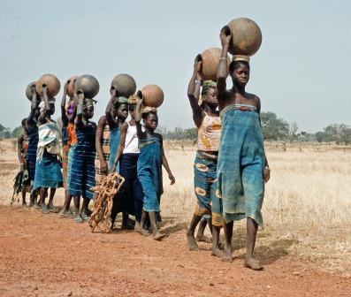
Consequences of changes in the Terms of Trade
LDCs
Low YED for primary products
Low PED for primary products
Huge supply increase due to technology, improved methods
Low PES for primary products
Draw an increase in demand for a primary commodity

Slide 16
Consequences of changes in the Terms of Trade
Fluctuations in Terms of Trade
Windfall gains
Unpredictable
Not always spent wisely
Tough for investment confidence
Do not encourage economic diversification

Slide 17
Consequences of changes in the Terms of Trade
Long-term deterioration for LDCs
Cost of imports rises – inputs needed for investment
Debt incurred to pay for imports
Exports become more crucial.
Potential overallocation of resources to this end
Reduced living standards
Poverty

