Slide 1
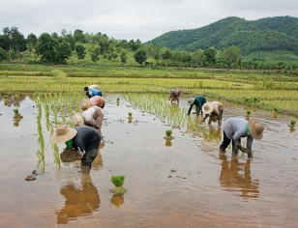
4.1 Economic Development

Slide 2
Economic Development
What is economic development?
How are economic development and economic growth related?
What do economically less developed countries have in common?
How do economically less developed nations differ from each other?
How is the world going with economic development?

Slide 3
What is economic development?
Definition
A process to improve the lives of all the people in a country.
This involves not only raising living standards, i.e. the production of goods and services, but the promotion of self esteem, dignity and respect, and the enlarging of people’s freedom to choose and to take control of their own lives
Growth can be a key driver.
Define GDP growth
How can growth help lift people out of poverty?
Video

Slide 4
Economic development and economic growth
What is wrong with GDP?
(This is revision)
A Nobel prize winning economist discusses GDP
https://www.youtube.com/watch?v=QUaJMNtW6GA&feature=youtu.be

Slide 5
Economic development and economic growth
Income poverty
A person’s income falls below a poverty line
Human poverty
A person lacks the opportunities that allow them to lead a long, healthy, creative life and to enjoy a decent standard of living, freedom, dignity, self-esteem and the respect of others

Slide 6
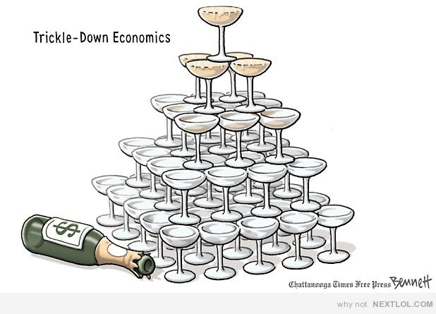
Economic development
Not only about growth:
Increasing income equality growth =/= growth for all

Slide 7
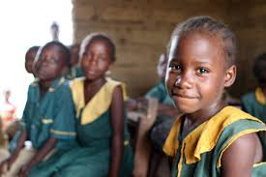
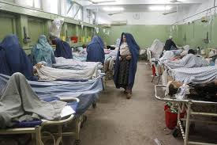
Economic development
Not only about growth:
Increasing opportunities for women and girls
Health care and education

Slide 8
Sources of economic growth
Sources of growth in economically less developed countries
Increases in physical capital
(machinery, tools, factories, buildings, road systems, airports, telephone lines)
All of these increase the productivity of labour
Draw an increase in labour productivity on an AD-AS diagram

Slide 9
Sources of economic growth
Increases in human capital
Defined as fundamental human rights in the United Nations Universal Declaration of Human Rights (1948)

Slide 10
Sources of economic growth
Increases in human capital
In groups, brainstorm positive externalities of education
(What benefits can it bring to a poor country?)

Slide 11
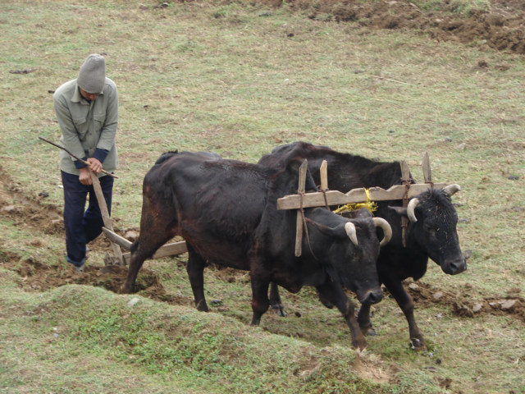
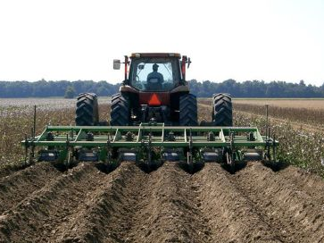
Sources of growth
Increases in technology
Important for technology to be appropriate
(geography, economic conditions, climate)
Often imported from overseas

Slide 12
Sources of growth
Institutional changes
Robust legal system
Enforcement of laws, contracts, dispute resolution
Property rights
Protection against corruption
Fair and transparent tax system
Access to credit
A market economy cannot function without well-developed institutions such as these

Slide 13
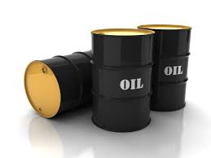
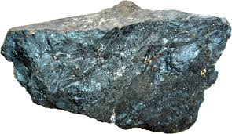
Sources of growth
Natural resources?
Can be a blessing and a curse
e.g. source of conflict
wealth without effort
price variability
political reasons
Dutch disease
Video

Slide 14
Characteristics of LDCs
LDC = Less developed country Current List
Low levels of GDP/GNI per capita
Ethiopia Liechtenstein
GDP GDP
US$13.92 billion US$5.48 billion
GDP per capita GDP per capita
US$580 US$115,000

Slide 15
Characteristics of LDCs
Low levels of GDP/GNI per capita
Still vast differences between LDCs
Somalia Solomon Islands
GNI per capita GNI per capita
US$250 US$1,830

Slide 16
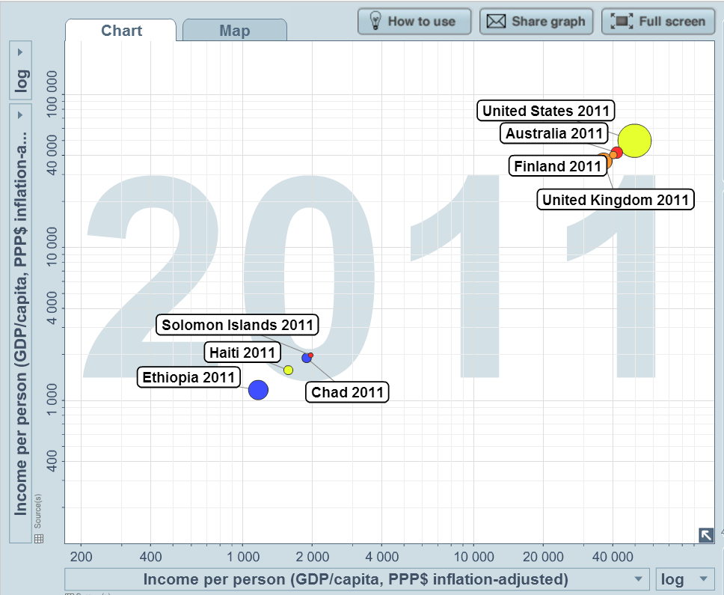
Characteristics of LDCs
Low levels of GDP/GNI per capita www.bit.ly/1L3TqDH

Slide 17
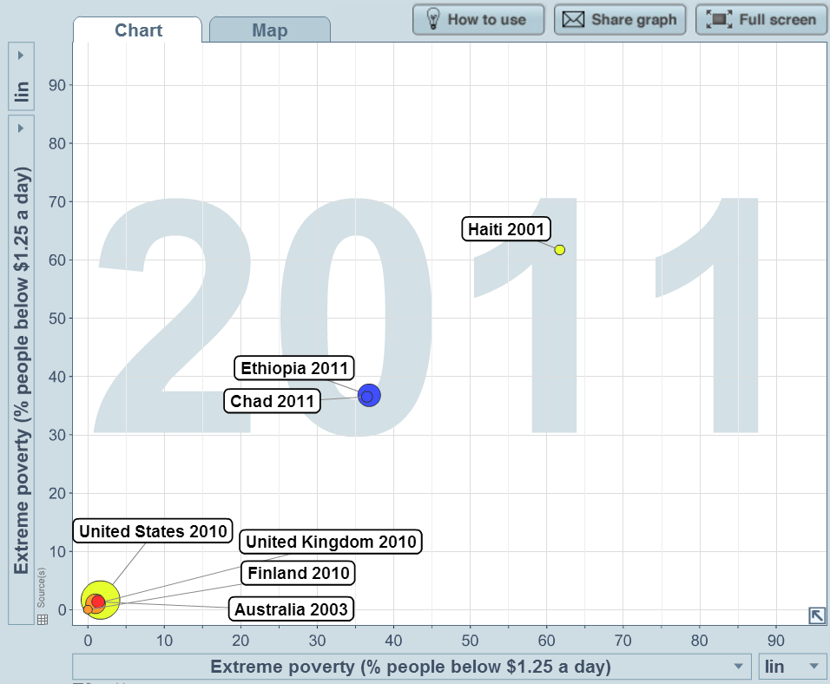
Characteristics of LDCs
High levels of poverty www.bit.ly/1oNAiPL
Moderate poverty – living on less than $2 a day
Extreme poverty – living on less than 1.25 a day

Slide 18
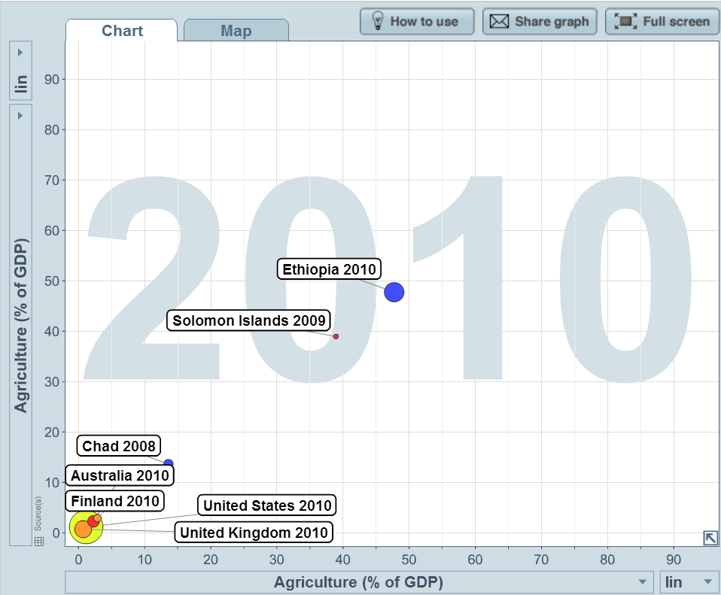
Characteristics of LDCs
Relatively large agricultural sectors www.bit.ly/1oNBjY0

Slide 19
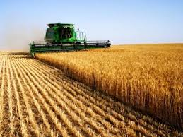
Characteristics of LDCs
Relatively large agricultural sectors
As countries become richer, agriculture’s share of GDP becomes smaller
Poorer Richer

Slide 20
Characteristics of LDCs
Relatively large agricultural sectors
YED e.g, if income grows at 4%, demand for food might grow by 1%.
YED = 0.25
How can we categorise this good?

Slide 21
Characteristics of LDCs
Relatively large agricultural sectors
Also can stay poor due to relatively large agricultural sectors
Can be at the mercy of global food prices. Why?
Agriculture GDP | GDP | Agriculture % share of GDP | GDP growth | YED for food
400,000 | 1,000,000 | 40% | 4% | 0.25
 |  |  | 4% | 0.25
 |  |  | 4% | 0.25
 |  |  | 4% | 0.25
 |  |  | 4% | 0.25

Slide 22
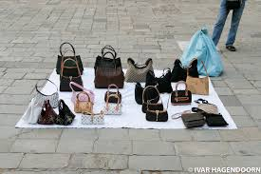
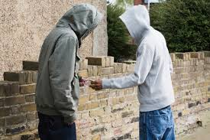
Characteristics of LDCs
Large urban informal sector (unregulated, unregistered)
No worker protection
Exploitation
Environmental concerns
Workplace safety

Slide 23
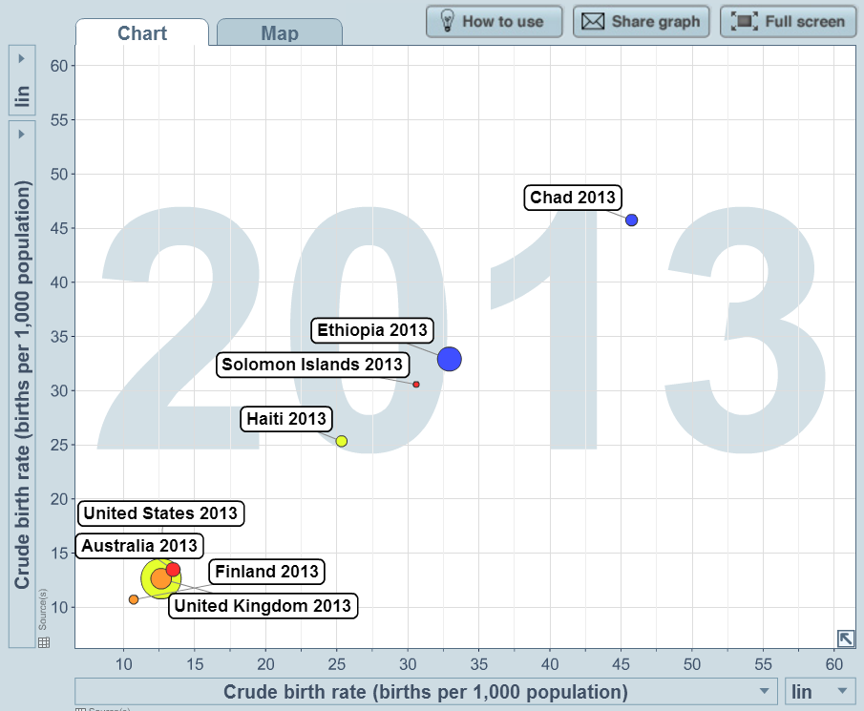
Characteristics of LDCs
High birth rates www.bit.ly/1VPC8KP

Slide 24
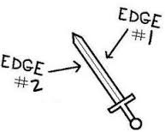
Characteristics of LDCs
High birth rates www.bit.ly/1VPC8KP
Lack of health care
Lack of education
High number of dependants stifles S, reducing I
Each additional child in a family means less investment in their human capital

Slide 25
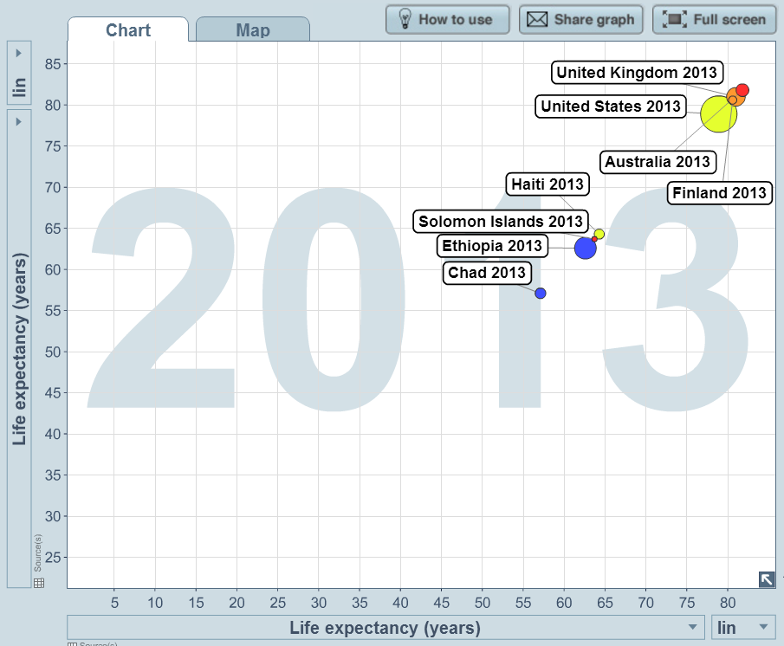
Characteristics of LDCs
Low life expectancy www.bit.ly/1VPCCQZ

Slide 26
Characteristics of LDCs
A cycle of poverty (without intervention, poverty breed poverty)
Low income
Low levels of human capital (health, education)
Low demand for goods and services
Low saving
Low productivity
Low competitiveness
Low capital investment

Slide 27
Diversity of LDCs
Natural resource endowments
Liberia Comoros
Iron ore, gold, diamonds, fish
rubber, arable land and not much else

Slide 28
Diversity of LDCs
Climate
Bhutan Vanuatu
subtropical tropical

Slide 29
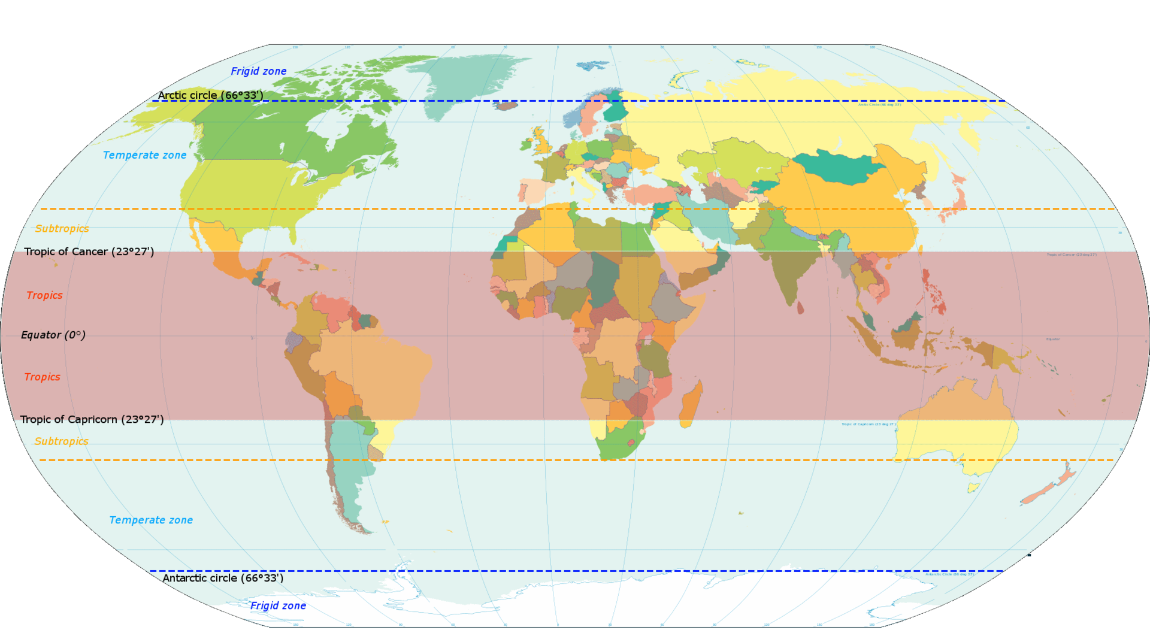
Diversity of LDCs
Climate

Slide 30
Diversity of LDCs
Geography
Central African Republic Solomon Islands
Landlocked 100% coastal
(no access to own sea ports)

Slide 31
Diversity of LDCs
Colonial history
Ethiopia Sierra Leone
Not colonised Gained independence from UK in 1971

Slide 32
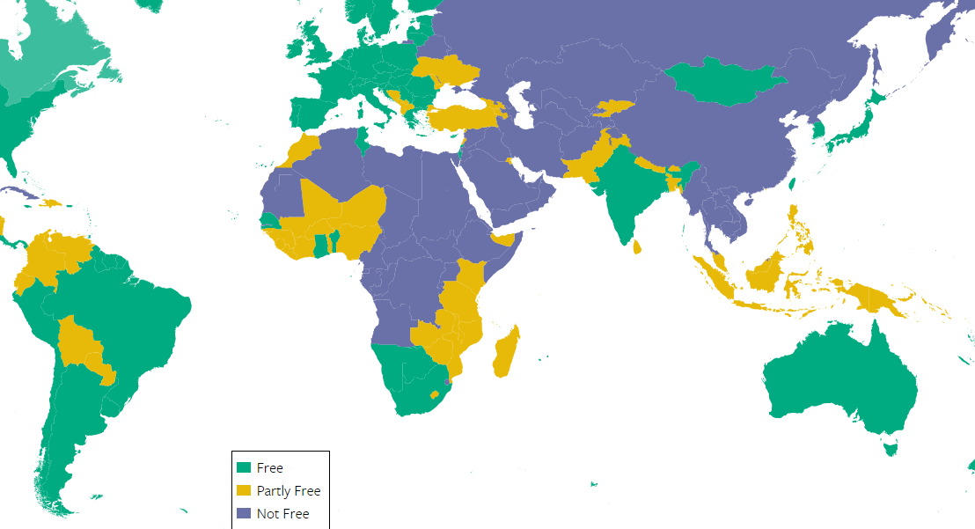
Diversity of LDCs
Political systems (Freedomhouse.org)
Measures political rights and civil liberties (0 = worst, 100 = best)
Eritrea (3) Solomon Islands (68)

Slide 33
Diversity of LDCs
Political stability
Political instability
Low level of investment
Low FDI from abroad
Poverty
Social conflict
Low output and growth
Low level of tax receipts

Slide 34
Diversity of LDCs
Political stability index (http://www.theglobaleconomy.com/rankings/wb_political_stability/)
Weak = -2.5 Strong = 2.5
Yemen (-2.53) Tuvalu (1.33)
188th most stable 5th most stable

