Slide 1
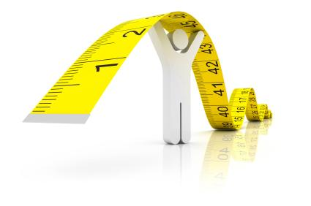
4.2 Measuring Development
Composite Indicators

Slide 2
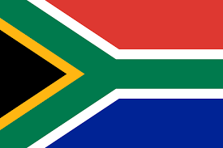
Composite Indicators
Some countries will do well in some indicators, but poorly in others
GNI per capita PPP GNI per capita PPP
$12,700 – 108th $55,860 – 16th
Life expectancy Secondary enrolment
62.34 - 191st 93.74 – 71st

Slide 3
Composite Indicators
Development is complex
At a glance, single indicators do not provide a broad sense of development
Combining single indicators into a composite indicator is a solution to this.

Slide 4
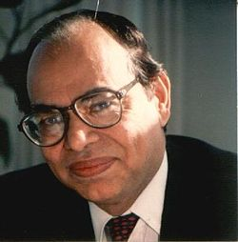
Human Development Index
Combines health, income and education
Health (Life expectancy at birth)
Education (mean years of schooling and
expected years of schooling)
Wealth (GNI per capita (PPP))
Value between 0 and 1
Higher value represents higher development
Lower value represents lower development
HDI – 0.944 Niger
HDI – 0.348
Mahbub el Haq

Slide 5
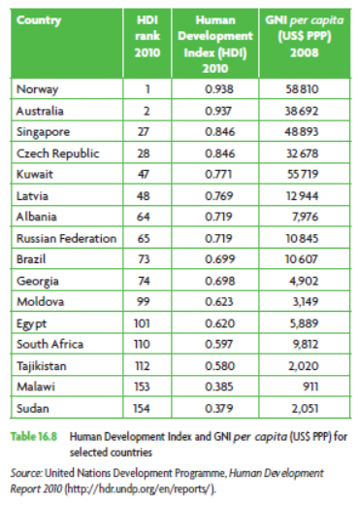
Human Development Index
Singapore vs Australia
Russia vs Albania
Tajikistan vs South Africa
GNI is not everything
Countries can do a lot without fixing GNI
Developed countries not immune to development issues

Slide 6
HDI – What’s wrong with it?
Has already been revised
Previously adult literacy and enrolment rate
Previously GDP per capita
Do we need it? Article

