Slide 1
4.2 Measuring Development

Slide 2
Measuring Development
How do we measure development using income indicators?
How do we measure development using health indicators?
How do we measure development using education indicators?
How do we measure development using all three?

Slide 3
Income Indicators
What are some indicators that measure income?
GDP per capita
GNI per capita
GDP per capita (PPP)
GNI per capita (PPP)

Slide 4
Income Indicators
GDP per capita VS GNI per capita
GNI per capita - World Bank data – Link
GDP per capita – World Bank data - Link

Slide 5
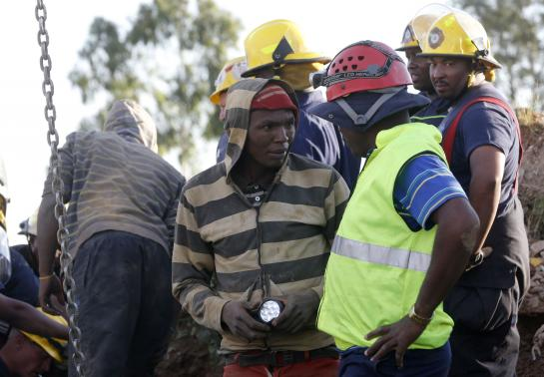
Income Indicators
Why the difference between GDP per capita and GNI per capita?
Movement of labour
Lesotho. Many workers work
in South African mines and
send (remit) income home.

Slide 6
Income Indicators
Why the difference between GDP per capita and GNI per capita?
Movement of capital
Equitorial Guinea. Since the
discovery of large oil deposits
in 1996, there has been large-
scale foreign investment.

Slide 7
Income indicators
Purchasing power parity (PPP)
The cost of living varies in different countries. PPP adjustments give meaning to cross country comparisons.
GDP per capita $52,172
GDP per capita (PPP) $47,662
GDP per capita $52,004
GDP per capita (PPP) $43,308

Slide 8
Income Indicators
Purchasing power parity (PPP)
In general
adjusts upwards values in developing countries
adjusts downwards values in rich countries

Slide 9
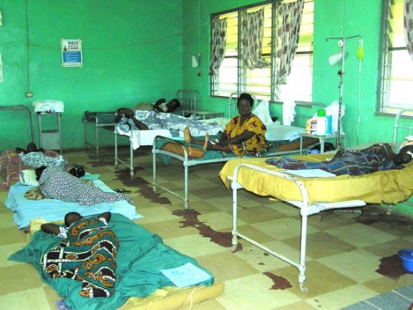
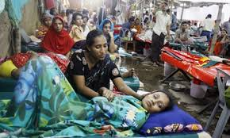
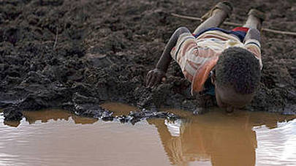
Health Indicators
Range of indicators located here
Why are health outcomes lower in LDCs?
All depends on:
Access to health services
Quality of health services
Education levels
Environmental standards

Slide 10
Education Indicators
Government intervention is the key
Primary education more important than secondary education in developing countries
Why?

