Slide 1
4.4 The Role of International Trade

Slide 2
The Role of International Trade
Barriers (explain)
- Narrow range of products (over-specialisation)
- Volatile prices of primary products
- Lack of access to international markets

Slide 3
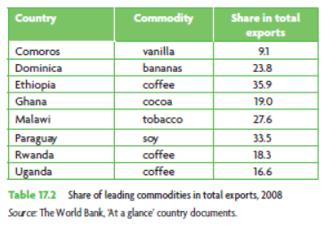
Over-specialisation in few products
Miss out on opportunities to ‘value add’.
‘Adding value’ leads to benefits such as:
Developing technologies
Employment
Diverse industries

Slide 4
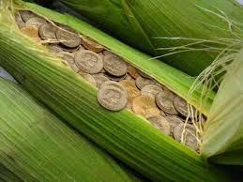
Over-specialisation in few products
Lack of market knowledge
Price volatility makes planning and investment difficult

Slide 5
Price volatility
Why are agricultural prices volatile?
Average yearly price fluctuations (1986-99)
Affects import affordability
What other effects occur when prices fall?
Commodity | Volatility | Commodity | Volatility
Coffee | 25.5% | Jute | 18.1%
Sugar | 22.4% | Cocoa | 17.7%
Poultry | 21.4% | Groundnut oil | 16.2%
Rubber | 18.7% | Butter | 16.1%
Palm oil | 18.7% | Cotton | 15.9%

Slide 6
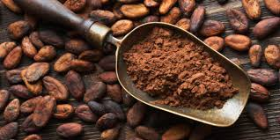
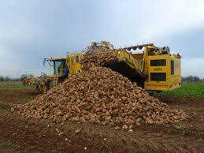
Access to international markets
Tariffs
Higher on ‘value-added’ goods
e.g. lower tariffs on cocoa than on chocolate
Subsidies
Cotton heavily subsidised in the US
Sugar heavily subsidised in the EU

Slide 7
Access to international markets
..developed countries were spending just over $1 billion
a year on aid to developing country agriculture, and they were also spending just under $1 billion a day in supporting their own farmers.
UN Development Report 2005

Slide 8
The Role of International Trade
Strategies (evaluate)
- Import substitution
- Export promotion
- Trade liberalisation
- (WTO)
- Preferential trade agreements
- Diversification

Slide 9
Import substitution
Relies on protectionism to create benefits of scale
What are the benefits?
Drawbacks (mainly abandoned in
1980s and 1990s)
Lack of competition
Requires government to ‘pick winners’
Tariffs on inputs
BoP difficulties
Restricts market size

Slide 10
Export promotion
Opening the economy
Lower trade protection
Freer access for MNCs – direct and portfolio investment
Inputs / capital goods affordable
Worked to their competitive advantage
Competition
Other countries’ trade barriers
Income inequality

Slide 11
Trade liberalisation
Washington Consensus
Trade liberalisation
Freely floating exchange rates
Privatisation
Deregulation
Freer foreign investment
Fiscal discipline
Gov spending targeted

Slide 12
Trade liberalisation
Allocative efficiency
FDI
Income, jobs
Income inequality
MNC power
Fiscal discipline

Slide 13
Preferential trade agreements
Specialisation
Greater market access
Cooperation – transport, R&D, environment
FDI
Coincidence of wants

Slide 14
Diversification
Get away from the resource curse
More sources of growth
More technology, skills
Where do the skilled come from?
Tariffs – primary vs secondary goods

