Slide 1
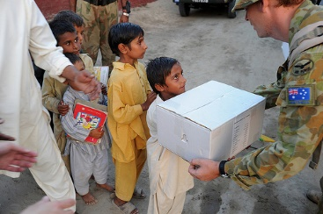
4.6 The Role of Foreign Aid and Multilateral Development Assistance

Slide 2
The Role of Foreign Aid
Who gives foreign aid?
What types of foreign aid exist?
Why do countries give foreign aid?
How effective is foreign aid?
Is trade a better alternative?

Slide 3
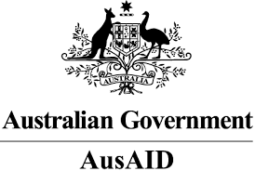
Who gives foreign aid?
Developed countries
Official Development Assistance (ODA)

Slide 4
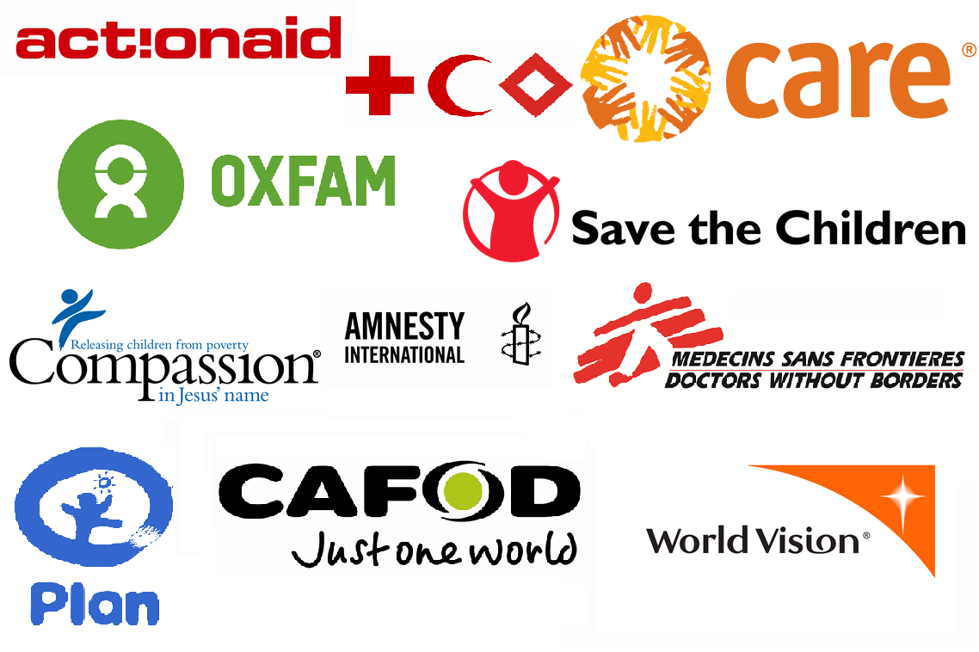
Who gives foreign aid?
Non-governmental organisations (NGOs)
Generally small-scale aid to reach specific development objectives

Slide 5
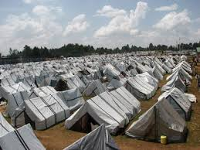
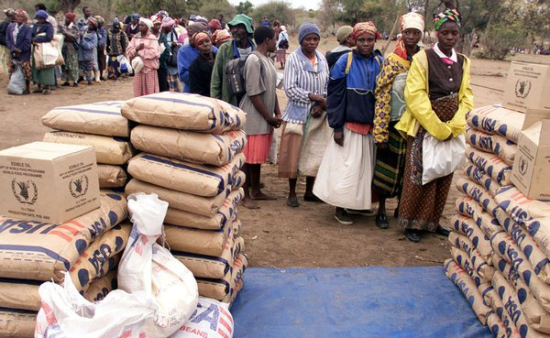
What types of foreign aid exist?
Humanitarian aid

Slide 6
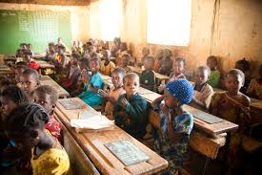
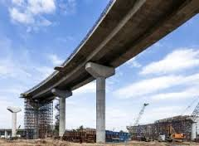
Development aid
Given in the form of…
Grants or Concessional long-term loans
What’s the difference?
Received as… Project aid or Programme aid
Specific projects, e.g. building infrastructure
Support for industry or sector, e.g. agriculture, education

Slide 7
Why do governments give aid?
Moral responsibility
The right thing to do. MDGs, SDGs.
Strategic and economic purposes
Keep countries ‘on side’
Set up trade networks
e.g. help set up export industry to access needed resources
Tied aid

Slide 8
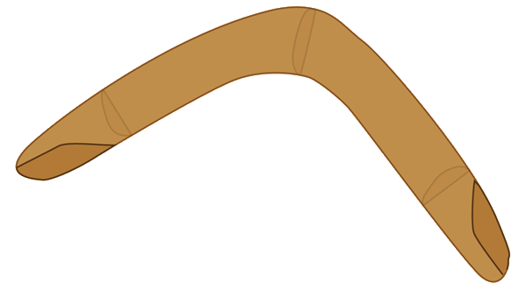
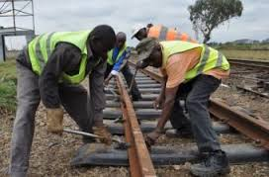
What is tied aid?
Aid funding given that must be spent in the donor country
e.g. “Here’s money for a train line, but
you have to buy Australian steel”
tied aid
tied aid

Slide 9
Effectiveness of foreign aid
How does aid help?
Breaking the poverty cycle
Limitations / criticisms
Has it actually helped growth? Dambisa Moyo
Corruption
Dependence
Indebtedness

Slide 10
Aid vs trade – compare and contrast
What can trade do that aid struggles to?
What can aid do that trade struggles to?
Which is better at promoting development?
“Aid without trade is a lullaby – a song you sing to children to get them to sleep.”
Yoweri Museveni, Ugandan President

Slide 11
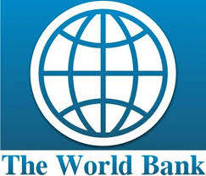
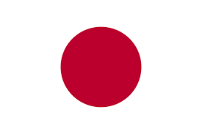
Multilateral development assistance
Aid given through international institutions such as the World Bank and IMF
LDCs

Slide 12
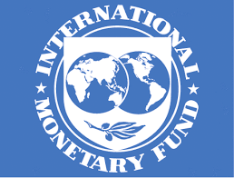
Multilateral development assistance
Loans and debt rescheduling to countries experiencing difficulties.
Conditionality
Removal of exchange restrictions
Low inflation
Budget balance
Removal of limits on FDI
Free-market policies – removal of price controls, subsidies, privatisation
Removal of trade barriers

Slide 13
IMF criticisms
“The main IMF prescription has been budgetary belt tightening for patients much too poor to own belts.”
Jeffrey Sachs, The End of Poverty
High interest rates stifle growth
Budget cuts hurt development outcomes
Trade liberalisation destroys domestic markets
Higher food prices affect the poorest
FDI without correct frameworks can create monopolies
Non-democratic nature of governance
Moral hazard

Slide 14
World Bank
In development terms, provider of
concessional loans.
Dominated by rich countries
Similar conditions to IMF
Environmental and social concerns
Strong US presence (every World Bank President has been American)
Majority US funding
US has 16% of voting rights (India and China have 7% combined)
One third to half of projects are failures

