Slide 1
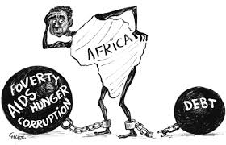
4.7 The Role of International Debt

Slide 2
The Role of International Debt
What is foreign debt?
How did some LDCs become so indebted?
Why is the debt such an issue for development?
What can be done about it?

Slide 3
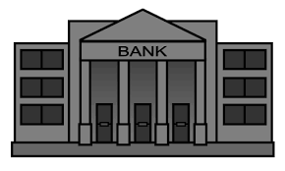
What is foreign debt?
Debt held by foreign creditors
Can be either public (government) or private debt
Government debt can be
From multilateral organisations
From foreign commercial banks
From the sale of bonds
Why do LDCs need to borrow from overseas?

Slide 4
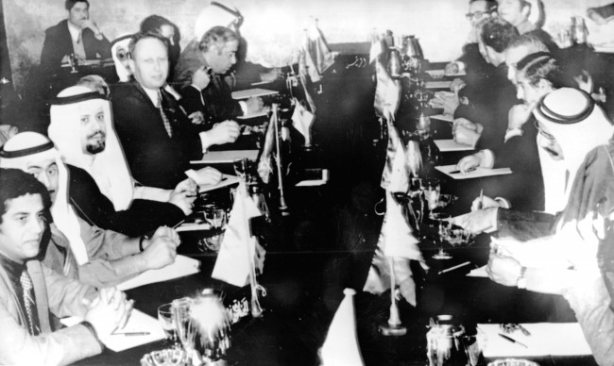
How did LDCs become so indebted?
1970s
Persistent CADs
value of imports > value of exports
financed by debt (financial account surpluses)
Oil boom
$$$ for OPEC
Deposited in western banks

Slide 5
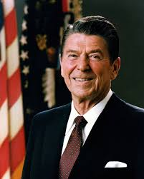
How did LDCs become so indebted?
1970s
Oil crisis
rich countries in recession
lots of loanable funds, no demand
lend to developing countries
(low risk, won’t go bankrupt)
Reagan
Huge budget deficits
↑ interest rates
↑ exchange rate

Slide 6
How did LDCs become so indebted?
1970s
Loans to developing countries were in US dollars
What effect would this have?
Loans were at market rates, usually variable
What effect would this have?
But they would be okay as long as exports pick up
↓ commodity prices

Slide 7
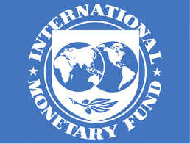
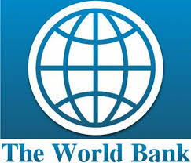
How did LDCs become so indebted?
The IMF and World Bank helped out
Bailouts, debt rescheduling
With their usual conditions:
Fiscal discipline
Deficit reduction
Deregulation
Privatisation
Reduced protectionism
Freely floating exchange rates

Slide 8
Why is debt such a problem?
Fund diversion
So much money goes to debt servicing
Where else could it go to help development?
In around 30 countries…
Debt servicing – 20% of government budget
Education -- 13 % of government budget
Healthcare -- 6% of government budget
During the ‘90s…
Africa spent four times more on debt servicing than health care

Slide 9
Why is debt such a problem?
Debt → debt
Loans to service debt
IMF ‘assistance’
Structural adjustment programs (SAPs) were harsh

Slide 10
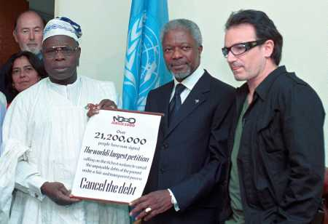
What can be done about it?
Debt relief
Heavily indebted poor
Countries (HIPC)
World Bank and IMF
Initiative
Must have low GNI
Must be in a debt trap
Must follow IMF and World Bank guidelines

