Slide 1
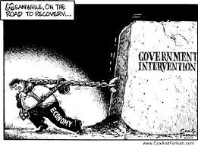
4.8 The Balance Between Markets and Intervention

Slide 2
The Balance Between Markets and Intervention
How do free market policies help development?
How do free market policies hinder development?
How does government intervention help development?
How does government intervention hinder development?
How do the two complement each other?

Slide 3
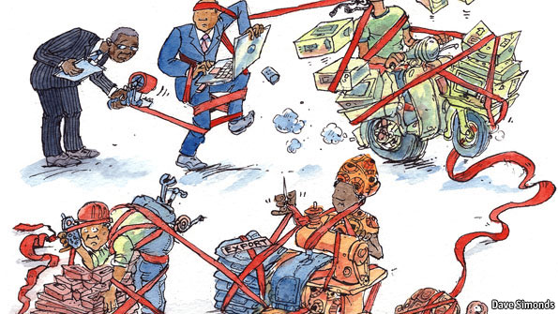
Advantages of Free Markets
What are free market policies, in development terms?
Resource allocation

Slide 4
Advantages of Free Markets
Competition, profit incentive

Slide 5
Advantages of Free Markets
Reduction of government involvement attracts FDI

Slide 6
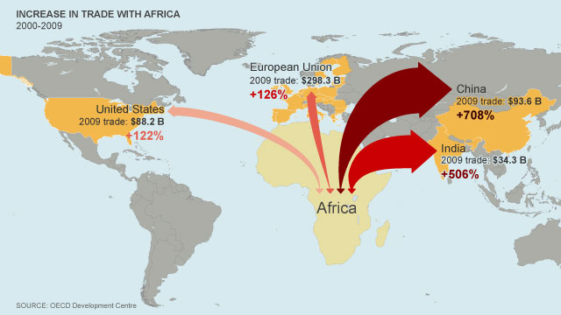
Advantages of Free Markets
Freer trade = larger markets

Slide 7
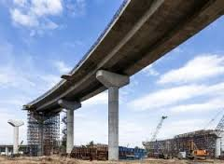
Disadvantages of Free Markets
Who provides the infrastructure?
How are health, education funded?

Slide 8
Disadvantages of Free Markets
Market failure
Income inequality

Slide 9
Disadvantages of Free Markets
Reliance on Free Trade

Slide 10
Disadvantages of Free Markets
Lack of strong institutions

Slide 11
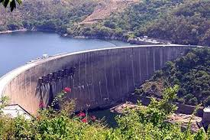
Advantages of Government Intervention
Infrastructure

Slide 12
Advantages of Government Intervention
Human capital investment
Employer

Slide 13
Advantages of Government Intervention
Economic management

Slide 14
Advantages of Government Intervention
Social security

Slide 15
Disadvantages of Government Intervention
Inefficiency
Corruption

Slide 16
Disadvantages of Government Intervention
Indebtedness

Slide 17
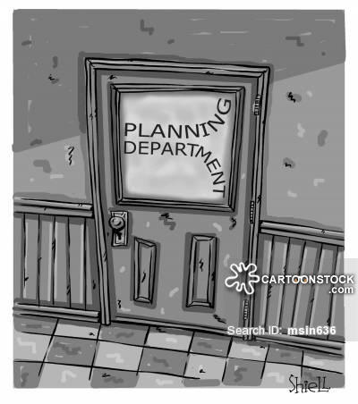
Disadvantages of Government Intervention
Poor planning

Slide 18
What’s the answer?
Good governance
Participation – right to vote, join unions, form political parties
Rule of law – fair and impartial laws, enforced impartially
Transparency – information is available to all
Consensus orientated – all opinions considered, government as mediator
Equity – fair opportunities, equals in the eyes of government
Effectiveness – produce the agreed results
Accountability -

Slide 19
What’s the answer?
Why not the best of both government intervention and market-oriented policies?

