Slide 1
IB Economics

Slide 2
5 Key Economic Assumptions
Society’s wants are unlimited, but ALL resources are limited (scarcity).
Due to scarcity, choices must be made. Every choice has a cost (a trade-off).
Everyone’s goal is to make choices that maximise their satisfaction. Everyone acts in their own ‘self-interest’.
Everyone makes decisions by comparing the marginal costs and marginal benefits of every choice.
Real-life situations can be explained and analysed through simplified models and graphs.

Slide 3
Thinking at the Margin
# Times Watching Movie | Benefit | Cost
1st | $30 | $10
2nd | $15 | $10
3rd | $5 | $10
Total | $50 | $30
Would you see the movie three times?
Notice that the total benefit is more than the total cost but you would NOT watch the movie the 3rd time.

Slide 4
Marginal Analysis
In economics the term marginal = additional
“Thinking on the margin”
additional benefit vs. the additional cost.
For Example:
You have been shopping in Rundle Mall for half an hour, the additional benefit of shopping for an additional half-hour might outweigh the additional cost (the opportunity cost).
After three hours, the additional benefit from staying an additional half-hour would likely be less than the additional cost.

Slide 5
Marginal Analysis
Notice that the decision making process wasn’t “should I go to town for 3 hours or should I stay home?”
You will continue to do something until the marginal cost outweighs the marginal benefit.
In reality the decision making process started with “should I go to the mall at all.”
Once you are there you thought “should I stay for an additional half hour or should I go?”
The marginal analysis approach to decision making is more commonly used than the “all or nothing” approach.

Slide 6
Trade-offs and Opportunity Cost
ALL decisions involve trade-offs.
Trade-offs are all the alternatives that we give up whenever we choose one course of action over others.
(Examples: going to school)
The most desirable alternative given up as a result of a decision is known as opportunity cost.
What are trade-offs of deciding to go to University?
What is the opportunity cost of going to University?

Slide 7
Production Possibilities Curve
A production possibilities curve (PPC) is a model that shows alternative ways that an economy can use its scarce resources
This model graphically demonstrates scarcity, trade-offs, opportunity costs, and efficiency.

Slide 8
Production “Possibilities” Table
 | A | B | C | D | E
Bikes | 14 | 12 | 9 | 5 | 0
Computers | 0 | 2 | 4 | 6 | 8
NOW GRAPH IT: Put bikes on y-axis and computers on x-axis

Slide 9
Production Possibilities
How does the PPC graphically demonstrates scarcity, trade-offs, opportunity costs, and efficiency?
14
12
10
8
6
4
2
0
Impossible/Unattainable
(given current resources)
A
B
G
C
Bikes
Efficient
D
Inefficient/ Unemployment
E
0 2 4 6 8 10
Computers

Slide 10
Opportunity Cost
Example:
1. The opportunity cost of moving from a to b is…
2 Bikes
2.The opportunity cost of moving from b to d is…
7 Bikes
3.The opportunity cost of moving from d to b is…
4 Computer
4.The opportunity cost of moving from f to c is…
0 Computers
5.What can you say about point G?
Unattainable

Slide 11
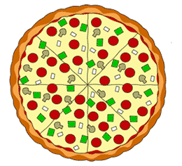
Production Possibilities
A B C D E
CALZONES 4 3 2 1 0
PIZZA 0 1 2 3 4
List the Opportunity Cost of moving from a-b, b-c, c-d, and d-e.
Constant Opportunity Cost- Resources are easily adaptable for producing either good.
Straight line PPC (not common)

Slide 12
Production Possibilities
A B C D E
PIZZA 20 19 16 10 0
ROBOTS 0 1 2 3 4
List the Opportunity Cost of moving from a-b, b-c, c-d, and d-e.
Law of Increasing Opportunity Cost-
As you produce more of any good, the opportunity cost (forgone production of another good) will increase.
Why would this be?
Result is a bowed out (Concave) PPC

Slide 13
Constant vs. Increasing Opportunity Cost
Identify which product would have a straight line PPC and which would be bowed out?
Corn
Cactus
Wheat
Pineapples

Slide 14
The Production Possibilities Curve and Efficiency

Slide 15
Efficiency
Productive Efficiency-
Products are being produced in the least costly way.
This is any point ON the Production Possibilities Curve
Allocative Efficiency-
The products being produced are the ones most desired by society.
Where would this be on a PPC?

Slide 16
Efficiency
Which points are productively efficient?
Which are allocatively efficient?
14
12
10
8
6
4
2
0
A
B
G
Bikes
C
E
F
D
0 2 4 6 8 10
Computers

Slide 17
Why two types of efficiency?
Is combination “A” efficient?
Size 20 running shoes
A
Size 10 running shoes

Slide 18
Shifting the Production Possibilities Curve

Slide 19
Production Possibilities
What if there is a change?
Three Shifters of the PPC
Change in resource quantity
Change in resource quality
2. Change in Technology

Slide 20
Production Possibilities
What happens if there is an increase in population?
Robots
Pizzas
20

Slide 21
Production Possibilities
What if there is a technology improvement in pizza ovens?
Robots
Pizzas
21

Slide 22
Capital Goods and Future Growth
Countries that produce more capital goods will have more growth in the future.
Panama – Favors Consumer Goods
Mexico – Favors Capital Goods
Current
PPC
Future
PPC
Future
PPC
Capital Goods
Current
PPC
Capital Goods
Consumer goods
Consumer goods
Panama
Mexico

Slide 23
PPC Practice
Draw a PPC showing changes for each of the following:
Pizza and Robots (3)
1. New robot making technology
2. Decrease in the demand for pizza
3. Mad cow disease kills 85% of cows
Consumer goods and Capital Goods (4)
4. Destruction of power plants leads to severe electricity shortage
5. Faster computer hardware
6. Many workers unemployed
7. Significant increases in education

Slide 24
Question #1
New robot making technology
Q
A shift only for Robots
Robots
Q
Pizzas
24

Slide 25
Question #2
Decrease in the demand for pizza
Q
The curve doesn’t shift!
A change in demand doesn’t shift the curve
Robots
Q
Pizzas
25

Slide 26
Question #3
Mad cow disease kills 85% of cows
Q
A shift inward only for Pizza
Robots
Q
Pizzas
26

Slide 27
Question #4
Destruction of power plants
Q
Decrease in resources decrease production possibilities for both
Capital Goods
Q
Consumer Goods

Slide 28
Question #5
Faster computer hardware
Q
Quality of a resource improves shifting the curve outward
Capital Goods
Q
Consumer Goods
28

Slide 29
Question #6
Many workers unemployed
Q
The curve doesn’t shift!
Unemployment is just a point inside the curve
Capital Goods
Q
Consumer Goods
29

Slide 30
Question #7
Significant increases in education
Q
The quality of labor is improved. Curve shifts outward.
Capital Goods
Q
Consumer Goods

Slide 31
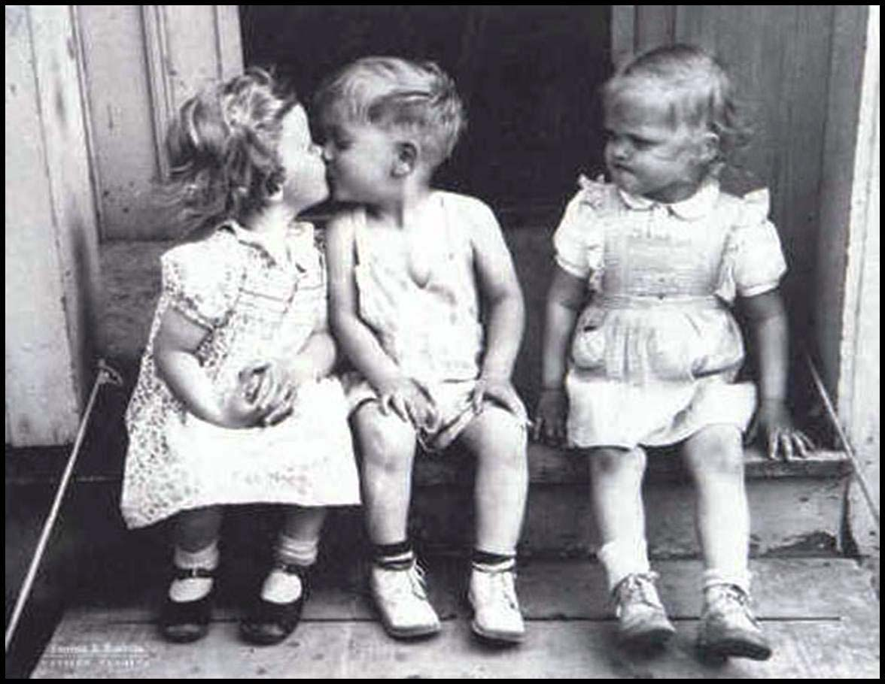
Scarcity Means There Is Not Enough For Everyone
Government must step in to help allocate (distribute) resources

Slide 32
The Three Economic Questions
Every society must answer three questions:
What goods and services should be produced?
How should these goods and services be produced?
Who consumes these goods and services?
The way these questions are answered determines the economic system
An economic system is the method used by a society to produce and distribute goods and services.

Slide 33
Economic Systems
Centrally-Planned (Command) Economy
Free Market Economy
Traditional Economy
Mixed Economy

Slide 34
Centrally-Planned Economies
(aka Communism)

Slide 35
Centrally Planned Economies
In a centrally planned economy (communism) the government…
owns all the resources.
answers the three economic questions
Examples:
Cuba, North Korea, former Soviet Union, and China
Why do centrally planned economies face problems of poor-quality goods, shortages, and unhappy citizens?
NO PROFIT MEANS NO INCENTIVE TO WORK HARDER

Slide 36
Irrational Soviet Production
Soviet companies were not guided by prices or profit. Gov’t officials determined output quotas based on quantitative measurements.
Businesses were paid based on meeting these quotas.
Why did a business make desk lamps that were filled with lead that were almost too heavy to carry?
2. Why did light bulb producers only make tiny night light size bulbs?
3. Why did oil companies drill many shallow holes when they knew that oil deposits are usually found in deep holes that require slower drilling?
Production quota based on weight
Production quota based number of bulbs produced
Production quota based number of feet drilled
36

Slide 37
Irrational Soviet Production
4. Why did a construction superintendent order his workers to remove bathtubs from the first floor and install them in the third floor while he slowly lead inspectors through apartment building.
5. Why did black market vendors sell burned out light bulbs?
Quota on # of apartments complete at inspection
Business got resources before the public so workers would steal good light bulbs from work and replace them with burnt out bulbs

Slide 38
Advantages and Disadvantages
What is GOOD about Communism?
What is BAD about Communism?
Low unemployment-everyone has a job
Great Job Security-the government doesn’t go out of business
Equal incomes means no extremely poor people
Free Health Care
No incentive to work harder
No incentive to innovate or come up with good ideas
No Competition keeps quality of goods poor.
Corrupt leaders
Few individual freedoms

Slide 39
Planned economies – Four resource types
No private ownership of resources. Commonly owned (commonly ➔ communist)
Land – Government decides what land is to be used for
Labour – Government decides what labour is worth (you cannot sell your labour to the highest bidder)
Capital – Government controls what is to be used for
Entrepreneurship – does not exist in a planned economy

Slide 40
Planned economy – Three economic questions
What, How and For Whom?
What to produce – Decided centrally
How to produce - Decided centrally
For whom to produce – Decided centrally

Slide 42
Free Market System
(aka Capitalism)

Slide 43
Characteristics of Free Market
Little government involvement in the economy. (Laissez Faire = Let it be)
Individuals OWN resources and answer the three economic questions.
The opportunity to make PROFIT gives people INCENTIVE to produce quality items efficiently.
Wide variety of goods available to consumers.
Competition and Self-Interest work together to regulate the economy (keep prices down and quality up).

Slide 44
Example of Free Market
Example of how the free market regulates itself:
If consumers want computers and only one company is making them…
Firms enter market
Competition
↓ prices, ↑ quality, ↑ variety
productive efficiency, allocative efficiency

Slide 45
Example of Communism
Example of why communism failed:
If consumers want computers and only one company is making them…
Firms can’t enter market
No competition
High prices, low quality limited variety
Rely on government action
Productive inefficiency, allocative inefficiency

Slide 46
The Invisible Hand
The concept that society’s goals will be met as individuals seek their own self-interest.
Example: Society wants fuel efficient cars…
How will this occur in the free market?
Competition and self-interest act as an invisible hand (pictured below) that regulates the free market.

Slide 47
Attacks against capitalism
Companies are greedy and do anything to screw over consumers!
Companies have an incentive to satisfy the needs of consumers. If they don’t they will go out of business.
Capitalism causes companies to outsource Australian jobs overseas. Australia suffers because companies want more profit!
How many of you benefit in the form of lower prices?
Capitalism only helps the rich. Large companies enslave and exploit third-world workers in sweatshops!
Sweatshop workers are not forced labor. They make the decision to work there voluntarily.
Why?

Slide 48
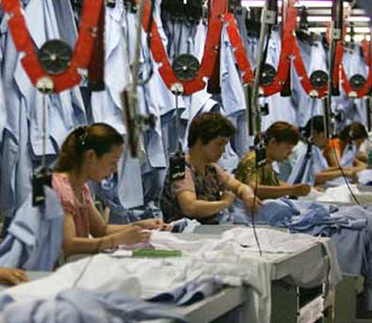
Sweatshops
Question: Who is to blame for these people being so poor?
Answer: Low productivity.
If a country doesn’t produce very much, it can’t afford to pay its workers very much.
Why do these countries have such low productivity?
Corrupt governments, inadequate physical capital and infrastructure, and underdeveloped human capital.
What does foreign investment bring to poor countries?

Slide 49
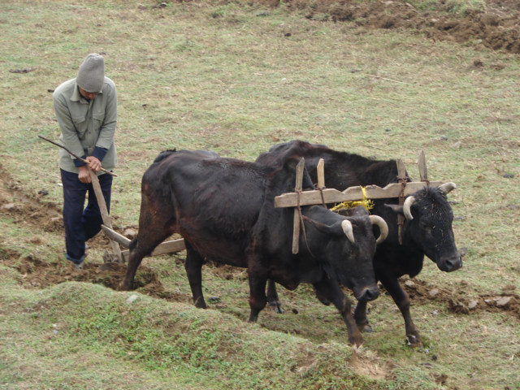
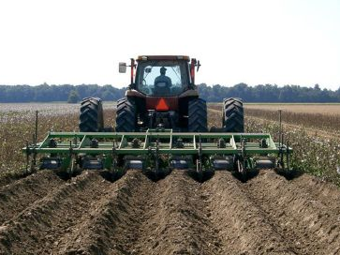
Productivity Creates Wealth
3rd World Countries
Developed Countries

Slide 50
Link to the PPC
Communism in the Long Run
Free Markets in the Long Run
CURRENT
CURVE
FUTURE
CURVE
Capital Goods
Capital Goods
FUTURE
CURVE
CURRENT
CURVE
Consumer goods
Consumer goods
Cuba
Costa Rica

Slide 51
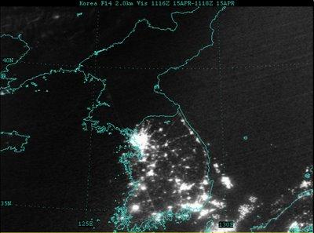
The difference between North and South Korea at night. North Korea's GDP is $40 Billion
South Korea's GDP is $1.3 Trillion (32 times greater).

Slide 52
Market economy – Four resource types
Private ownership of resources.
Land – Owners can sell to the highest bidder - rent
Labour – Owners can sell to the highest bidder - wages
Capital – Owners can sell to the highest bidder - interest
Entrepreneurship – organises land, labour and capital to make profit. The profit incentive exists.

Slide 53
Market economy – Three economic questions
What, How and For Whom?
What to produce Consumers
How to produce Producers
For whom to produce Market value of resources

Slide 54
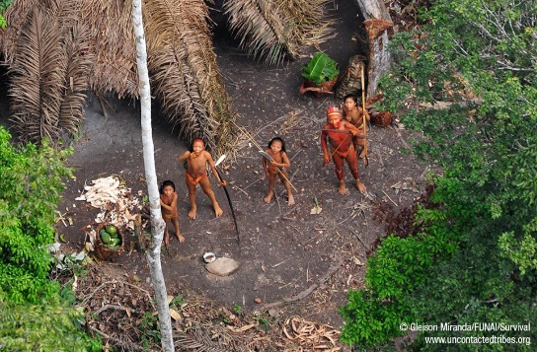
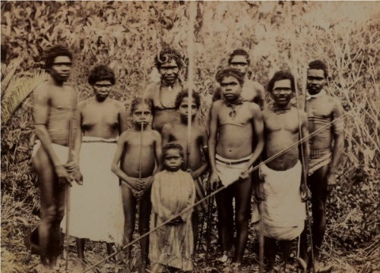
Traditional economy
Individuals produce goods and services for their own use, not for exchange.
Neither the market nor the government decides the ‘what’, ‘how’ and ‘for whom’ of production.
Examples:

Slide 55
Mixed economies
The three previous systems are simplified models. In reality, economies are a mixture.
e.g. Child seats are mandatory ➔ ➔
➔➔ The govt decides ‘what’ is produced
We always buy Easter eggs ➔ ➔
➔➔ Tradition decides ‘what’ is produced
Welfare payments are made to people with disabilities ➔ ➔
➔ ➔ The government deciding ‘For whom’

Slide 56
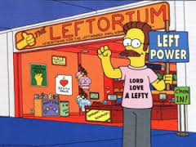
Economies in transition
Most economies are tending to the right
Socialism
Capitalism

Slide 57
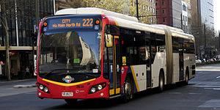
Privatisation

