Slide 1
The Economic Problem
Unlimited Wants
Scarce Resources – Land, Labour, Capital, Entrepreneurship
Resource Use
Choices

Slide 2
Three economic questions
What goods and services should an economy produce?
How should goods and services be produced?
Who should get the goods and services produced?

Slide 3
Scarcity
The excess of wants resulting from having limited resources (land, labor, capital and entrepreneurs) in satisfying the endless wants of people.
It is a universal problem for societies – it is not limited to poor countries.
To the economist, all goods and services that have a price are relatively scarce.

Slide 4
Four factors of production (resource types)
Land - natural resources available for production
- renewable and non-renewable
Labour - physical and mental effort of people used in production
Capital - all non-natural (manufactured) resources that are used in the creation and production of other products
Enterprise (Entrepreneurship) - refers to the management, organisation and planning of the other three factors of production

Slide 5
Opportunity Cost
Definition – the cost expressed in terms of the next best alternative sacrificed
Helps us view the true cost of decision making
Implies valuing different choices

Slide 6
Choice
We always need to make choices
They have to decide how to allocate their limited financial resources and so always need to choose between alternatives.
Infinite wants and finite resources = choices

Slide 7
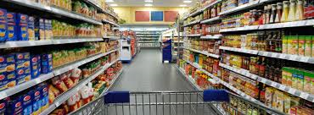
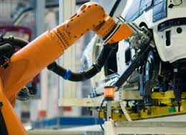
Types of Products
Consumer goods – products sold to general public
Capital goods – products purchased by other businesses to produce other goods and services

Slide 8
Production Possibilities Curve
Show the different combinations of goods and services that can be produced with a given amount of resources
No ‘ideal’ point on the curve
Any point inside the curve – suggests resources are not being utilised efficiently
Any point outside the curve – not attainable with the current level of resources
Useful to demonstrate economic growth and opportunity cost

Slide 9
Production Possibility Curves
Capital Goods
Ym
Yo
A
Y1
B
Xo
X1
Xm
Consumer Goods

Slide 10
Production Possibility Curves
Capital Goods
C
Y1
Yo
.B
A
Xo
X1
Consumer Goods

Slide 11
Production Possibility Curves
Schools
Y₁
Y
Z₁
Z
W
V
0
X
X₁
Motorcars

Slide 12
PPC Practice
Draw a PPC showing changes for each of the following:
Bacon and lamps(3)
1. Government mandates new wellbeing standards for pig farms
2. A new source of lampshade bamboo is found
3. A decrease in the demand for lamps
Consumer goods and Capital Goods (4)
4. Ebola outbreak takes 15% of population
5. An increase in demand for consumer goods
6. Inefficient production of consumer goods
7. Global oil supply tightened by OPEC

Slide 13
Question #1
Government mandates new wellbeing standards for pig farms
Q
A shift inward only for bacon
Lamps
Q
Bacon

Slide 14
Question #2
A new source of lampshade materials is found
Q
A shift only for lamps
Lamps
Q
Bacon
14

Slide 15
Question #3
Decrease in the demand for lamps
Q
The curve doesn’t shift!
A change in demand doesn’t shift the curve
Lamps
Q
Bacon
15

Slide 16
Question #4
Ebola outbreak takes 15% of the population
Q
Decrease in resources decrease production possibilities for both
Capital Goods
Q
Consumer Goods

Slide 17
Question #5
An increase in demand for consumer goods
Q
The curve doesn’t shift!
A change in demand doesn’t shift the curve
Capital Goods
Q
Consumer goods
17

Slide 18
Question #6
Inefficient production of consumer goods
Q
The curve doesn’t shift!
Productive inefficiency is just a point inside the curve
Capital Goods
Q
Consumer Goods
18

Slide 19
Question #7
Global oil supply tightened by OPEC
Q
Decrease in resources decrease production possibilities for both
Capital Goods
Q
Consumer Goods

Slide 20
Rationing systems
The basic economic questions:
(1) WHAT to produce
(2) HOW to produce it
(3) WHO shall receive it

Slide 21
Planned economies
Sometimes called
= a centrally planned economy or
= a command economy
What, How and For whom are decided by government
All resources all collectively owned.
In what ways would central planning be difficult?
http://kimjongillookingatthings.tumblr.com/

Slide 22
Free market economy
Sometimes called:
= a private enterprise economy or
= capitalism
All production is in private hands
Few cases of surpluses and shortages
{If there are changes in the pattern of demand, then there will be changes in the pattern of supply in order to meet the new demand pattern}
Is a self-righting system

Slide 23
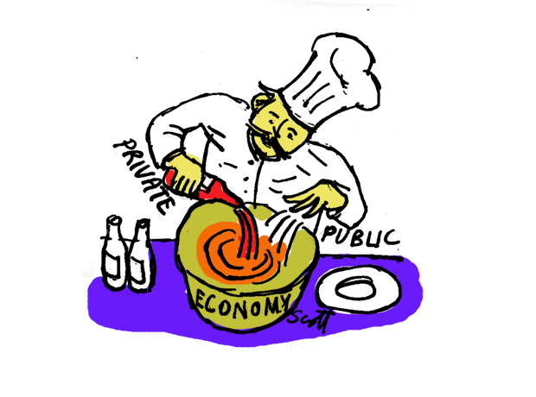
Mixed economies
In reality, all economies are mixed economies
Some countries have high levels of planning and government involvement in the economy (eg. China)
Government involvement is essential as sometimes the market fails

Slide 24
Transition economies
Countries that have been moving towards a more market-oriented balance in their economic systems.
Examples: Hungary, Poland and Russia

Slide 25
Free market economy - disadvantages
Demerit goods will be over-provided.
Merit goods will be underprovided.

Slide 26
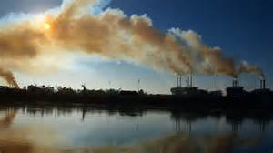
Free market economy - disadvantages
Sustainability
Unequal resource ownership
Monopoly power

Slide 27
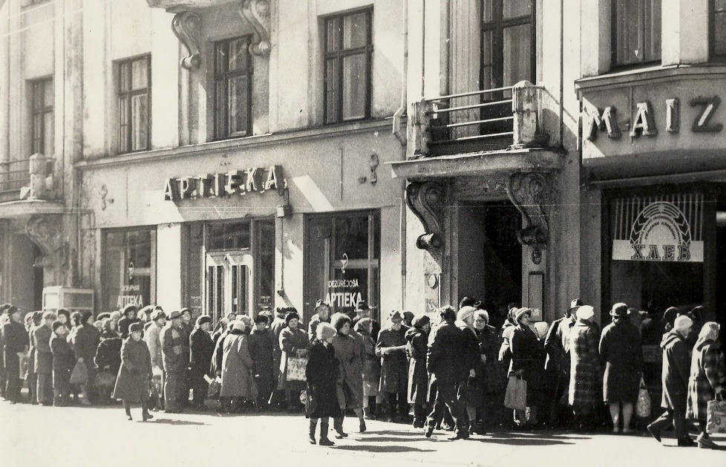
Planned economy - disadvantages
Too complex, let the invisible hand guide the way
Lack of information due to lack of price signals.

Slide 28
Planned economy - disadvantages
Do government aims equal the people’s aims?
Incentives
Workers are guaranteed employment and managers gain no share of profits
Lack of liberty and personal choice

Slide 29
Shortages of basic products such as corn, milk and chicken have plagued Venezuela for years.
Shortages that first affected the dining table have now made their way into the bedroom.
President Nicolas Maduro announced in June his government was building a condom factory to supply the domestic market. The factory was built, but pharmacy managers say quality has not been what their customers demand. Production levels are not meeting domestic demand either.
…public health experts worry the scarcity of contraception methods might have long-term consequences.
Fifth highest teen pregnancy rate in Latin America.
HIV infection rate is 0.6%
http://edition.cnn.com/2015/02/05/americas/venezuela-expensive-condoms-shortage/

