Slide 1
IB Economics

Slide 2
A brief outline
Section 1: Microeconomics
Section 2: Macroeconomics
Section 3: International economics
Section 4: Development economics
Internal Assessment: 20% - commentaries
External Assessment 80% - Paper 1, Paper 2,
Paper 3 (HL only)
Notes:
Brainstorm

Slide 3
A brief outline
2016
13-14 weeks: Microeconomics
13-14 weeks: Macroeconomics
6-7 weeks: International economics
Students will only learn SL content.
HL content will be taught to those who choose in 2017
We will complete at least one Internal Assessment commentary.
Notes:
Brainstorm

Slide 4
A brief outline
2017 – revision and completion
International Economics
Development Economics
HL content – micro, macro, international, development
Theory of the Firm for HL students
Completing Internal Assessment commentaries
Extended Essay in economics (if applicable)
Revision and exam preparation
Notes:
Brainstorm

Slide 5
What will make you successful in IB Economics?
Organisation
Concise, accurate writing
Seeing both sides of an argument
Attention to detail
ibeconomicsbaum.weebly.com

Slide 6
6

Slide 7
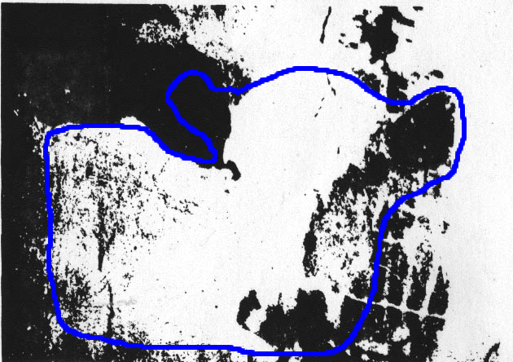

Slide 8
This is just like our IB class
Why?

Slide 9
The Cow Analogy
1. Are you “smarter” than someone if you see the cow first?
2. What is your responsibility when you see the cow?
3. What kind of student will not see the cow?
If you don’t see the cow, don’t leave the room!

Slide 10
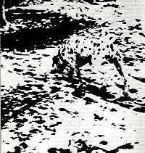

Slide 11
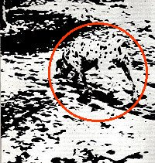

Slide 12
$9
8
7
6
5
4
3
2
200
175
150
125
100
75
50
25
MC
ATC
Price, costs, and revenue
D
MR
Q
0 1 2 3 4 5 6 7 8 9 10
A monopoly making a profit

Slide 13
What is economics?
Notes:
Brainstorm

Slide 14
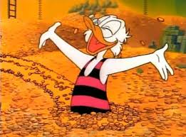
I WON THE LOTTERY!
I’ll give you anything you want other than money.
What do you want?
Would your list ever end?
Why not?
Scarcity!!!

Slide 15
What is Economics?
Economics is the science of scarcity.
Scarcity means that we have unlimited wants but limited resources.
Since we are unable to have everything we desire, we must make choices on how we will use our resources.
choices
In economics we will study the choices of individuals, firms, and governments.

Slide 16
Examples:
You must choose between buying jeans or buying shoes.
Businesses must choose how many people to hire
Governments must choose how much to spend on welfare.
Textbook Definition
Economics- Social science concerned with the efficient use of scarce resources to achieve maximum satisfaction of economic wants.
(Study of how individuals and societies deal with ________)
scarcity

Slide 17
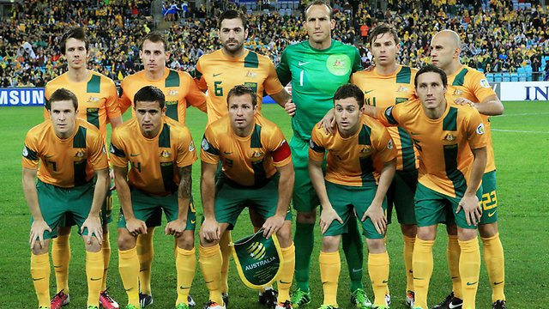
Logic
Why are so many top Australian soccer players born in August?

Slide 18
Logic
Age group cut-off point
Leigh (2014)

Slide 19
Incentives
Why do corporations implement environmental programs voluntarily?

Slide 20
Incentives
“It is not from the benevolence of the butcher, the brewer or the baker that we expect our dinner but from their regard to their own interest.”
- Adam Smith

Slide 21
Perverse incentives
Barbados vs Grenada 1994 Caribbean Cup
To advance, Barbados need to win by at least 2 goals. Any other result means Grenada advance.
With 80 mins gone, Barbados Grenada
2 0
83rd minute 2 1
87th minute 2 2
Golden goal in extra time worth two goals

Slide 22
Micro vs. Macro
MICROeconomics-
Study of small economic units such as individuals, firms, and industries (ex: supply and demand in specific markets, production costs, labor markets, etc.)
MACROeconomics-
Study of the large economy as a whole or economic aggregates (ex: economic growth, government spending, inflation, unemployment, international trade etc.)

Slide 23
Positive vs. Normative
How is Economics used?
Economists use the scientific method to make generalisations and abstractions to develop theories. This is called theoretical economics.
These theories are then applied to fix problems or meet economic goals. This is called policy economics.
Positive Statements- Based on facts. Avoids value judgements (what is).
Normative Statements- Includes value judgements (what ought to be).

